Slide 1
Delivering International Accreditation through International Quality Review (IQR)
Douglas Blackstock
Chief Executive

Slide 2
What I will cover
About QAA
Our mission
Our UK-wide and international roles
QAA’s work with International Accreditation
Our International Quality Review process
Our globally-mapped accreditation benchmarking
IQR case studies
Broader QAA expertise – support for accredited institutions with strategic development and capacity building.

Slide 3
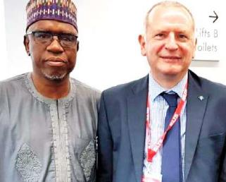
UK and Nigeria
In 2017-18, Nigeria was the
fifth-largest host country for UK TNE students (29,865) and the ninth-largest sending country of international students to the UK (10,500).
2019 British Council project
QAA’s relationship with the NUC

Slide 4
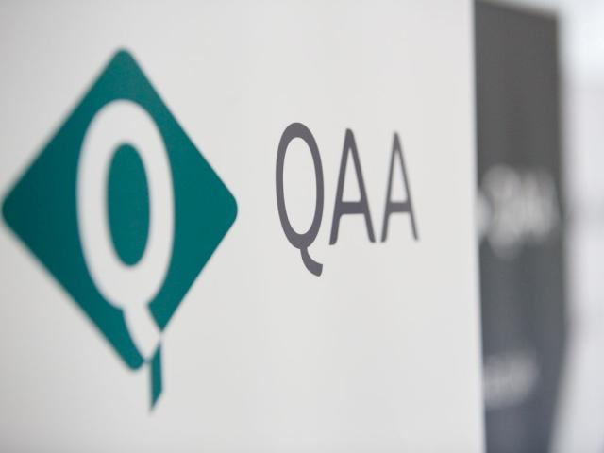
About QAA
QAA is the UK’s independent,
expert, higher education quality
body
Tailored quality approaches for each of the four UK nations, supported by UK-wide work
Founded in 1997, we have 257 voluntary member institutions in the UK

Slide 5
Our mission
To safeguard standards and improve the quality of UK higher education, wherever it is delivered
QAA works internationally to:
provide institutional accreditation and quality review
support UK providers delivering transnational education
build reputation, trust and understanding

Slide 6
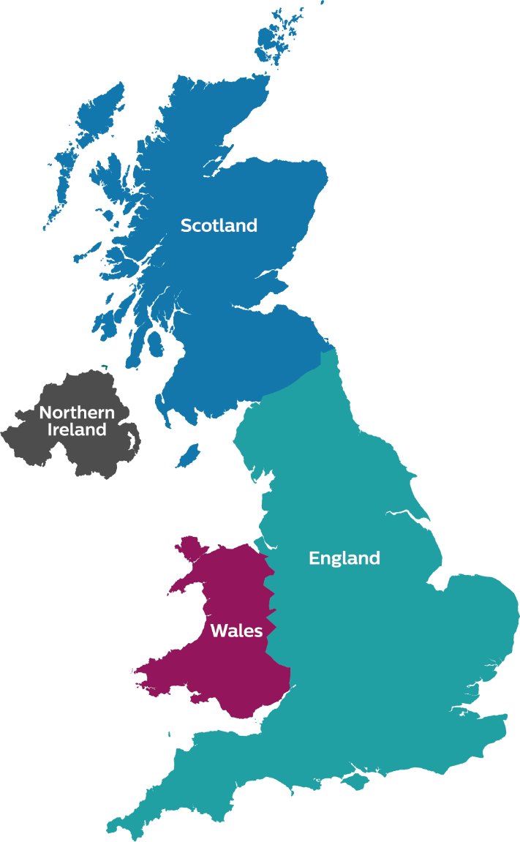
QAA’s UK-wide work
Quality assessment and assurance
UK Quality Code
Advice on degree awarding powers and university title
Teaching Excellence Framework
Assurance of transnational education
Strategic international engagement

Slide 7
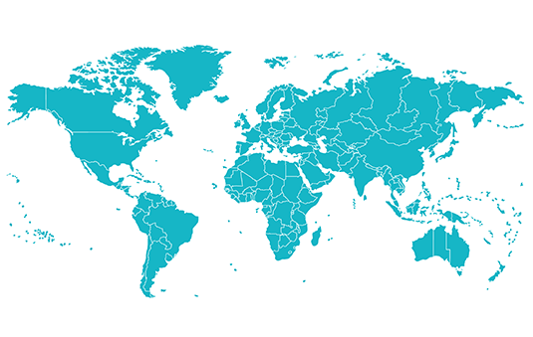
International Partnerships
QAA has links with agencies around the world, through Memoranda of Understanding and Cooperation.
Through our partnerships, we have delivered world-leading capacity-building work.

Slide 8
International Quality Assurance Programme (IQAP)
Our professional development and capacity-building programme for higher education staff worldwide has welcomed over 120 delegates from more than 40 countries globally.

Slide 9
International networks & frameworks

Slide 10
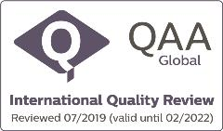
International Quality Review
(QAA accreditation)
IQR helps institutions build a global reputation, by providing accreditation against internationally recognized standards (ESG). The process is designed to help institutions:
Demonstrate effective quality assurance, measured against international benchmarks and comparable to international best practice
Drive improvement and excellence
Strengthen their global positioning
Develop partnerships with UK

Slide 11
International Quality Review
(QAA accreditation)
Benchmarked against the Standards and Guidelines for Quality Assurance in the European Higher Education Area:
Policy for quality assurance
Design and approval of programmes
Student-centred learning, teaching and assessment
Student admission, progression, recognition and certification
Teaching staff
Learning resources and student support
Information management
Public information
Ongoing monitoring and periodic review of programmes
Cyclical external quality assurance.
International Quality Review, offered by QAA to overseas providers, is established as a well-documented and demanding process, fully in line with the ESG.
ESG

Slide 12
International Quality Review
(QAA accreditation)
Five-stage accreditation process;
Application
Scoping
Review
Accreditation
Mid-cycle Review

Slide 13
International Quality Review
Institutional Case Studies
(QAA accreditation)
We currently have 40-50 enquiries from across the world.

Slide 14
Broader QAA expertise
Review
Strategic Development
Training
International Quality Review
Degree awarding powers
Concepts of Quality
Bespoke Higher Education Review
Bespoke quality assurance
International Quality Assurance Programme
Peer Review case study programme
Capacity building
Bespoke quality training

Slide 15
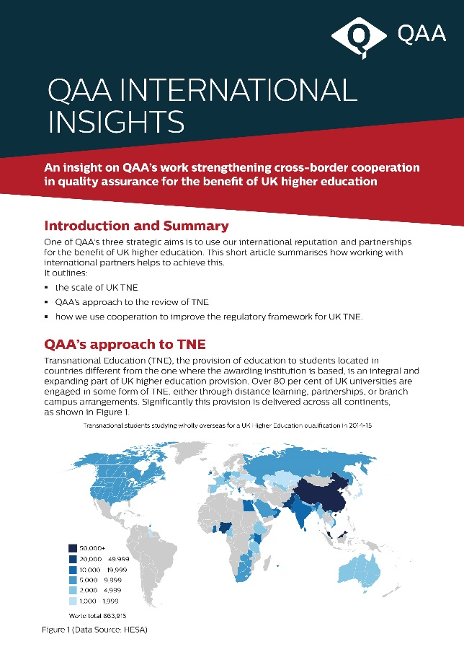
Country Reports and International Insights
Country Reports
Nigeria
China
Hong Kong
Pakistan
Ireland
United Arab Emirates
Philippines
Thailand
International Insights
Strengthening cross-border cooperation in quality assurance
Hosting regular webinars

Slide 16
Cultures of Quality Reports
2 reports, published in 2015 and 2017
Focuses on recent developments in higher education systems and their approaches to quality assurance
Case studies from 9 countries across the world

Slide 17
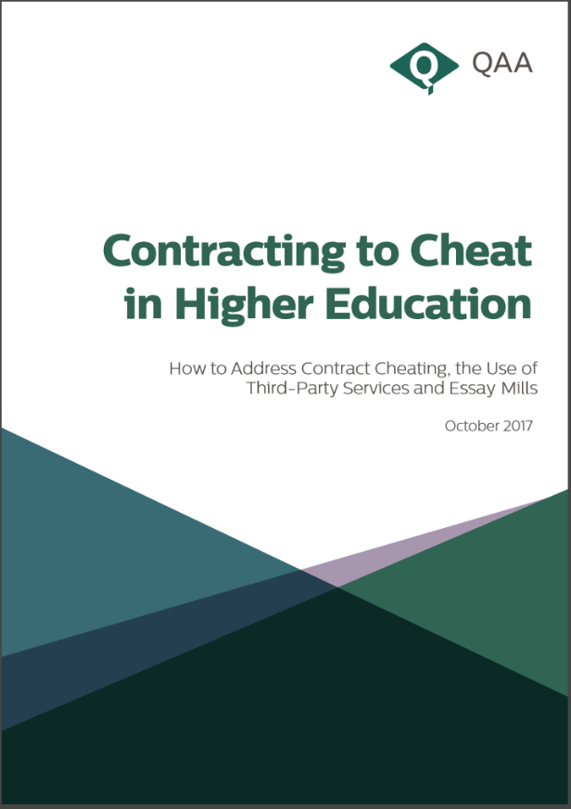
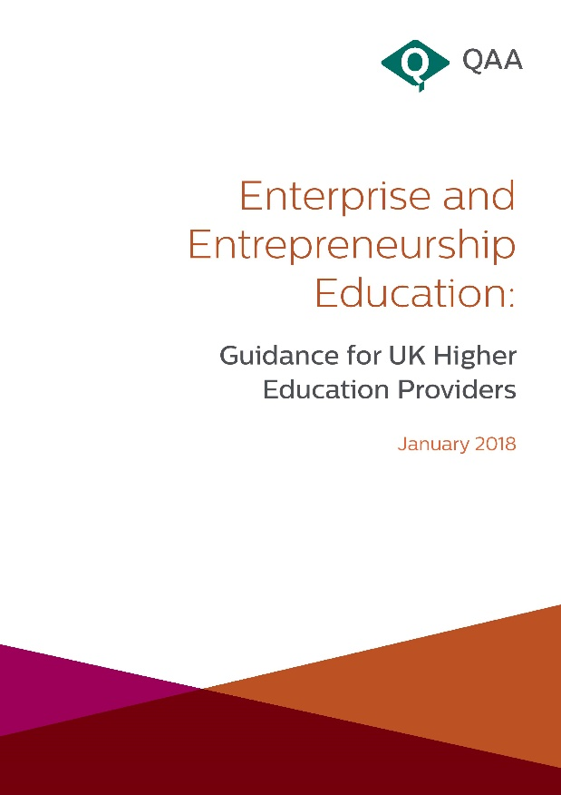
Further briefings and insights
Sustainability
Contract Cheating
Entrepreneurship

Slide 18
QAA’s International Team
Dr Alison Felce
Mr Will Naylor
Accreditation & International Services Operations Manager
Quality Assurance Specialist

Slide 19
Thank you

