Slide 1
Digital Education :
The road to Excellence
Dr Dimitrios Noukakis (Ecole polytechnique fédérale de Lausanne - EPFL)
Dr Abdourahmane Mbengue (Université Virtuelle du Sénégal - UVS)
Notes:
Outline:
WHAT WE TEACH: Education for the digital revolution
HOW WE TEACH; Education with digital tools, education in context via projects

Slide 2
Outline
Short review of Djibouti interactions
Defining Excellence in (Higher) Education
Digital tools, technologies and resources towards excellence
Findings of research on NPDL (New Pedagogies for Deep Learning)
Case study: Techno-pedagogical training of faculty
Discussion
DO’s and DON’T’s

Slide 3
The Tectonic Lines of Education for the Next 10 years (as seen @EPFL
50% will be blended learning dedicated to core technical competences
  Personalized learning
  Online content, with learning analytics
50% will be dedicated to projects and aiming at developing skills that give humans an edge w.r.t machines and algorithms:
  Creativity, innovation
  Solving problems with no training set !
  Interdisciplinarity
  Ethics
  Identifying problems
Campus infrastructures need to be adapted accordingly !

Slide 4
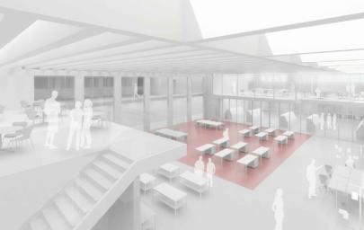
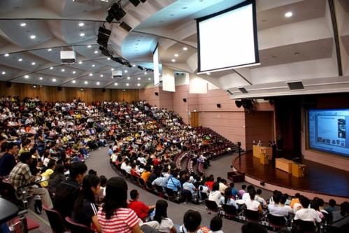
Invent the campus of the future
and build it !
Notes:
We already know the future of the classrooom is not the model on the left. We should really start aiming at sustainable learning infrastructures. For that we must invent the campus of the future

Slide 5

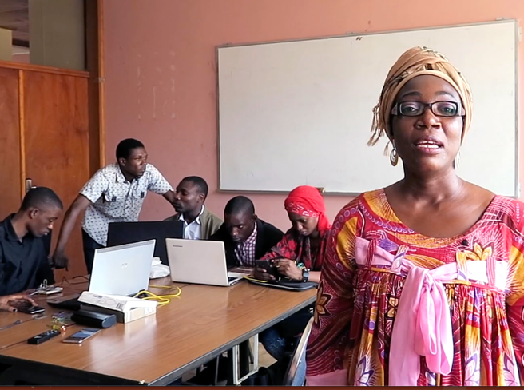
From transmissive teaching to active learning
Ex-cathedra course @Faculty of Sciences
Supervised group projects @Polytechnic
Transformation ?
Notes:
Ex-cathedra teaching of STEM is of little use. Hands-on practice and active learning are the way to go.

Slide 6

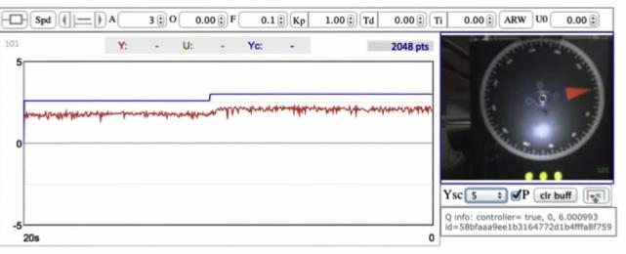
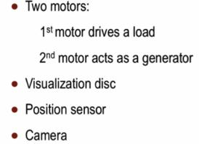
Online courses / Onsite training / Distant labs – Open 365/365
Electrical drive x 20 !
Systems control teaching:
MOOC + experimental set up
Remote access x 20 !
EPFL
MOOCs4@frica
Notes:
Laboratory on systems control at EPFL. Students from Yaoundé were able to follow the MOOC and conduct the remote labs online.

Slide 7
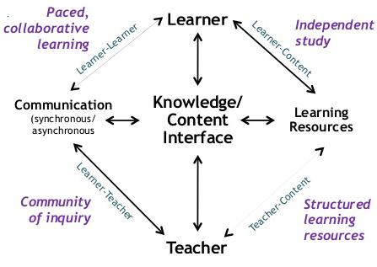
A Theory of Online Education - Challenges
Terry Anderson, Athabasca Univ. Canada, 2004
How to construct a learning environment that is simultaneously learner-centered, content-centered, community-centered, and assessment-centered.
No single best media of online learning, nor a specifications giving the best type of interaction with all type of learners and contexts.
Teachers must learn to widen their skills so that they can respond to both existing and emergent student and curriculum needs by developing a repertoire of online learning activities
Notes:
Learning outcomes can be achieved through e-learning, via a combination of online community activities and computer-supported independent study activities
A revolution is happening and teachers need to be trained !

Slide 8
Excellence in (Higher) Education
Excellence
from Latin: excellere (to surpass)
”Plain vanilla” HighEd programs
World-class branded curricula

Slide 9

Excellence in (Higher) Education
??? What does it take to be able to provide educational programs that are of excellent quality and of local relevance ???
Planning, creativity, commitment
Multi-stakeholder engagements
Learning from others
Adapting to local context
© MATT HARRIS, ED.D.
??? What are the expected outcomes of excellent educational programs ???
Notes:
Example of MOOCs for Africa: We had to train the Profs on how to best use the MOOCs within their own teachings
What are the expected outcomes of excellent educational programs? Define student skills and competencies

Slide 10
Excellence in (Higher) Education
Quality standards in (Higher) Education
??? Is program accreditation enough to reach excellence ???
  Necessary but not sufficient. Too much focus on process and not enough on outcomes
  Need QA systems committed to closely monitor over the long-term
??? Appropriate benchmarking ? Regional or Global ???
  Peer (regional) benchmarking AND Aspirational (Moon shooting) global benchmarking
??? Quality Assurance in line with excellence ? Where to focus on ???
  Teaching environment (class and labs) + pedagogy tools of quality; Students’ evaluations
  Self-assessment; External evaluation; Feedback from industry, employers and society

Slide 11
Excellence in (Higher) Education
??? Can African universities offer excellent education without going Digital ???
  Not really. Digital alone will not make the difference but needs to be part of the implementation plan. A hybrid approach is often a good option.
??? What are the options/alternatives to Leapfroging ???
  Conduct cutting-edge research and link it to the educational project
  Involve the students in the planning and implementation of education
  Relate educational programs to local relevance
  Focus on Skills acquisition, Problem solving, Transferable competencies,…
??? What can Digital Education Technologies bring to reach excellence ???

Slide 12
Excellence in (Higher) Education
??? What can Digital Education Technologies bring to reach excellence ???
  Efficiency (in developing quality educational resources AND in teaching)
  Standardization of teaching resources
  Quality through peer-reviewing
  Collaboration in preparing educational material
  Life-long learning platforms

Slide 13
Benefits of Digital Education Technologies
Ressources de qualité, mises à jour, mais pas toujours pertinentes localement
Formation pédagogique des enseignants
Formation continue thématique et mise à jour des connaissances des enseignants
Méthodes d’enseignements modernes à l’aide de la technologie
Mutualisation et partage de ressources éducatives au niveau régional et global. Ressources éducatives dont la granularité permet le partage.
Contrôle qualité par la pression des pairs et l’auto-régulation

Slide 14
DO’s and DON’T’s
DON’T’s
Invest in synchronous broadcasting of ex-cathedra classes to thousands of students
Start by investing in technical infrastructure for production studios and MME
Develop digital educational material without taking into account what has already been produced “next door”
Think technology will solve all problems !

Slide 15
DO’s and DON’T’s
DO’s
Design a comprehensive plan for the introduction and long-term usage of Digital Resources and Technologies into the classes
Implement the institutional reforms to integrate TICE into teaching
Invest in ubiquitous intranet access and “one-laptop-per-student” program
Revise old curricula and build new ones with a novel mindset
Create techno-pedagogical units to manage support and continuing training of teachers on the long-term
Notes:
Monitoring and Evaluation of teaching should be standard practice

Slide 16
DO’s and DON’T’s
DO’s
Train faculty modern pedagogy and digital education (Passive to Active)
Provide institutional incentives for the early adopters
Establish a long-term reward scheme for high-performing teachers
Promote and value students’ informal learning
Pool resources to develop and share quality and updated educational material within the ACE network and beyond

Slide 17
Merci de votre attention
Thank you for your attention

