Slide 1
Digital Economy for Africa (DE4A)
Digital Skills capacity Building Project
FY2020
ACE Impact Workshop
Dakar, Senegal
September 24 2019

Slide 2
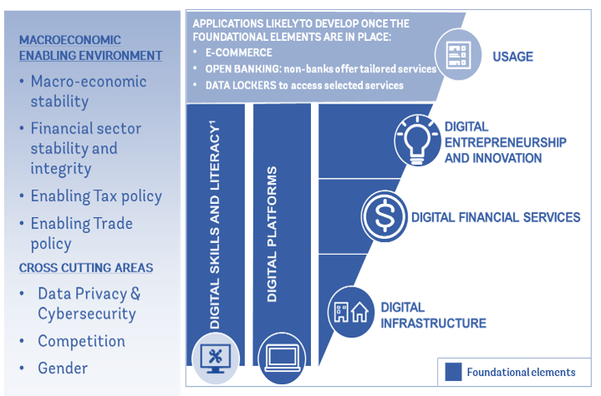
the five foundations of the digital economy

Slide 3
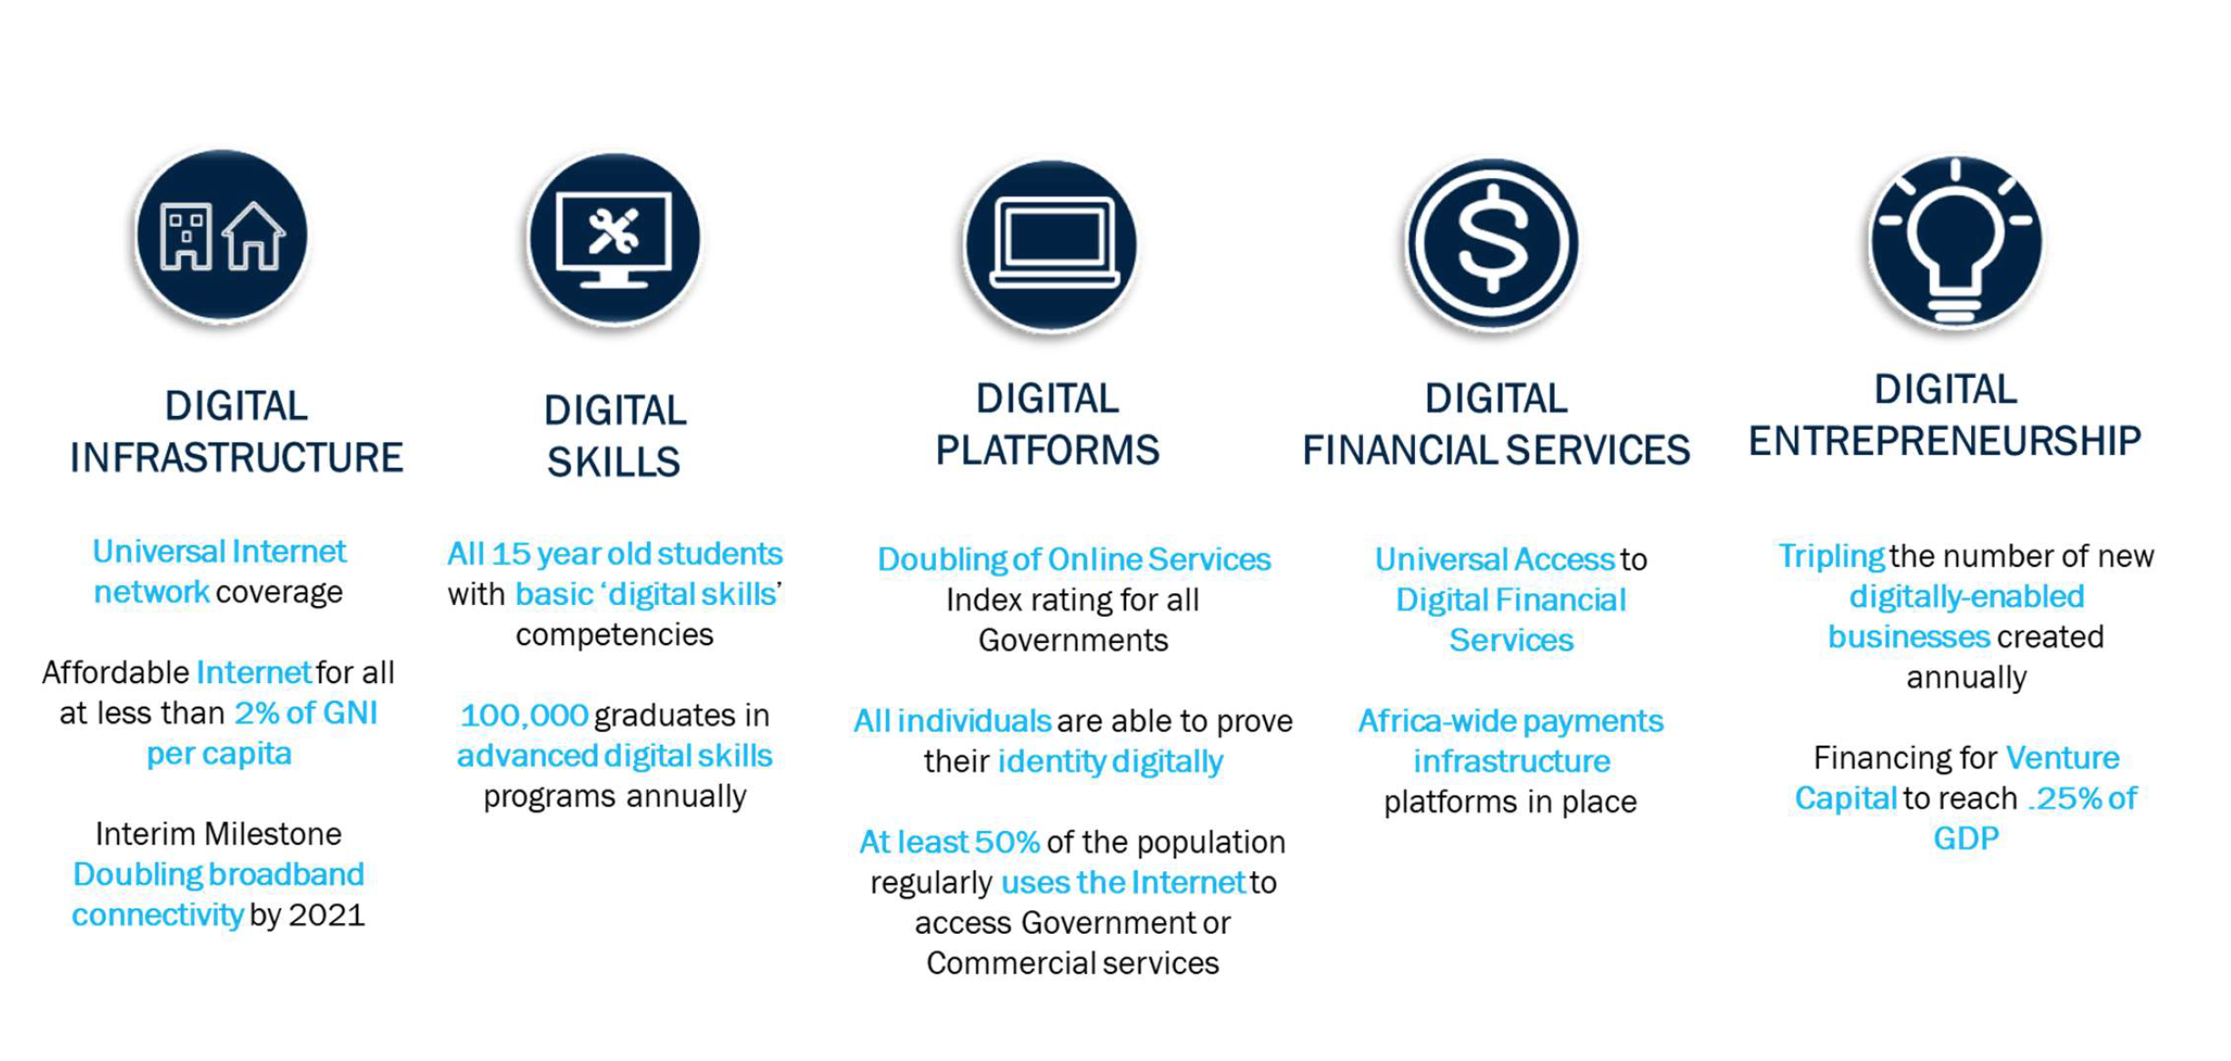
DE4A Pillar Foundational Elements and OBJECTIVES

Slide 4
Digital Skills Capacity building Project
The World Bank’s Digital Economy for Africa (DE4A) initiative includes “digital skills” as one of five foundational pillars, which aims to ensure that all African individuals, businesses and governments are digitally enabled by 2030. The objective of the Digital Skills pillar is to support countries in maximizing the benefits of the digital economy and complement other DE4A pillars to leverage the opportunities for accelerating digital growth in Africa. The flagship Digital Skills Capacity Building Project is geared towards realizing the objectives of the digital skills agenda, which proposes two indicators to assess progress on this pillar:
Percentage of 15-year olds who have basic digital skills (target: all 15-year olds by 2030)
Number of graduates produced annually with advanced digital skills (target: 100,000 annually by 2030)

Slide 5
Digital Skills Challenges for Africa
Lack of a comprehensive digital skills framework, despite country-level frameworks that are mostly fragmented
Unclear definition of digital skills
Competencies for measuring skills are not robust
Connecting digital skills teaching and training with labour force needs
Addressing supply side and demand side constraints
Insufficient supply, large demand (local/regional/global)
Talent/Brain drain
Societies are not yet Digital – with a few exceptions

Slide 6
Digital Skills Capacity building Project
A radical and systematic approach to accelerating digital skills in Africa through:
Cross GP effort that catalyses Digital Skills for Development across the World Bank
Generating a demand for digital skills teaching and training among civil service employees and adults (life long learning)
Addressing all categories of beneficiaries – eSociety with a focus on youth

Slide 7
Digital Skills Framework
Work Force
Apply digital skills to meet sector demands
In-house training for acquiring highly specialised digital skills
Multisectoral interventions for incorporating digital skills
Education
Education curriculum reform
University and postgraduate level programs for digital skills
Teacher training and professional development
Digital Skills Development
Digital Training
Targeted programs for:
Unskilled workers & professionals
Civil service employees
University courses, TVET
Employment in occupations intensive in ICT use at work in developing countries has increased by 10% between 2000 and 2012, almost two times the increase in developed countries
Over 230 million jobs in Sub-Saharan Africa will require digital skills by 2030
A NEPAD study reported that 55% of secondary students participating their e-schools initiative reported no experience with computers and most schools did not provide opportunities or teacher training

Slide 8
Digital Skills Capacity building Project
A radical and systematic approach to accelerating digital skills in Africa using these principles:
Let’s not reinvent the wheel Leverage private sector know how and existing curriculum Link with jobs, present and future, Link with private sector demand Monitor and iterate with private sector and universities Focus on STEM / STEAM / STI for creation of local talent independent from global talent pool ACE project critical for DS acquisition & scale up
Sustainability of ongoing investment

