Slide 1
Results-Based Financing
Disbursement Linked Indicator Approach

Slide 2
Why Performance-Based Funding?
Origin
Traditional Funding
Performance-based Funding
Characteristics
Funding based on input factors
Expenditures
Issues
No talk of performance of institutions:
Quality of education
Learning/employability
Scale-up of education
Research publication and outreach to companies
Institutions pursue their goals
Aim:
To achieve better results
Respects institutional autonomy and leadership, and still align institutional goals with development goals
Improve Institutional capacity to plan, decide and implement
Increase accountability
Objective, predictable, and transparent funding allocation
Additionally for the WB: support a government program, pilot an approach to results-based financing, and use of government procurement rules to strengthen capacity

Slide 3
How does Results-Based financing work?
Government, World Bank, and institutions design a government program: performance and funding agreement to establish Africa Centers of Excellence
Results
Measurable and within control of institution
.
Disbursement
Linked to results
Reimbursement of select costs
.
Costs
.
Investment Line, Regular Salaries and Other Recurrent Costs
In budget.

Slide 4
The Basic Idea
World
Bank
.
Government
Institution
Financing Agreement:
- Results
Disbursement
Costs
Performance
Agreement:
Same Results
Same Disbursement
Same Costs
+ TA
Government only disburses when WB disburses: no financial risk to government

Slide 5
How does it work under the ACE model?
Each ACE prepares an implementation plan for the project duration.
Every year and Annual Work Plan (AWP) is prepared and reviewed by AAU experts and Approved by WB
Eligible expenses are only approved activities within the Approved AWP
.
ACE Parameters are
Only 1 bus and 1 car
No more than 25% on civil works
15% must be spent on African partnerships (regionality)

Slide 6
How do you get money? When you achieve Results!
Fiduciary
Quality of education
International accreditation
Publications
Learning environment (infrastructure and equipment)
Institutional
Readiness
Development
Impact
Relevance
Revenue generation
Internship
Entrepreneurship linkages
Students
With bonus on regionality and gender
Institutional
Impact

Slide 7
Role of Government, AAU and World Bank to ensure you get results and funds
Verification
AAU and World Bank
V
S
Supervision
Government, World Bank and AAU
Support
Government,
World Bank and AAU
S
I
Implementation
You, your team, your university, your country!

Slide 8
ACE 1 – Consistent increase in POST GRADUATE student enrollment
At least 1600 PhD students and 6,800 Msc students supported through the ACE project
Majority of the funding is towards PhD and MSc student enrollment

Slide 9
ACE 1 – Africa achieves global standards and partners globally
18 education programs have been accredited internationally
2iE- Burkina, UGB- Senegal, Yaoundé I- Cameroun, University of Ghana, University of Lomé, University of Abomey-Calavi
First time for 5 out of 6 universities
10 education programs have been accredited regionally
UCAD – Senegal
Huge effort on international funding partnerships:
Parallel funding with foundations, bilateral, scholarship funds, research councils etc.

Slide 10
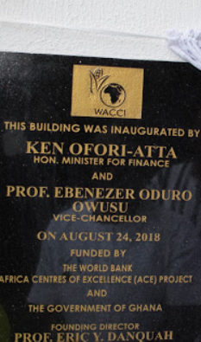
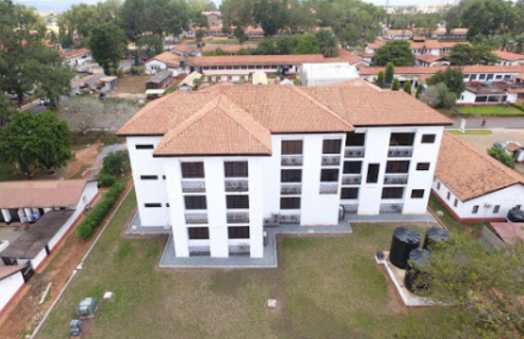
Ace 1 – Improvement of universities teaching and learning environment
WACCI Multipurpose Building Inauguration
Office, conference and lecture rooms
Seed science, tissue culture and cold room laboratories
Bioinformatics platform

Slide 11
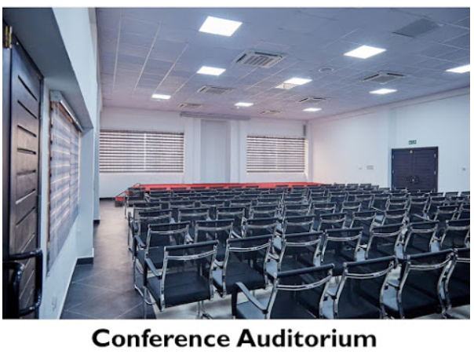
Ace 1 – Improvement of universities teaching and learning environment
WACCI Multipurpose Building - Office, conference and lecture rooms

Slide 12
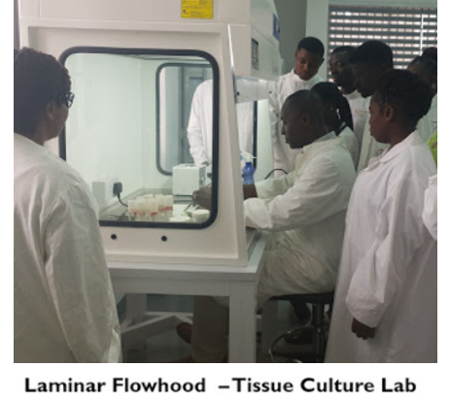
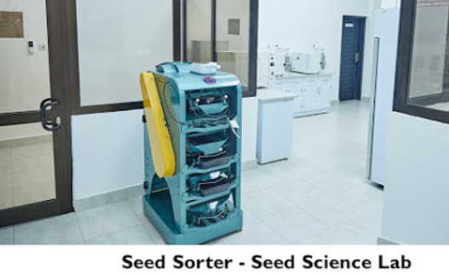
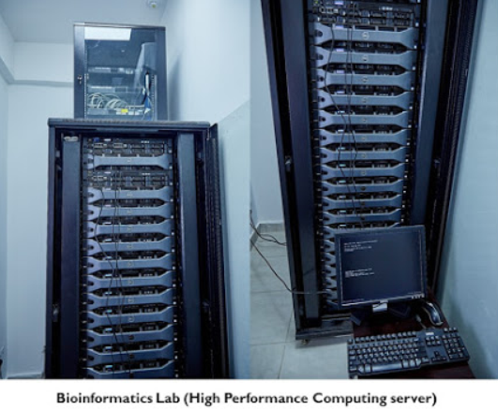
Ace 1 – Improvement of universities teaching and learning environment

