Slide 1
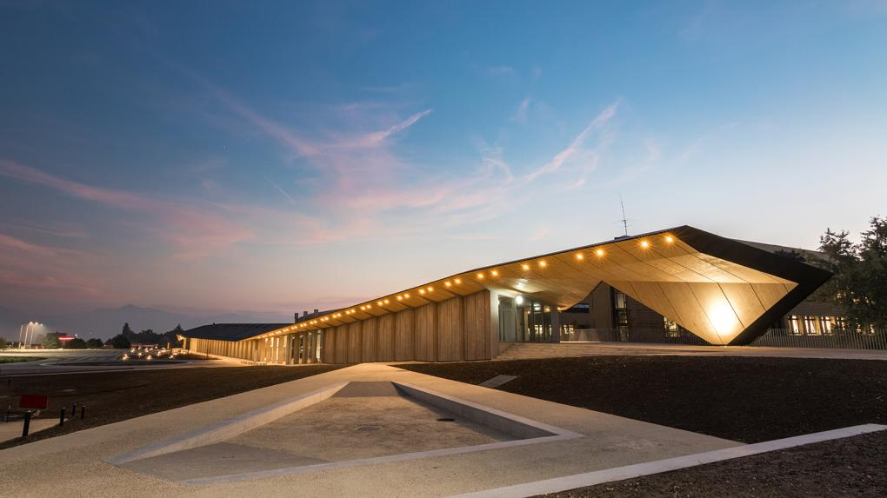

Ecole polytechnique fédérale de Lausanne
Transformation of Higher Education using Digital Tools and Technologies
Dr Dimitrios Noukakis
Notes:
Outline:
WHAT WE TEACH: Education for the digital revolution
HOW WE TEACH; Education with digital tools, education in context via projects

Slide 2
Outline
EPFL and our thoughts on the future of education
Digital tools and technologies as changing agents
MOOCs Africa 2013-2018: Lessons learned
A pilot project in 3 institutions
  Pedagogy
  Technology
  Content
Potential for ACE Impact

Slide 3
11’000 students (2’200 PhD), 4’100 staff, ~ 1 B USD annual budget
ENAC
SB
STI
IC
SV
5 Schools
13 Sections
Architecture, Civil Engineering, Environmental Science & Engineering
Mathematics
Chemistry
Physics
Electrical Engineering Microengineering
Mechanical Engineering
Materials Science
Computer Science Communication Science
Life Sciences
& Technology
Bioiengineering
CDM
CDH
2 Colleges
7 Interdisciplinary Centers
Management
of Technology
Financial Engineering
Human &
Social Sciences
Transport, Energy, Neuroprosthetics, Design (EPFL+ECAL Lab) etc...
26 Institutes
350 Laboratories
and Research Groups
Notes:
Research intensive
Innovation driven
Promotes excellence in education and research

Slide 4
Coping with the 4th industrial revolution
Enablers
  Big Data
  Ubiquitous sensing, IoT
  Cloud
  Machine Learning, Artificial Intelligence, Data Science
Transformative effect on industry
  From advanced manufacturing to health
  All levels of education

Slide 5
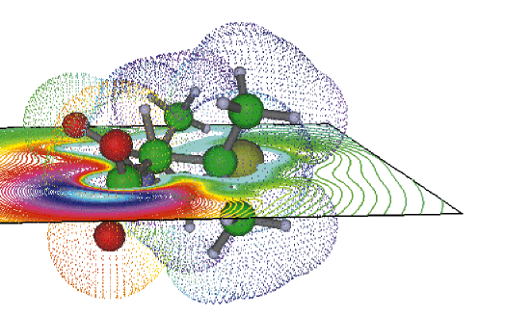
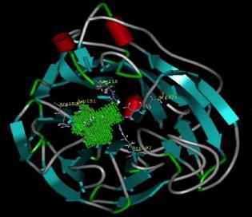
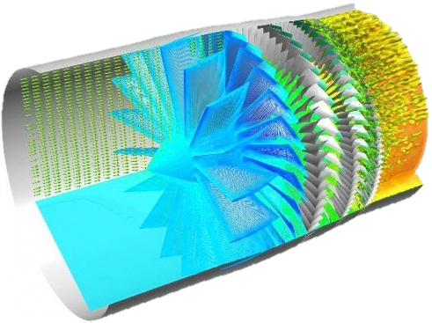
20th Century: Computational-X
Computational
chemistry
Computer aided
drug design
Computational
Fluid dynamics
Notes:
Simulations, we can solve complex problems, solving equations of physics, chemistry etc … In particular this allows us to simulate before designing.

Slide 6
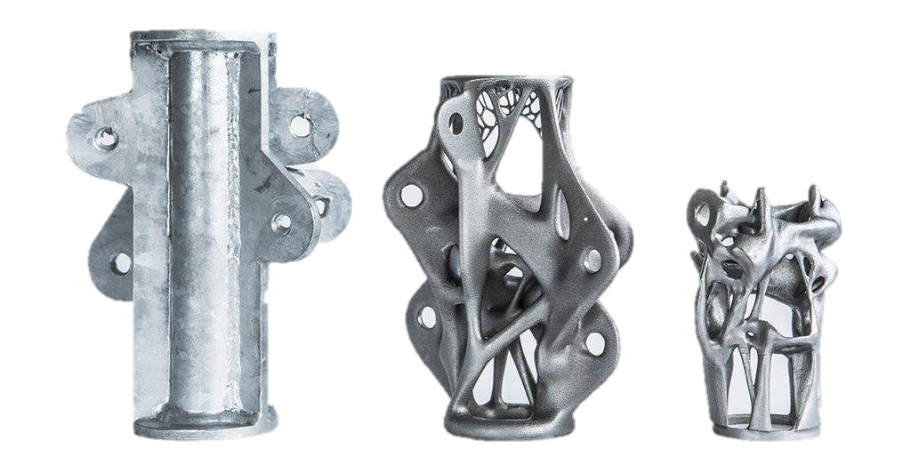
Computational thinking
From simulation to exploration, not just 20th century computational science
Thought processes based on calculations, data, information and algorithms
Notes:
Here are three structural nodes, intended to hold cables above a road in The Hague. The node on the far left was designed by a human, and on the far right by a computer. More importantly, the node on the far right supports the same weight, but weighs 75% less and is 50% smaller.
Optimized for additive manufacturing

Slide 7
The Tectonic Lines of Education for the Next 10 years
50% will be blended learning dedicated to core technical competences
  Personalized learning
  Online content, with learning analytics
50% will be dedicated to projects and aiming at developing skills that give humans an edge w.r.t machines and algorithms:
  Creativity, innovation
  Solving problems with no training set !
  Interdisciplinarity
  Ethics
  Identifying problems
Campus infrastructures need to be adapted accordingly !

Slide 8
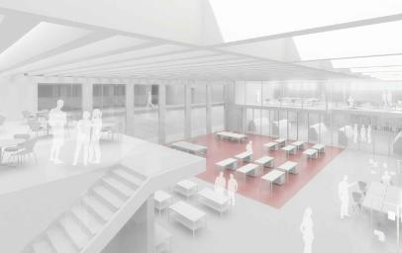
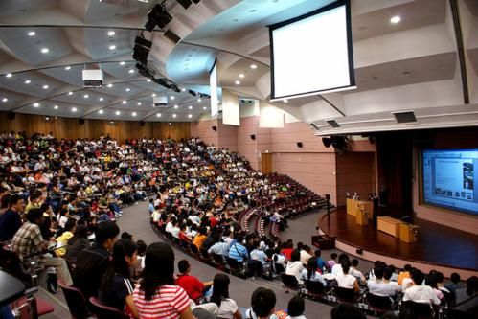
Invent the campus of the future
and build it !
Notes:
We already know the future of the classrooom is not the model on the left. We should really start aiming at sustainable learning infrastructures. For that we must invent the campus of the future

Slide 9

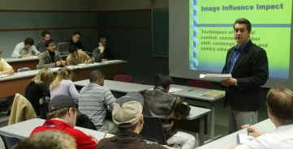

The organization of teaching through times
Early universities: walk-in libraries giving access to rare handwritten books and manuscripts
Early distant education: printed or digital content (text) coupled with asynchronous communication by post mail or e-mail
Contemporary universities: campus-based, providing meeting and lecture spaces for synchronous interactions between students and teachers.
Contemporary distant education: ubiquitous access to unlimited digital content coupled with synchronous communication via the Internet

Slide 10
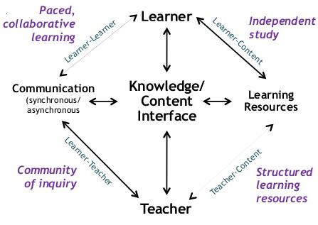
A Theory of Online Education - Challenges
Terry Anderson, Athabasca Univ. Canada, 2004
No single best media of online learning, nor a specifications giving the best type of interaction with all type of learners and contextes.
Teachers must learn to widen their skills so that they can respond to both existing and emergent student and curriculum needs by developing a repertoire of online learning activities
Notes:
Learning outcomes can be achieved through e-learning, via a combination of online community activities and computer-supported independent study activities
A revolution is happening and teachers need to be trained !

Slide 11
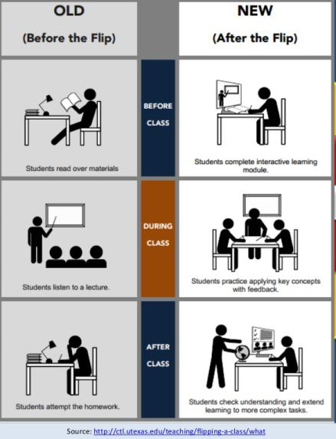
Example: Flipped classroom
Change the learning/teaching mindset of students and teachers
Prepare students to work in a connected world !
Learn digital skills by immersion, not just theory
Students are connected and use the Internet for all kind of things. It’s more natural to them to follow courses online. → better attendance, though it may seem counter-intuitive.

Slide 12
6 Reasons to Implement Blended Learning
Studies show students learn better (University of Iowa )
It Promotes student autonomy and ownership of learning
It prepares students for a tech-centered world
It (can) cuts costs
It increases collaboration (student-student, teacher-student, teacher-teacher)
Keeps students more interested and engaged (as they use their everyday online media)

Slide 13



A vision in 2012 …
Offer higher education courses of the highest quality to all students of Africa thanks to MOOCs, in partnership with local universities and social partners.
Partners committed to promote accessible education for all

Slide 14
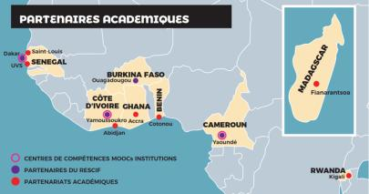
MOOCs Africa 2013-18 – Planting the seeds for capacity building in Higher Education in Africa
Realizations
      Network of 11 partner universities in sub-Saharan Africa
      2 MOOC Factories created in partner African universities
      147 African teachers and technicians trained to produce and use MOOCs & OER
      48 courses produced or co-produced, of which 13 in collaborative (North-South) mode
      48 courses produced or co-produced, of which 13 in collaborative (North-South) mode
      +182’000 registered participants from Africa
      +3’500 certificates delivered in Africa
      2 Cursus en ligne – prepared in topics with local relevance

Slide 15



MOOCs at the global educational market
MOOC-based online education programs are already making a big impact in education related to the skills needed to accompany the digital transition of our societies.
Micro- and nano-degrees delivered by the international platforms Coursera and edX.
Open Classrooms at the French-market
Training professionals to the digital job-skills needed.
Notes:
This slide is to introduce what have we learned 5 years later.

Slide 16
MOOCs & OER potential in the Developing World ?
Address some of the most urgent challenges in education, such as:
Quality – Teachers qualifications, access to content and scientific literature
Relevance – Update of curricula, in-line with job-skills demand & digital economy
Capacity – Massification of universities, geographic and gender inclusion
      Better professional qualifications
      Reduction of inequalities

Slide 17
First cycle of higher education
”MOOCs & OER are a great tool to transform higher education in Africa and in emerging countries. They help universities :
  cope with the scarcity of qualified instructors,
  give access to updated educational material, and
  introduce modern pedagogical methods into teaching.”
Notes:
This slide is to introduce what have we learned 5 years later.

Slide 18
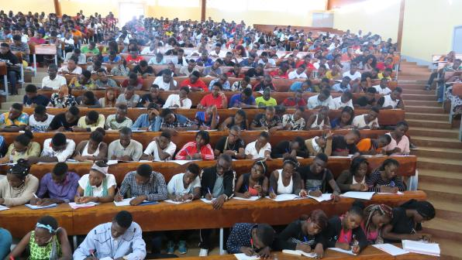
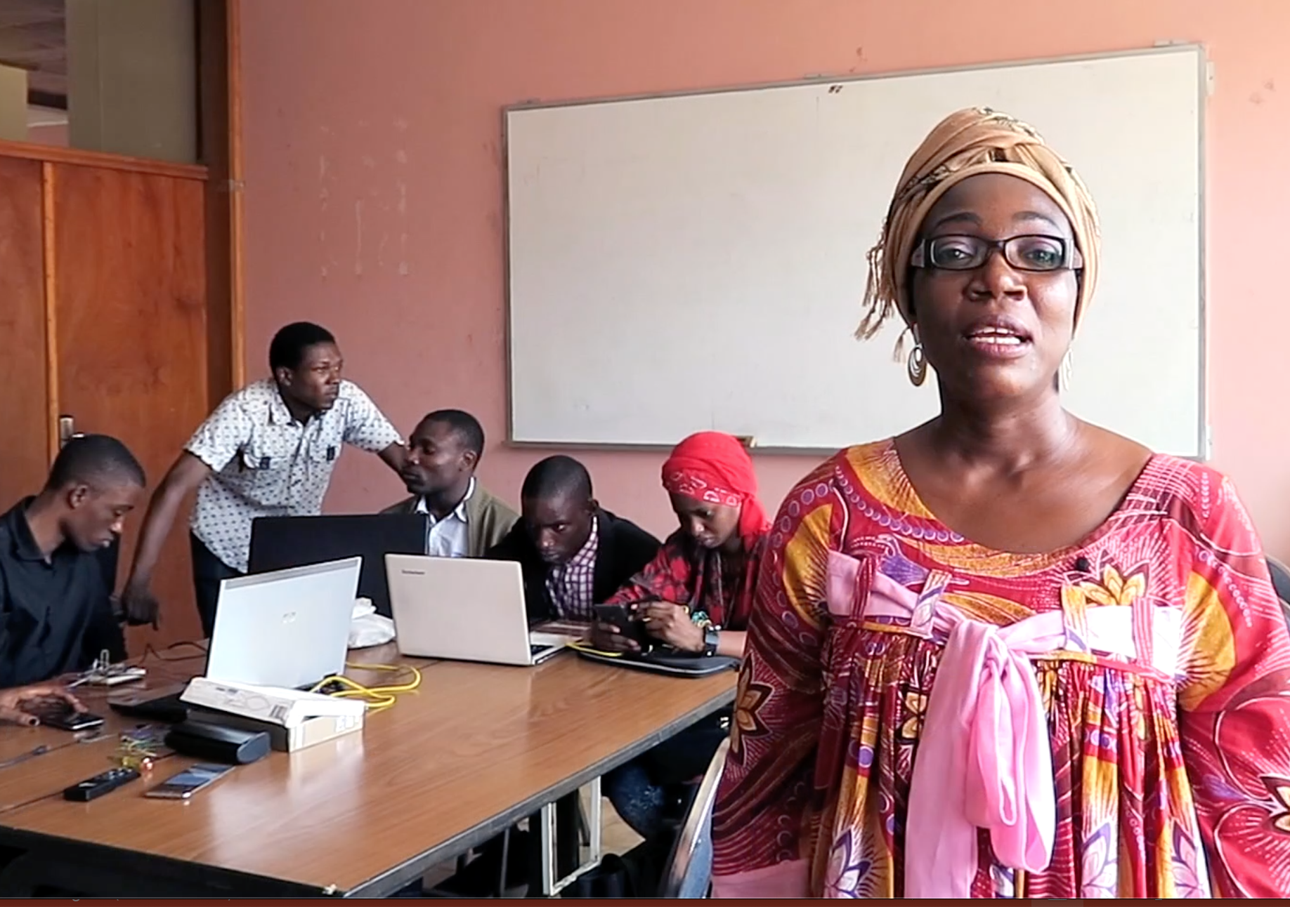
From transmissive teaching to active learning
Ex-cathedra course @Faculty of Sciences
Supervised group projects @Polytechnic
Transformation ?
Notes:
Ex-cathedra teaching of STEM is of little use. Hands-on practice and active learning are the way to go.

Slide 19
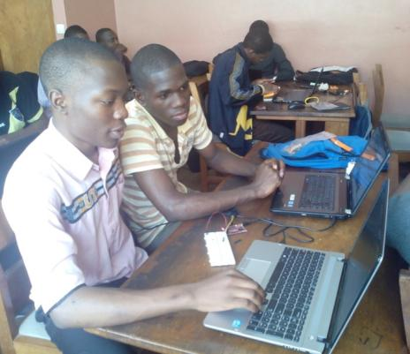
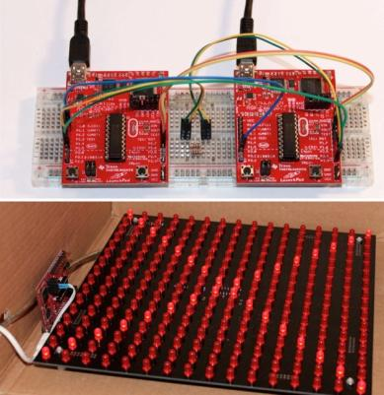
Online courses / Onsite training / Distant labs – ENSP Yaoundé
EPFL
MOOCs4@frica
Notes:
Laboratory on microcontrollers at Polytechnique Yaounde. Printed circuit boards and electronic material were sold (under 20 EUR) by EPFL to those who followed the MOOC.
Note: all laptops belong to students !

Slide 20
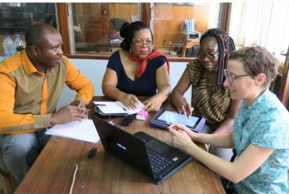
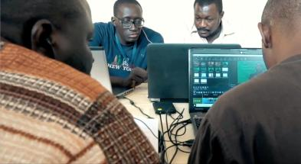
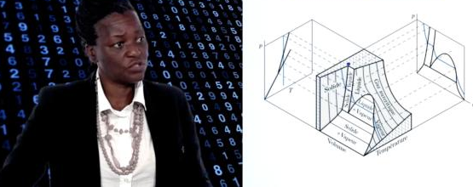
Train and accompany the teachers
Pedagogy primers
Instructional design
Digital tools & resources
MOOCs & OER
Notes:
Train the local teachers and give incentives to produce digital resources and tools and put them in practice within their classes. It’s the only way to catch up with pedagogy AND digital education

Slide 21
3-sites pilot: Building up local capacity for digital education
2 Pedagogical Engineers
Pedagogical Eng.
No 1
Pedagogical Eng.
No 2
2 Experts– n 1
Dakar
ESP
Ya’kro
INPHB
Yaoundé
ENSPY
3 institutions
Extented workshops for experts – n 2
Teachers workshops and mentoring - n 3
10 teachers trained as pedagogical experts
X1
X3
X5
X7
X9
X2
X4
X6
X8
X10
60 teachers trained in digital education
T2
T1
T60
T3
Notes:
Training includes a personal project on the transformation of at least one course with the help of digital tools and content

Slide 22
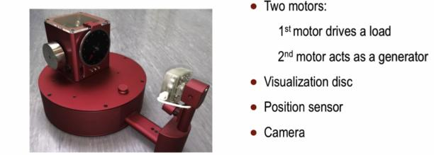
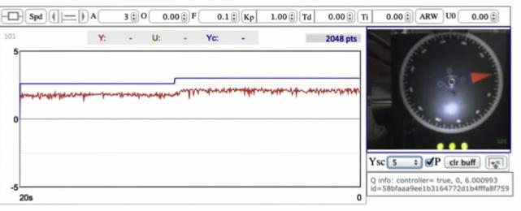
Online courses / Onsite training / Distant labs – Open 365/365
Electrical drive x 20 !
Systems control teaching:
MOOC + experimental set up
Remote access x 20 !
EPFL
MOOCs4@frica
Notes:
Laboratory on systems control at EPFL. Students from Yaoundé were able to follow the MOOC and conduct the remote labs online.

Slide 23
Online courses / Onsite training / Distant labs
MOOCs & OER
+
Remote / Local Labs
+
Local tutors (trained)
Quality training onsite 😊
Alternative ???
Study abroad ☹️
EPFL
MOOCs4@frica

Slide 24
Adult training and Continuing Education
” Demand-driven educational programs – combining MOOCs, proctored exams, onsite training, local supervision and formal certification – have the potential to re-invent further education and adult training, and offer a response to the job-skills needs of the local economies. ”
Notes:
4th Industrial Revolution needs STEM and e-learning

Slide 25

Short, blended (online & onsite) programs . . .
MOOCs
X credits
Personal work,
supervised locally
Y credits
Certificate
Distant/Local partner
X+Y credits

Slide 26
Short, blended programs . . .
Offer quality training, specifically developed for Africa, with Africans
Great leverage across several countries
Allow local partner institutions to upgrade their continuing education offer
Up-to-date professional competencies delivered locally

Slide 27
How to get there ? 3 Intervention axes with digital edu.
Pedagogy
Rethink and update the pedagogical models
Towards active learning, acquisition of competencies, problem-solving
Technology
Usage of ICT, LMS and modern communication media
Design and production of digital content
Content
Quality, relevant and up-to-date from the best available
Sharing and pooling resources across the globe + Contextualisation

Slide 28
How to get there ? ACEs could invest in:
Training of Faculty members & Teachers
  Pedagogy
  Usage digital content, tools and technologies
Hiring of qualified personnel
  Accompany pedagogical transformation
  Produce and distribute digital educational content
Creating the right learning environment
  Infrastructure to produce and publish digital content (production studios, LMS, online content publishing platforms,etc)
  Buildings and classrooms that promote group work, experimentation and interactions

Slide 29
Actions for Leapfrogging of Higher Education
NextGen of Higher Education institutions:
  Less brick & mortar → More on dematerialized services
  Train the trainers with and for the digital education
Access to education and training:
  Contribute to Internet access and bandwidth
  Reach out to underserved communities/gender

