Slide 1

University Engagement with CERHI, University of Benin

Slide 2
Investments of UNIBEN in CERHI
Initial Take-off grant of NGN 10.0 Million
Office Space ¼ floor in the College of Medical Sciences building
VC’s and Registrar representatives in Weekly meetings of CERHI
CERHI curricular development and review done by multidisciplinary staff of the University and approved by Senate
All staff of CERHI – deployed from the University to date (nearly 16)
All academic staff of CERHI deployed are paid work-load/exam/supervision allowances by the University
CERHI included in University’s annual budget – now recognized as a distinct academic Unit.
School of Postgraduate Studies fully involved in CERHI’s activities

Slide 3
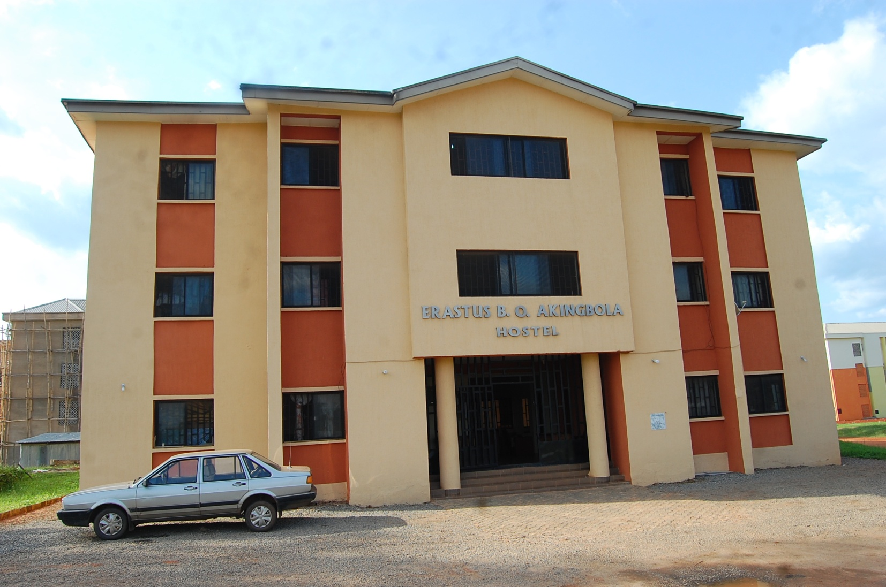
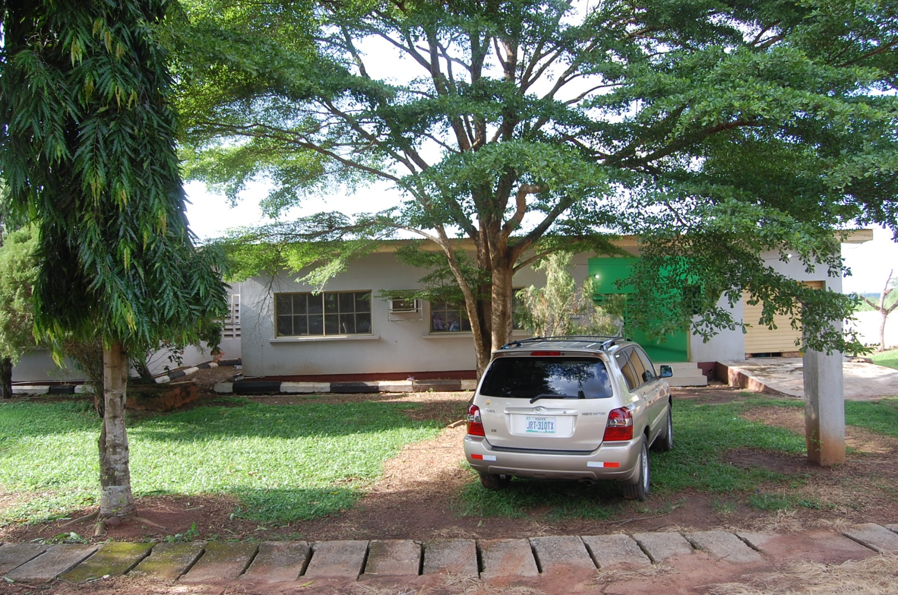
Provision of Int’l Students and staff Accommodation
The University has provided two separate buildings for regional staff/students accommodation and housing.
All staff managing these facilities are the staff of the University
Buildings are being renovated by an architect and Works department, directly paid for by the University

Slide 4
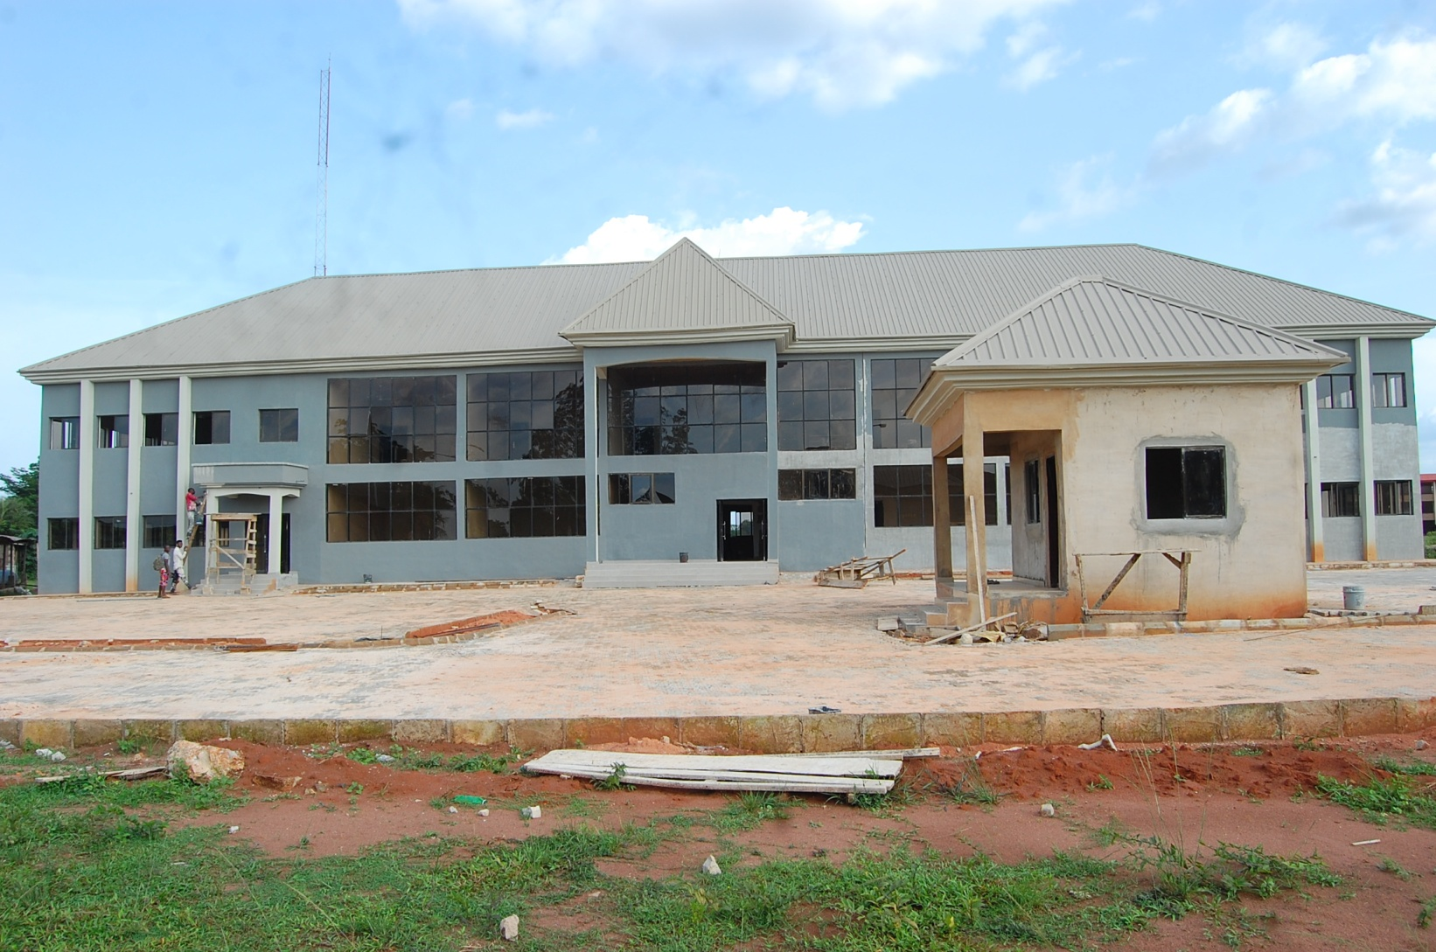
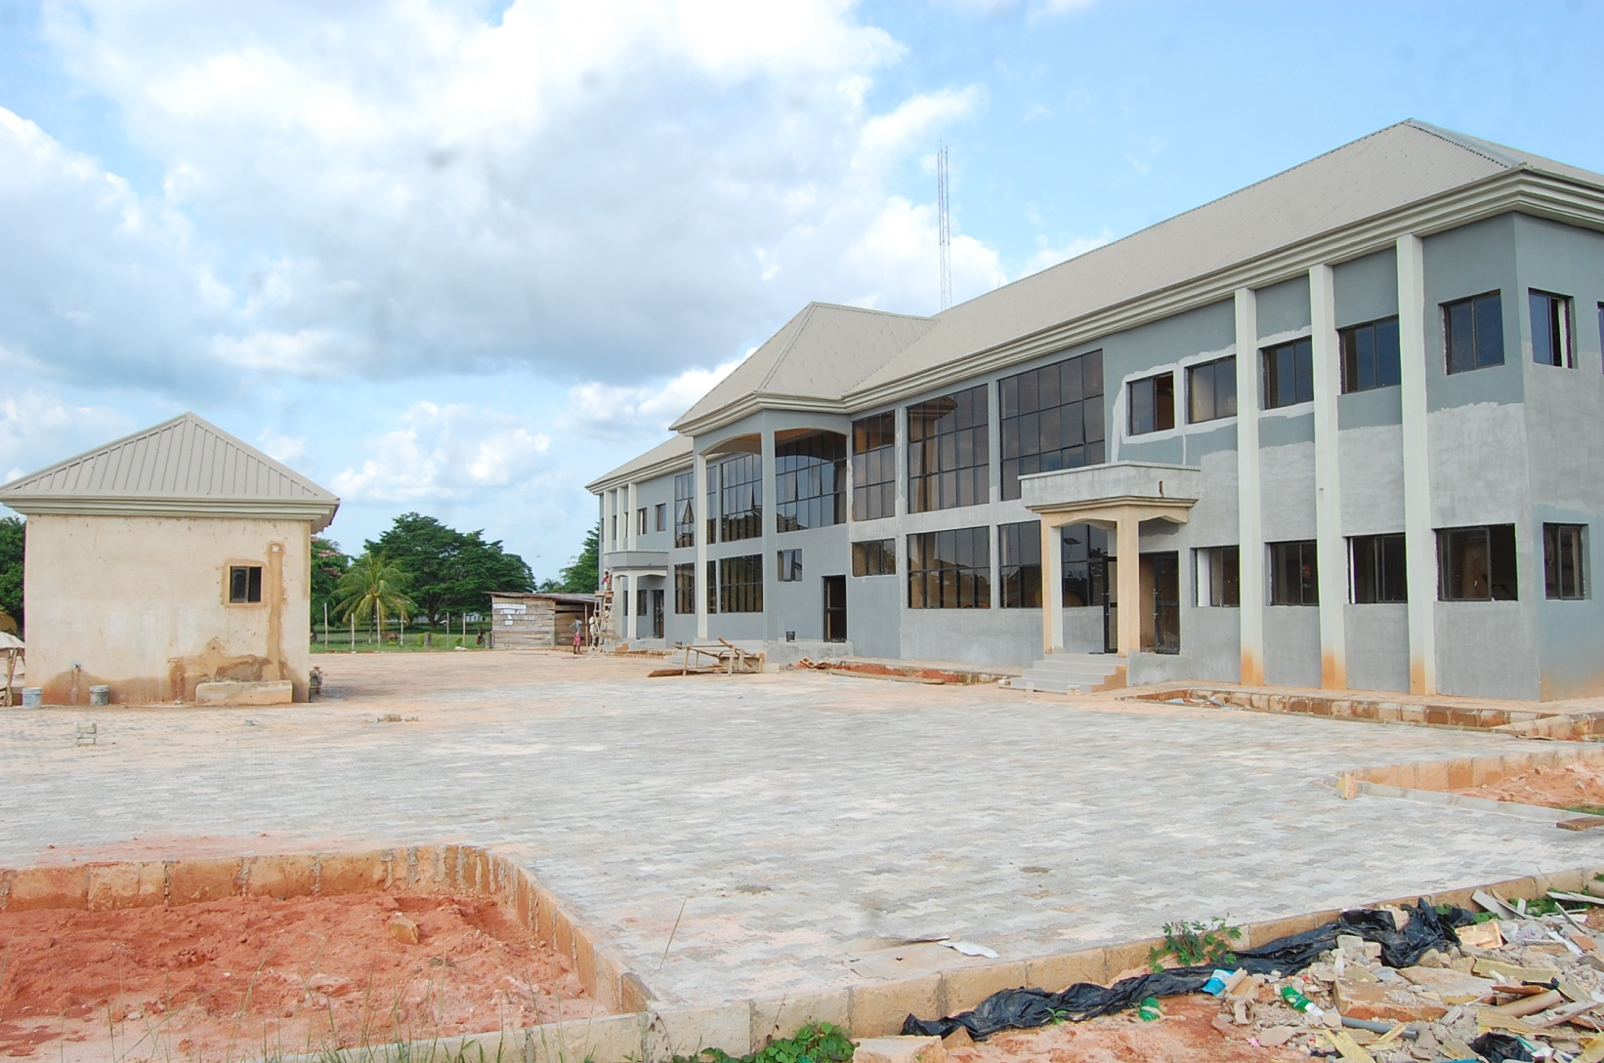
Completion of CERHI’s Secretariat & Academic Complex
Architectural drawings and supervisory responsibilities borne by the University
Land and supporting services (water, electricity, security, etc.) provided by the University
A University’s special task force is currently working to complete and equip the building

Slide 5
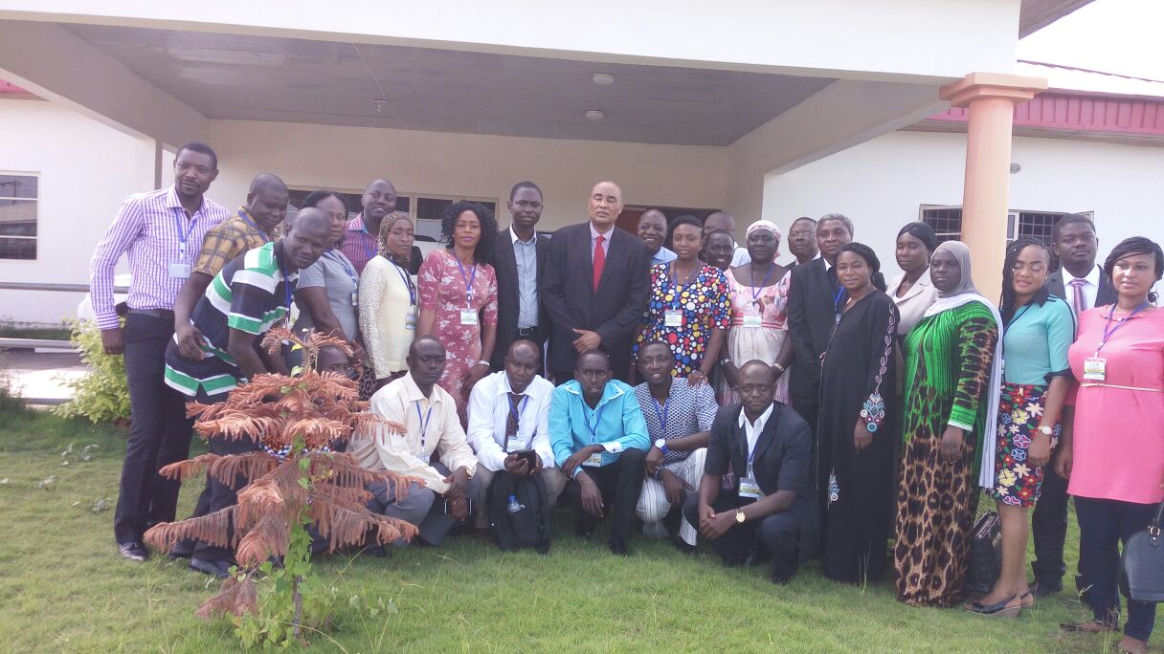

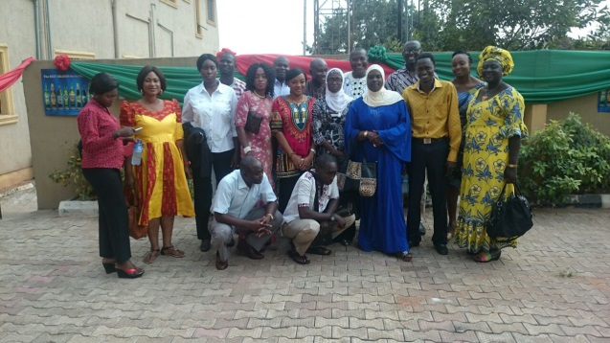
CERHI’s Experiences with Regional Students
2016-2017: 17 Students.
2017-2018: 0
Positive Experiences:
Internships for all
Research groups
Sponsorship to Int’l Conferences – 3 students
2017-2018 actions
Complete CERHI’s teaching and research strengthening
More active advert of CERHI
Planned visit to regional institutions

Slide 6
CERHI – A change advocate at UNIBEN
Our change mantra is founded on: Transparency, Effectiveness and Accountability (TEA):
Transparency – We are up-to-date on internal and external audits, published in our Website
Effectiveness – weekly meetings, enhancing self-learning and prompt delivery of services.
Accountability – fidelity with procurement guidelines and anti-corruption procedures
- Also, CERHI’s specific workshops on fund-raising, proposal writing, mentoring and research have targeted the entire University.
- CERHI now provides internet to the entire University through it’s acquisition of the NGRen portal.

Slide 7
Total Cumulative Numbers of Students in CERHI Courses
Course Cumulative Total
M.Sc. (Repr Health) 53
PhD (Repr Health) 4
M.Sc. (Public Health) 75
M.Sc.(Rep &Family Health) 41
PhD (Rep &Family Health) 6
M.Sc. (Nursing) 58
PhD (Nursing) 11
M.Sc. (Health Economics) 30
PhD (Health Economics) 5
Grand Total 283

Slide 8
Progress in International Accreditation
This is still being pursued in view of the fact that we were told by the NUC to pursue national accreditation first before pursuing international accreditation.
We were also waiting for the completion of CERHI’s building and the related academic facilities.
Now that CERHI has obtained the NUC accreditation for 7/9 courses, and we have completed the building, we will pursue international accreditation with vigor.

Slide 9
New IGR in CERHI since Abidjan 2016
Abidjan Report New IGR since Abidjan
$58,087.50 $99,835.96
Sources of New IGR
School fees
Fees paid by contractors for bids
Accommodation and acceptance fees
Constraints
Unwillingness of participants to pay for short courses and even school fees.
CERHI building yet to be completed.
Over-coming the fund raising challenges
Grant writing opportunities
CERHI RH Lab would serve the entire South-south region

Slide 10
CERHI’s Progress with DLR 2.8
Activity | Target to date | Achieved to date (total and %) | Comments
DLR 2.8 …Procurement of e-learning materials, new learning technologies, and multi-nodal learning materials and platforms | Procurement of e-learning materials, new learning technologies, and multi-modal learning materials and platforms | Yes (80%) | All departments have benefited from procurement of e learning materials. Access to online content, e-learning platform via NGREN has also been given to all HODs to share with faculty and students

Slide 11
THANK YOU

