Slide 1
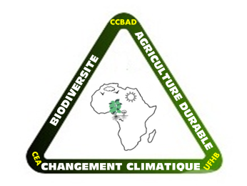
CEA Changement climatique Biodiversité et Agriculture Durable/UFHB
CEA-CCBAD: Climate and interaction
Prof. KONARE Abdourahamane
Presented by Dr. BAMBA Adama

Slide 2
Our previous PhD programme
Climate and Interaction is endorsed at CRNI
PCOA
Physico-Chimie de l’Ocean et de l’Atmosphere
QAS
Qualite de l’Air et Sante
EREM
Energie Renouvelable et Materiaux

Slide 3
UNIVERSITIES AND INTERNATIONAL PROGRAMS PARTNERS OF CRNI
quantify the coupling between aerosols and clouds and
identify the processes controlling the formation and persistence of low clouds and precipitation
DACCIWA Dynamics-aerosol-chemistry-cloud interactions in West Africa
Doctoral Interuniversity Program (PDI) in Public Health, option "Ecosystems, Health and Sustainable Development"
CHAIRE POLE “ECO HEALTH”
IRD, PASRES, LTHE, LA, UNA, UPGC, SODEXAM, CRO, LAMTO, Global Land Project
OTHERS PROGRAMMES ET UNIVERSITIES
Prediction and prediction, provision of climate services
Digital Simulation Pole Climate and suitable development (ClimDD)

Slide 4
STUDENTS ORIENTATION
PhD students
Modélisation Climatique Régionale et Applications (MOCRA)
Regional climate modeling and applications

Slide 5
MOCRA RESEARCH AXES
Air quality and health (RegCM, WRF, COSMOS-ART)
Impact of aerosols on climate and population health in West Africa;
Observation and Modeling of Urban Pollution and its Transport.
Physical and dynamic modeling and processes of the atmosphere (RegCM, WRF, COSMOS-ART, NEMO, CLM).
Vegetal Covert;
Convection and microphysics schemes;
Convective boundary layer;
Horizontal Resolution;
Coupling with the ocean;
Impact of aerosols on the formation of cloud systems.
Climate Impacts
Agriculture (seasonal and long-term forecast to anticipate agricultural yield (sowing date));
Health (understanding and predicting the impact of climate on health, understanding, predicting and controlling the onset, development and spread of endemic diseases (Malaria, Meningitis, etc.) ;
Energy (yield of hydroelectric dam, renewable energy, energy demand according to climate change).

Slide 6
MOCRA, STUDENTS AND RESEARCHERS WORKS IN PROGRESS
Impact of climate on health: dust modeling for meningitis epidemics in sub-Saharan Africa;
Impact of dust on the West African climate;
Impact of the position of the green belt on the climate in West Africa;
Empowerment of regional climate models to simulate the distribution of rainfall in western Africa: the role of horizontal resolution and dynamics;
Impact of air pollution on regional climate and local meteorology: case of Yopougon urban area;
Formation of previous clouds: role of atmospheric limit layer

Slide 7
Working facilities
CENTRE NATIONAL DE CALCUL, COTE D’IVOIRE (CNCCI)
USE: The simulation activities will be organized into digital simulation clusters for the priority research themes identified at the national level. Thus, clusters were identified to support the research effort that will be carried out in the clusters

Slide 8
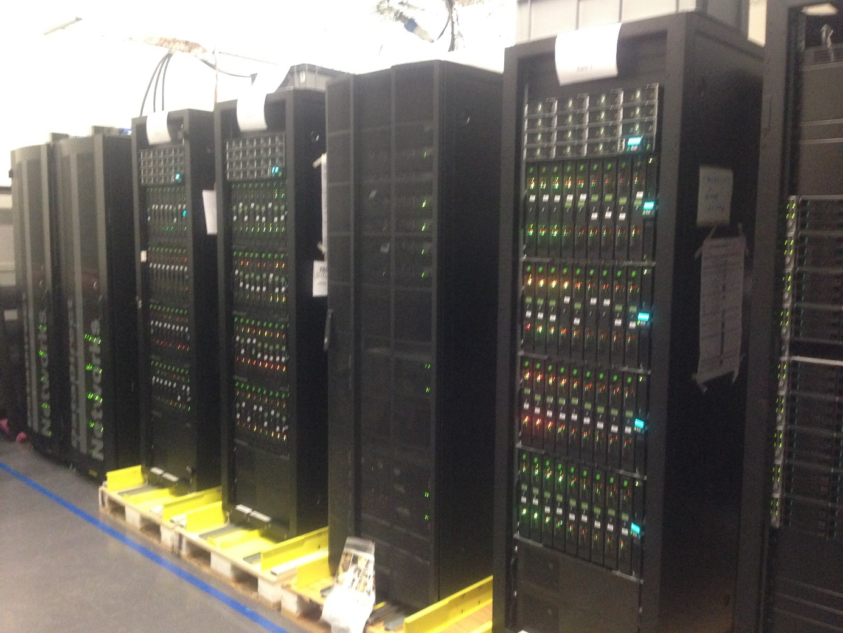
Different components
More than 8000 cores for calculation and
peak power of the order 350 Teraflops

Slide 9
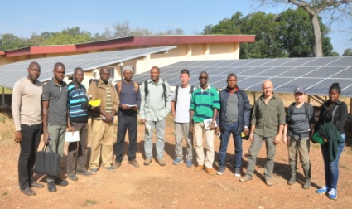
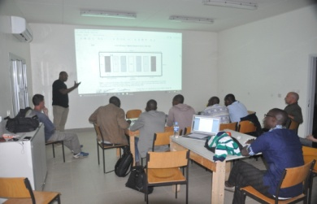
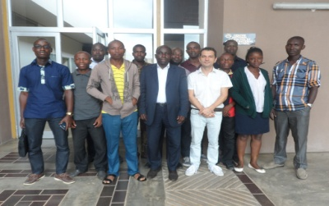
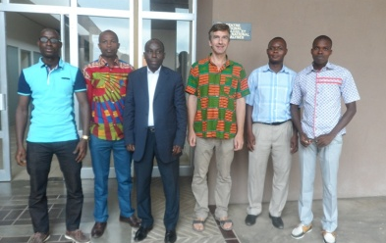
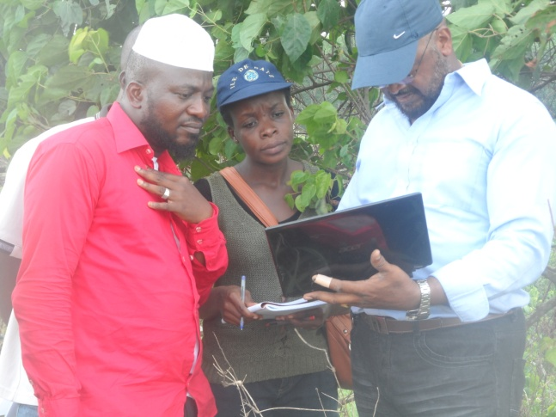
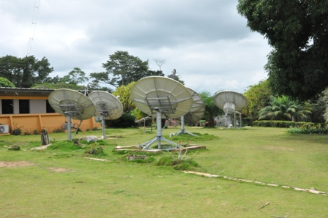
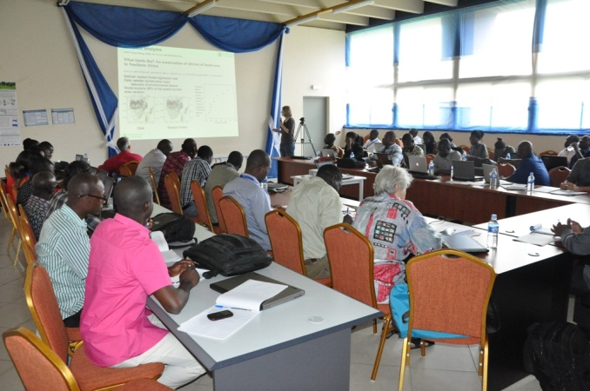
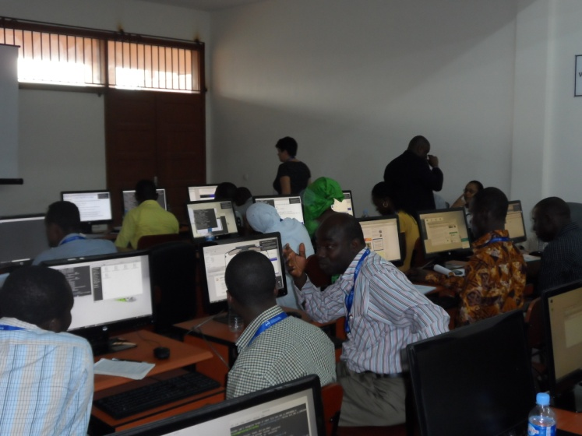
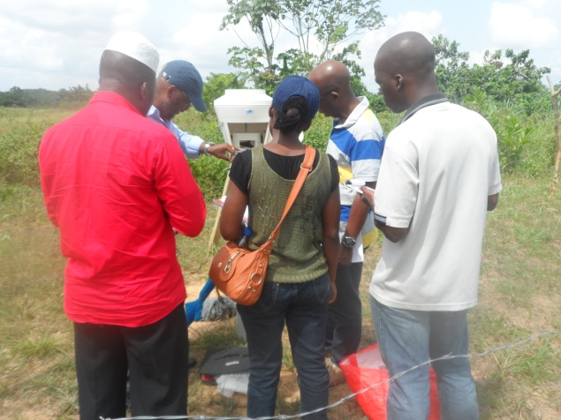
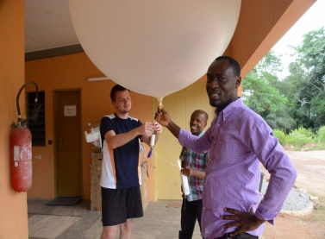
Some activities of the First Promotion in image

Slide 10
Merci pour votre aimable attention

