Slide 1
CENTRE D’EXCELLENCE AFRICAIN EN MATHEMATIQUES, INFORMATIQUE & TIC (CEA-MITIC) Accra, 18 mai 2016
Pr Moussa LO, email : moussa.lo@ugb.edu.sn

Slide 2
AFRICAN CENTRE OF EXCELLENCE IN MATHEMATICS, COMPUTER SCIENCE and ICT
Pr. Moussa LO
5th ACE WORKSHOP Accra, 16-20 May 2016
http://www.ceamitic.sn

Slide 3
Center Team in Accra
Pr Baydallaye KANE, Rector (VC)
Pr Moussa LO, Center Leader
Pr Amadou S. H. MAIGA, Deputy Leader
Mme Ndeye Aminata Diagne SY, Monitoring & Evaluation
M. Ibrahima NDIAYE, Financial Management
M. Mame Mor DIOP, Procurement
M. Taib FALL, Students monitoring and Partnership
http://www.ceamitic.sn

Slide 4
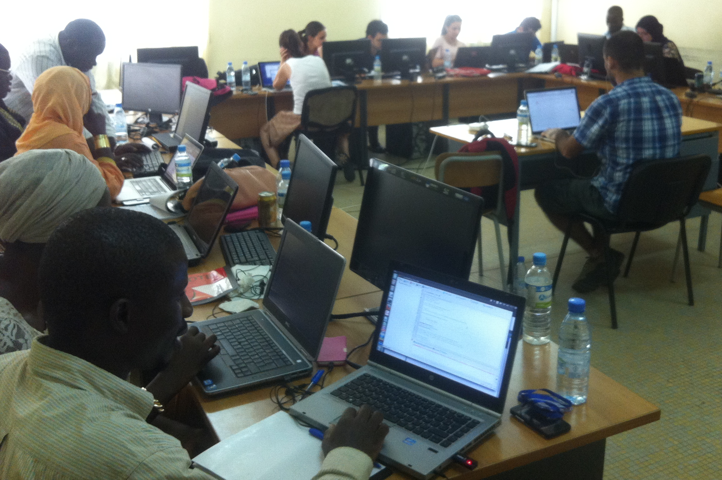
CEA-MITIC : General objective
Change the jobs access dynamics by achieving education and connecting all stakeholders customers and service providers in the fields of mathematics, computer science and ICT.

Slide 5
CEA-MITIC : Specific objectives
Contribute to increase the number and level of Master and PhD curriculums in Maths, Computer Science and ICT
Challenge : Train more students and better training quality
➔Produce innovative technologies locally through research.
5

Slide 6
CEA-MITIC : Program Activities and their DLR for the DLI 2.6 and results on private sector.

Slide 7
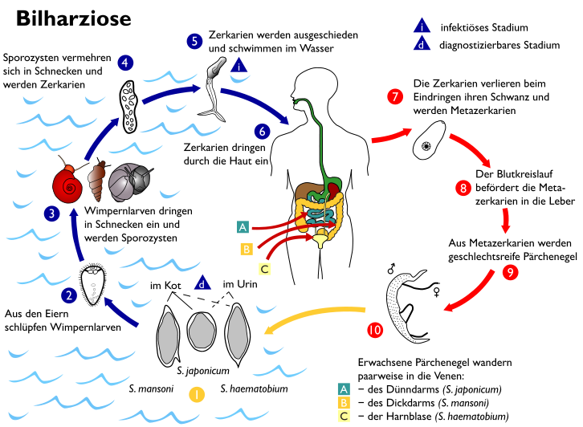
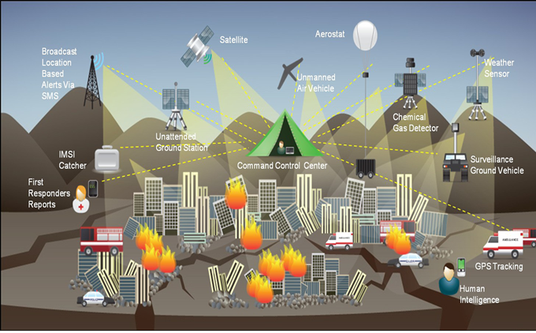
CEA-MITIC Priority Research Topics
Secured Network and Systems with Mobility
(Networking, Security, WSN, IoT, Remote Sensing)
Complex Systems Modelling
(Health, Environment, Epidemiology)
* Images are copyrighted by their owners

Slide 8
Research- Published Articles – DLR 2.6 - Statistics & Proba
TITLE | NAME OF JOURNAL | AUTHORS
Retarded evolution systems driven by fractional Brownian motion with Hurst parameter H>1/2. | Nonlinear Analysis, 97 (2014), 15–29. | Diop, Mamadou A.; Garrido-Atienza, María J.
Exponential stability for some stochastic neutral partial functional integrodifferential equations with delays and Poisson jumps. | Semigroup Forum 88 (2014), no. 3, 595–609. | Diop, Mamadou Abdoul; Ezzinbi, Khalil; Lo, Modou
Probabilistic approach to homogenization of a non-divergence form semilinear PDE with non-periodic coefficients. | Bulletin des Sciences Mathématiques 138 (2014), no. 4, 483–509 | Bahlali, K.; Diop, M. A.; Elouaflin, A.; Said, A.
Existence and exponential stability for some stochastic neutral partial functional integrodifferential equations. | Random Operator and Stochastic Equations 22 (2014), no. 2, 73–83. | Diop, Mamadou Abdoul; Ezzinbi, Khalil; Lo, Modou
Asymptotic stability of impulsive stochastic partial integrodifferential equations with delays. | Stochastics 86 (2014) | Diop, Mamadou Abdoul; Ezzinbi, Khalil; Lo, Modou
Asymptotic behavior of neutral stochastic partial functional integro-differential equations driven by a fractional Brownian motion. | Journal of Nonlinear Sciences and Applications 7 (2014), no. 6, 407–421 | Caraballo, Tomás; Diop, Mamadou Abdoul; Ndiaye, Abdoul Aziz
Fixed points and exponential stability for stochastic partial integro-differential equations with delays. | Adv. Dyn. Syst. Appl. 9 (2014), no. 2, 133–147 | Caraballo, Tomás; Diop, Mamadou Abdoul; Ndoye, Ahmet Seyni

Slide 9
Research- Published Articles – DLR 2.6 - Statistics & Proba
TITLE | NAME OF JOURNAL | AUTHORS
Existence results for time-dependent stochastic neutral functional integrodifferential equations driven by a fractional Brownian motion. | Journal of Numerics Mathematics and Stochastic 6 (2014), no. 1, 84–99 | Caraballo, T.; Diop, M. A.; Ndiaye, A. A.
Asymptotic stability of neutral stochastic functional integro-differential equations. | Electronic Communications in Probability 20 (2015) | Caraballo, Tomás; Diop, Mamadou A. Diop
Exponential behavior of solutions to stochastic integrodifferential equations with distributed delays. | Stochastic Analysis and Applications 33 (2015), no. 3, 399–412 | Caraballo, Tomás; Diop, Mamadou Abdoul; Ndiaye, Abdoul Aziz
Existence and stability for impulsive neutral stochastic integrodifferential equations with infinite delays. Gulf J. Math. | Gulf Journal of Mathematics 3 (2015), no. 3, 68–84 | Mamadou Abdoul Diop; Mahamat Mahamat Zene
Measure theory and S2-pseudo almost periodic and automorphic process: application to stochastic evolution equations. | Afrika Mathematika 26 (2015), no. 5-6, 779–812 | Diop, Mamadou Abdoul; Ezzinbi, Khalil; Mbaye, Mamadou Moustapha
Existence and global attractiveness of a pseudo almost periodic solution in p-th mean sense for stochastic evolution equation driven by a fractional Brownian motion | Stochastics, An International Journal of Probability and Stochastic Processes: formerly Stochastics and Stochastics Reports, DOI: 10.1080/17442508.2015.1026345 | Diop, Mamadou Abdoul; Ezzinbi, Khalil; Mbaye, Mamadou Moustapha
On the asymptotic stability of impulsive neutral stochastic partial integrodifferential equations with variable delays and Poisson jumps | Afrika Mathematika (2015-05-01): 1-14 , May 01, 2015 | Mamadou Abdoul Diop; Mahamat Mahamat Zene

Slide 10
Research- Published Articles – DLR 2.6 - Statistics & Proba
TITLE | NAME OF JOURNAL | AUTHORS
Nonparametric estimation of the conditional extreme-value index with random covariates and censoring | Journal of Statistical Planning and Inference, 2015 | Ndao, P., Diop, A., Dupuy, J.-F.
Simulation-based inference in a zero-inflated Bernoulli regression model. | Communications in Statistics - Simulation and Computation, 2014 | Diop, A. Diop, A. Dupuy, J.-F
Nonparametric estimation of the conditional tail index and extreme quantiles under random censoring | Computational Statistics and Data Analysis, 2014 | Ndao, P., Diop, A. and Dupuy, J.F
A mixture integer-valued GARCH model | REVSTAT-Statistical, 2014 | Diop, M.L., Diop, A. and Diongue, A.K
Consistency of a nonparametric conditional mode estimator for random fields | Statistical Methods and Applications, 2014 | Dabo-Niang, S., Ould-Abdi, S. A., Ould-Abdi, A. and Diop, A
Seasonal dynamics of Culicoides (Diptera: Ceratopogonidae) biting midges, potential vectors of African horse sickness and bluetongue viruses in the Niayes area of Senegal. | Parasit Vectors, 2014 | Diarra M, Fall M, Fall AG, Diop A, Seck MT, Garros C, Balenghien T, Allène X, Rakotoarivony I, Lancelot R, Mall I, Bakhoum MT, Dosum AM, Ndao M, Bouyer J, Guis H.
Modelling the abundances of two major Culicoides (Diptera: Ceratopogonidae) species in the Niayes area of Senegal | Plosone, 2015 | Diarra M, Fall M, Lancelot R, Diop A, Fall AG, Dicko A, Seck MT, Garros C, Balenghien T, Allène X, Rakotoarivony I, Mall I, Bakhoum MT, Ndao M, Bouyer J, Guis H.

Slide 11
Research- Published Articles – DLR 2.6 - Statistics & Proba
TITLE | NAME OF JOURNAL | AUTHORS
Culicoides (Diptera: Ceratopogonidae) midges, the vectors of African horse sickness virus - a host/vector contact study in the Niayes area of Senegal. | Parasit Vectors, 2015 | Fall M, Diarra M, Fall A.G, Balenghien T, Seck M.T, Bouyer J, Garros C, Gimonneau G, Allène X, Mall I,
Soil suitability for the production of rice, groundnut, and cassava in the peri-urban Niayes zone, Senegal | Soil & Tillage Research, 2015 | M. D. Diallo, S. A. Wood, A. Diallo, M. Mahatma-Saleh, O. Ndiaye, A. K. Tine, T. Ngamba, M. Guissé, S. Seck, A. Diop, A. Guissé
ETUDE COMPARATIVE DE LA SALINITE DE L’EAU ET DES SOLS DANS LA ZONE NORD DES NIAYES (SENEGAL) | African Crops Science Journal, 2015 | M.D. DIALLO, O. NDIAYE, M. MAHAMAT SALEH, A. TINE, A. DIOP and A. GUISSE
Influence de la décomposition de la nécro-masse des espèces végétales tropicales sur le pH et la structure génétique des communautés bactériennes d’un sol ferrugineux tropical au Sénégal | Journal of Applied Biosciences, 2015 | M. D. Diallo, M. M. Saleh, O. Ndiaye, A. Diop, A. Guisse
High Moments Jarque-Bera Tests for Arbitrary Distribution Functions | Applied Mathematics, 2015 | Gane Samb Lo, Oumar Thiam, Mohamed Cheikh Haidara
Functional Weak Laws for the Weighted Mean Losses or Gains and Applications | Applied Mathematics, 2015 | Gane Samb Lo, Serigne Touba Sall, Pape Djiby Mergane
Probabilistic, statistical and algorithmic aspects of the similarity of texts and application to Gospels comparison | Journal of Data Analysis and Information Processing, to appear | Gane Samb Lo, Soumaila dembelé

Slide 12
Research- Published Articles – DLR 2.6 - Statistics & Proba
TITLE | NAME OF JOURNAL | AUTHORS
A general strong law of large numbers and applications to associated sequences and to extreme value theory | Annales Mathematicae et Informaticae, to appear | Gane Samb Lo, Harouna Sangharé
Generalized Fractional BSDE with non Lipschitz coefficients | AfriKa Mathematica, 2015 | Sadibou Aïdara, Ahmadou Bamba Sow
Anticipated BDSDE driven by Lévy process with non Lipschitz coefficients | Random Operators and Stochastic Equations, 2015 | Sadibou Aïdara, Ahmadou Bamba Sow
Modelling Internally Displaced Persons’ (IDPs) Time to Resuming their Ancestral Homes after IDPs’ Camps in Northern Uganda Using Parametric Methods | International Journal of Science and Research, 2014 | Joseph Okello Omwonylee, Abdou Ka. Diongue, Leo Odiwuor Odongo
Parametric Models and Future Event Prediction Base on Right Censored Data | American Journal of mathematics and statistics, 2014 | Joseph Okello Omwonylee, Abdou Ka. Diongue
Modeling and Forecasting Gambia’s Inflation Rates, | International Journal of Economics and Finance, 2014 | Joseph Okello Omwonylee, Abdou Ka. Diongue, Leo Odiwuor Odongo
Estimation for seasonal fractional ARIMA with stable innovations via the empirical characteristic function method | Statistics, 2015 | Mor Ndongo, Abdou Kâ Diongue, Aliou Diop, Simplice Dossou-Gbete
Analysis of missing data in sero-epidemiological study | African Journal of Applied Statistic, 2015 | Oumy Niass, Abdou Ka Diongue, Aissatou Touré
A general strong law of large numbers and applications to associated sequences and to extreme value theory | Annales Mathematicae et Informaticae, to appear | Gane Samb Lo, Harouna Sangharé
5

Slide 13
Research- Published Articles – DLR 2.6 - Mathematics
TITLE | NAME OF JOURNAL | AUTHORS
A path convergence theorem and construction of fixed points for nonexpansive mappings in certain Banach spaces | Carpathian Journal of Mathematics, 2015 | T.M. M. Sow, N. Djitté and C.E. Chidume
Strong convergence theorems for a common fixed point of finite family of multivalued mappings in certain Banach spaces | Int. Journal of Math. Anal., 2015 | T.M. M. Sow, M. Sene, and N. Djitté
Approximation of common fixed point of a finite family of multivalued mappings | Pacific Journal of Optimization, 2015 | C. Diop, M. Sene, N. Djitté,
Iterative algorithm for zeros of multivalued accretive operators in certain Banach spaces | Afrika Matematika, 2015 | C.E. Chidume, N. Djitte, M sene
Iterative algorithms for a finite family of multivalued quasi-nonexpansive mappings | Advances in Numerical Analysis, 2014 | M. Sene, C. Diop and N. Djitté,
A Krasnoselkii type algorithm approximating a common fixed point of a finite family of multivalued strictly pseudo-contractive mappings in Hilber spaces | J. Maths. Sci. Adv. Appl., 2014 | M. Sene, P. Faye and N. Djitté,
Iterative algorithm for fixed points of multi-valued pseudo-contractive mappings in Banach spaces | Journal of Nonlinear and Convex Analysis, 2014 | C.O. Chidume, N.Djitte & M.S. Minjirbir
Strongly Hopfian and Strongly Cohopfian Objects in the Category of Complexes of Left A-Modules, | Journal Of Mathematics Research, vol. 6, No. 3, 2015 | El H. O. Diallo, M. Ben MAAOUIA and M. SANGHARE
Graduation of module of fraction on a graded domain ring not necessarily commutative" | International Journal of Algebra, 2015 | A. OULD CHBIH, M. BEN MAAOUIA and M. SANGHARE
5

Slide 14
Research- Published Articles – DLR 2.6 - Computer science
TITLE | NAME OF JOURNAL | AUTHORS
Contextual preference mining for user profile construction | Information Systems (2015), pp. 182-199 | Sandra de Amo, M. S. Diallo, C. T. Diop, A. Giacometti, D. Li, A. Soulet
Greedy Algorithms for Target Coverage Lifetime Management Problem in Wireless Sensor Networks, | International Journal of Control and Automation (IJCA), vol. 8, no. 2, pp. 232-250, 2015 | B. Diop, D. Diongue and O. Thiare
An Energy Efficient Self-Healing Mechanism for Long Life Wireless Sensor Net- works | Lectures Notes in Electrical Engineering (LNEE), vol. 313, pp. 599-605, Springer- Verlag, 2015 | Dame Diongue and Ousmane Thiare
Découverte de motifs fréquents guidée par une ontologie | Revue ARIMA, Numéro spécial CNRIA’2015, A paraître | Y. Traore, C. T. Diop, M. Sadouanouan, M. Lo and S. Ouaro
Construction d'une ontologie de domaine et d'une ontologie des processus de la propagation des maladies infectieuses. | Revue d'Intelligence Artificielle 28(2-3): 167-190, 2014 | G. Camara, S. Desprès, M. Lo, R. Djedidi
Formalisation des processus de la veille épidémiologique des maladies infectieuses. | Revue d'Intelligence Artificielle 29(3-4): 399-423 (2015) | G. Camara, S. Desprès, M. Lo
Real-world Deployment of a Smart and Green Wireless Sensor Network for Intrusion Detection | IJCSI International Journal of Computer Science Issues, Volume 12, Issue 6, November 2015, | Maïssa Mbaye, Mohamed Aymen Chalouf, Francine Krief and Martin Peres
Building a Schistosomiasis Process Ontology for an Epidemiological Monitoring System. | Recent Advances in Knowledge Engineering: Paradigms and Applications, Innovations in Intelligent Machines (4),Volume 514, pp 75-99 C. and Jain, L. Eds., Springer-Verlag, 2014. | G. Camara, S. Despres, R. Djedidi, M. Lo
Towards an Ontology-Based Framework for Data Integration: Application to Agriculture and Health Domains in Senegal | Computing in Research and Development in Africa : Benefits, Trends, Challenges and Solutions, pp 41-57, Springer International Publishing, 2015. | M. Lo, G. Camara, C. A. T. Niang, S. M. Ndiaye, O. Sall
Une approche à base d’agents particule pour les processus biologiques d’agrégation | "Modéliser & simuler. Epistémologies et pratiques de la modélisation et de la simulation", tome 2, Paris, Editions Matériologiques, 2014. pp. 665-685. | Dembele, J.M., Cambier, C.
5

Slide 15
Research- Published Articles – DLR 2.6 - Computer science
TITLE | NAME OF JOURNAL | AUTHORS
Autonomic Management using Self-Stabilization for Hierarchical and Distributed Middleware | IEEE International Conference on Dependable, Autonomic and Secure Computing (IEEE/DASC 2015) | M. D. Faye, Eddy Caron and O. Thiare
Handling Voice in LTE | IEEE International Conference on Computer, Communication, and Control Technology (IEEE/I4CT 2015) | A. A. El Arby and Ousmane Thiare,
Managing Target Coverage Lifetime in Wireless Sensor Networks with Greedy Set Cover | IEEE International Conference on Multimedia, Computer Graphics and Broadcasting (IEEE/MulGraB 2014) | Babacar Diop, Dame Diongue and Ousmane Thiare
Target Coverage Management in Wireless Sensor Networks | IEEE International Conference on Wireless Sensors (IEEE/ICWiSE 2014) | Babacar Diop, Dame Diongue and Ousmane Thiare
A Weight-based Greedy Algorithm for Target Coverage Problem in Wireless Sensor Networks | IEEE International Conference on Computer, Communication, and Control Technology (IEEE/I4CT 2014) | Babacar Diop, Dame Diongue and Ousmane Thiare
An Hybrid Scheduling Algorithm for Wireless Sensor Networks | IEEE International Conference on Computer Communication and Informatics (IEEE/ICCCI 2014), | Dame Diongue and Ousmane Thiare
A Cloud-based Architecture for Network Attack Signature Learning | IEEE COMSOC & IFIP TC6.5 WG Conference, NTMS 2015 on New technologies Network and Security, 2015 | Omessaad Hamd, Maïssa Mbaye, Francine Krief
Vers un système iconique d’aide à la décision pour les praticiens de la médecine traditionnelle | 13th African Conference on Research in Computer Science and Applied Mathematics (CARI 2016), to appear | A. KOUAME, K. M. BROU, M. LO, J. B. LAMY
An agent-particle on GPU for deterministic convection-diffusion. | IEEE 2nd World Conference on complex systems (WCCS14). ISBN: 978-1-4799-4648-8. pp 575 - 580. | Ka, C. O., Cambier, C., Dembele, J.M., Lo, M.
Multi-Agent Simulation of Water Contact's Patterns in relation to Schistosomiasis A BDI Architecture Using Kernel Functions. | IEEE 2nd World Conference on complex systems (WCCS14). ISBN:978-1-4799-4648-8. pp 536 – 541. | Cissé, P. A., Dembele, J.M., Cambier, C., Lo, M.,
5

Slide 16
Research- Published Articles – DLR 2.6 - Engineering
TITLE | NAME OF JOURNAL | AUTHORS
Diachronic Monitoring of Surface Energy Fluxes by Remote Detection in the Northen-est of Niger National W Park | Journal of Engineering Research and Technology, 1(4) , 143-149 | H. Arouna Saley, O. Diop, A. S. Maiga
Thinning the active layer of TFTs. | ECS Transactions, 64 (10) 9-16 | M.L. Samb, H. Dong, E. Jacques, G. Sissoko, A. Seidou-Maiga, T. Mohammed- Brahim
Antireflection Coatings Combining Silicon Nitride with Silicon Nanoparticles | Journal of Engineering Research and Technology, 1(2), 72-78 | M. Beye, F. Ndiaye, and A. S. Maiga
Modelling of polyccrytalline photovoltaic module based on climatic conditions in Niger. | ICCMREA | Fatou NDIAYE, Moustapha SENE, Amadou S. MAIGA , Modou BEYE
Effects of climatic conditions on a polycrystalline photovoltaic module in Niger | International Letters of Chemistry, Physics and Astronomy Vol. 55 pp 60-66 | Fatou NDIAYE, Moustapha SENE, Amadou S. MAIGA , Modou BEYE
5

Slide 17
Private Sector and non-academic structures partners
Ministère en charge des TIC
CENTRE DE SUIVI ECOLOGIQUE (CSE)
Hopital le Dantec de Dakar
Hopital Régional de Saint-Louis

Slide 18
Research activities with Private Sector and non-academic structures
Hopital le Dantec
CENTRE DE SUIVI ECOLOGIQUE (CSE)
Research activities :
Modélisation mathématique de l’acquisition de l’immunité du paludisme et l’impact des interventions
Etude de l’effet des protocoles d’intervention sur le paludisme
Modélisation de la rage
Impact du climat sur l’agriculture
Results :
Research school in BioInformatique with IPD at UGB, September 2016, 13 Ph D students in short-course term

Slide 19
Research activities with Private Sector and non-academic structures
Hopital le Dantec
CENTRE DE SUIVI ECOLOGIQUE (CSE)
Results (cont.):
Ph D thesis co-supervised in progress
Oumy Niass, Modélisation mathématique de l'acquisition de l'immunité du paludisme et l'impact des interventions dans le contexte Dielmo-Ndiop; Encadrement Pr Aliou DIOP (UGB) et Aissatou Touré (IPD). Soutenance prévue en 2016.
Cheikh Talla, Modélisation de la dynamique spatio-temporelle de l’abondance des deux principaux vecteurs de la fièvre de la vallée du Rift à Barkédji. Encadrement Pr Aliou DIOP (UGB) et Dr Mawlouth Diallo (IPD). Soutenanvce prévue en Juillet 2016.
Co-Publications
Soil suitability for the production of rice, groundnut, and cassava in the peri-urban Niayes zone, Senegal | Soil & Tillage Research, 2015 | M. D. Diallo, S. A. Wood, A. Diallo, M. Mahatma-Saleh, O. Ndiaye, A. K. Tine, T. Ngamba, M. Guissé, S. Seck, A. Diop, A. Guissé
ETUDE COMPARATIVE DE LA SALINITE DE L’EAU ET DES SOLS DANS LA ZONE NORD DES NIAYES (SENEGAL) | African Crops Science Journal, 2015 | M.D. DIALLO, O. NDIAYE, M. MAHAMAT SALEH, A. TINE, A. DIOP and A. GUISSE
Influence de la décomposition de la nécro-masse des espèces végétales tropicales sur le pH et la structure génétique des communautés bactériennes d’un sol ferrugineux tropical au Sénégal | Journal of Applied Biosciences, 2015 | M. D. Diallo, M. M. Saleh, O. Ndiaye, A. Diop, A. Guisse

Slide 20
On going research projects with Private Sector and non-academic structures
Apport de la télédétection et la modélisation à l’estimation superficies cultivées et des rendements agricoles pour une meilleure évaluation de la vulnérabilité du système agricole dans le contexte des changements climatiques.
Partenaires : Centre de Suivi Ecologique, ANACIM, UGB
Une plateforme de simulation à base d'agents pour sensibilisation dans le cadre du contrôle et de la prévention de la propagation d'une épidémie : cas de la méningite au Burkina Faso.
Partenaires : Université Polytechnique de Bobo, Université de Ouagadougou, Centre de recherche en santé de Nouna, Université Gaston Berger, Université Alioune Diop de Bambey
SIMENS Système d’Information Medical National pour le Sénégal.
Partenaires : Centre Hospitalier Régional de Saint-Louis, Polyclinique de l’UGB, Centre de recherche et de prise en charge ambulatoire de la drépanocytose (CERPAD) / Fondation Pierre Fabre
WAZIUP Open Innovation Platform for IOT-Big Data in Sub-Saharan Africa
Partenaires : Université Gaston Berger, Easy Global Market SAS, Université de Pau, Unparallel Innovation LDA, Innotec21 GMBH, Coders4Africa Senegal, CTIC Dakar, Université Polytechnique de Bobo Dioulasso, Ispace Foundation, Farmerline Ltd, L'Africaine D'architecture

Slide 21
Main Programming Challenges
Accreditation
National accreditation is on going
Manifestation of interest for HCERES accreditation
More research activities with private sector and technology transfert
encourage collaboration between academics and non academic (particularly private sector) to propose joint research programs
develop innovative projects (Ex.: « Saint-Louis numerique 2025 »)
Revenue generation
students scholarships
competitive research funding
funds from private sector

Slide 22
Main Program Management Challenges
Financial management software (tom-pro) acquisition
How manage the financial aspects for research projects leaded by foreign partners ?
Get next (second) disbursement ?

Slide 23
Main Goal/Hope for the next meeting
Start the new New Interuniversity Master Programs
Succeed DLI 2.8
National accreditation for 2 Master (ANAQ-SUP) and start the international HCERES accreditation

Slide 24
Thank you for your attention
Web : www.ceamitic.sn
Email : ceamitic@ugb.edu.sn

