Slide 1
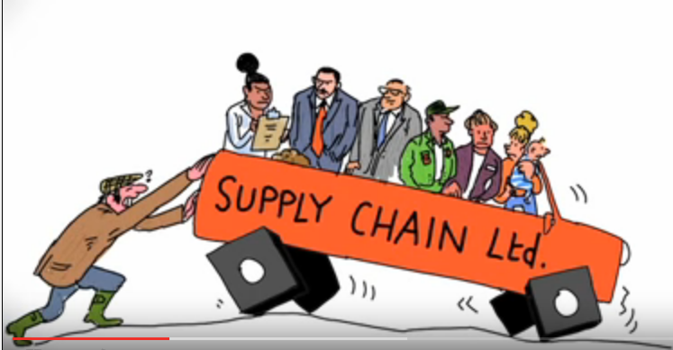
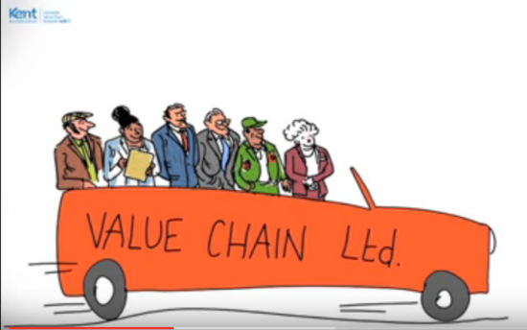
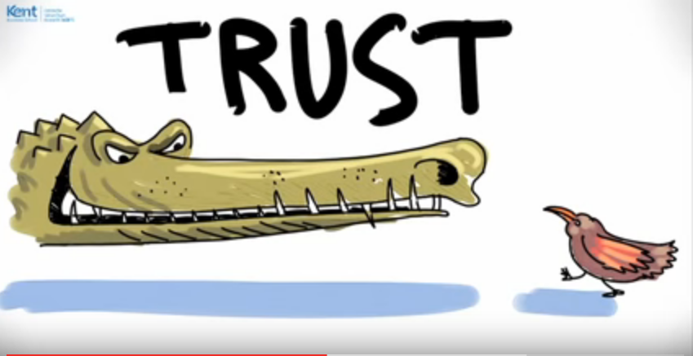
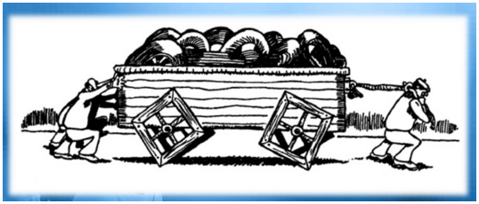
Facilitating the ACE transform Universities Group activities/Discussions Demonstrating excellent administration, education, research and outreach
R.G. Wahome

Slide 2
Group One: Becoming Smarter ACEs
Adhering to the IP
Governance arrangements
Activities Budgets lines and times
Timely delivery and reporting of results: Have the planned results to date been achieved?
Internal, Local and international accreditation
Achieving excellence
New attitudes
New practices
New hopes
On-line reporting?

Slide 3
Group 2: Working and fruitful Partnerships
Beyond MoUs and agreements
ACE ambitions and aspirations
Inclusivity
Responsibilities in decision making, implementation and spending
Partnerships gains (especially industrial partners: Can you demonstrate what each partner has gained in the year (Cost-benefit matrix)?
Have all planned target groups access to / using project results/services available so far?

Slide 4
Group three: Agricultural growth and productivity
New products: not just programmes
Innovations/patents/copyrights
To do what?
For who?
New Jobs and New money
For who?
Have all planned target groups access to / using project results/services available so far?

Slide 5
Group Four: WAACEs Working Together
Integrated view of specific niches
Who is doing what? Who can benefit from who?
Coordinated and Joint symposia, forums, open days etc
Joint communiqué and press releases
Joint adverts
What else can we do together

Slide 6
Group Five: ACEs will Deliver Education Excellence
Desired degree and short-term training
Needs determination
Programming, tracking and achieving timely completion
Managing supervision relationships
Outreach and inreach

