Slide 1


African Center of Excellence for Genomics of Infectious Disease (ACEGID)
Redeemer’s University, Ede, Osun State, Nigeria
Christian Happi, PhD

Slide 2
ACEGID Team
NAME | ROLE
Professor Christian T. Happi | Center Director
Dr. Onikepe Folarin | Deputy Center Director
Professor Isaac Komolafe | Investigator
Mrs. Adesola Okunola | Project Accountant
Mrs. Lucy Osilaja | Procurement Officer
Mrs. Banjo Adeyemi | Project Auditor

Slide 3


Education
:Mission
Project Goals
(1) Develop African research capacity in genomics by building a critical mass of well-trained scientists;
(2) Empower African researchers to utilize genomics-based tools towards the control and elimination of infectious diseases;
(3) Create genomics curricula to support and promote cutting-edge genomics-based research; and
(4) Engage communities in prevention efforts and public health education.
World Bank funded Project

Slide 4

Education
Genomics capacity
Research
Graduate-level genomics education programs
Genomics teaching and sequencing labs
Diagnostic
metagenomic studies
Diagnostics core facility
Sample collection networks
On-site training workshops
Partnered training programs
Sustainable science careers
Bioinformatics

Slide 5

Human, Health, and Hereditary (H3) Africa-funded Project
Research
Characterizing Fevers of Unknown Origin through Microbial Metagenomics
Project goals:
Use field-deployed and state-of-the-art genomic technology to identify pathogens driving febrile illness.
Create a foundation for African scientists to carry out tractable and important genetic research projects entirely in country

Slide 6

The Next Generation: African Pathogen/Microbes Hunters

Slide 7
ACEGID: Achievements

Slide 8
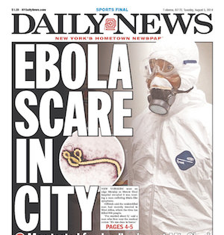
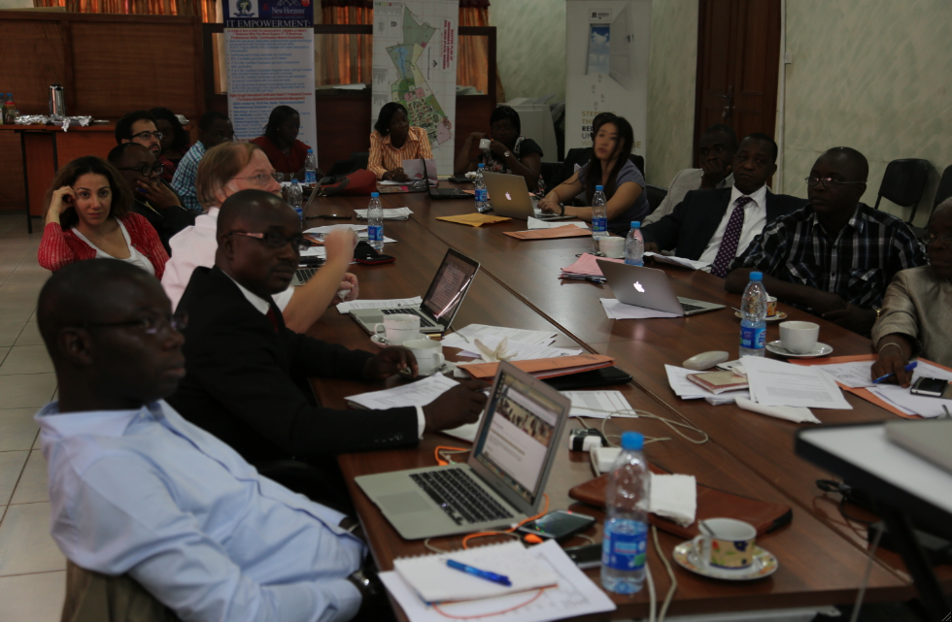
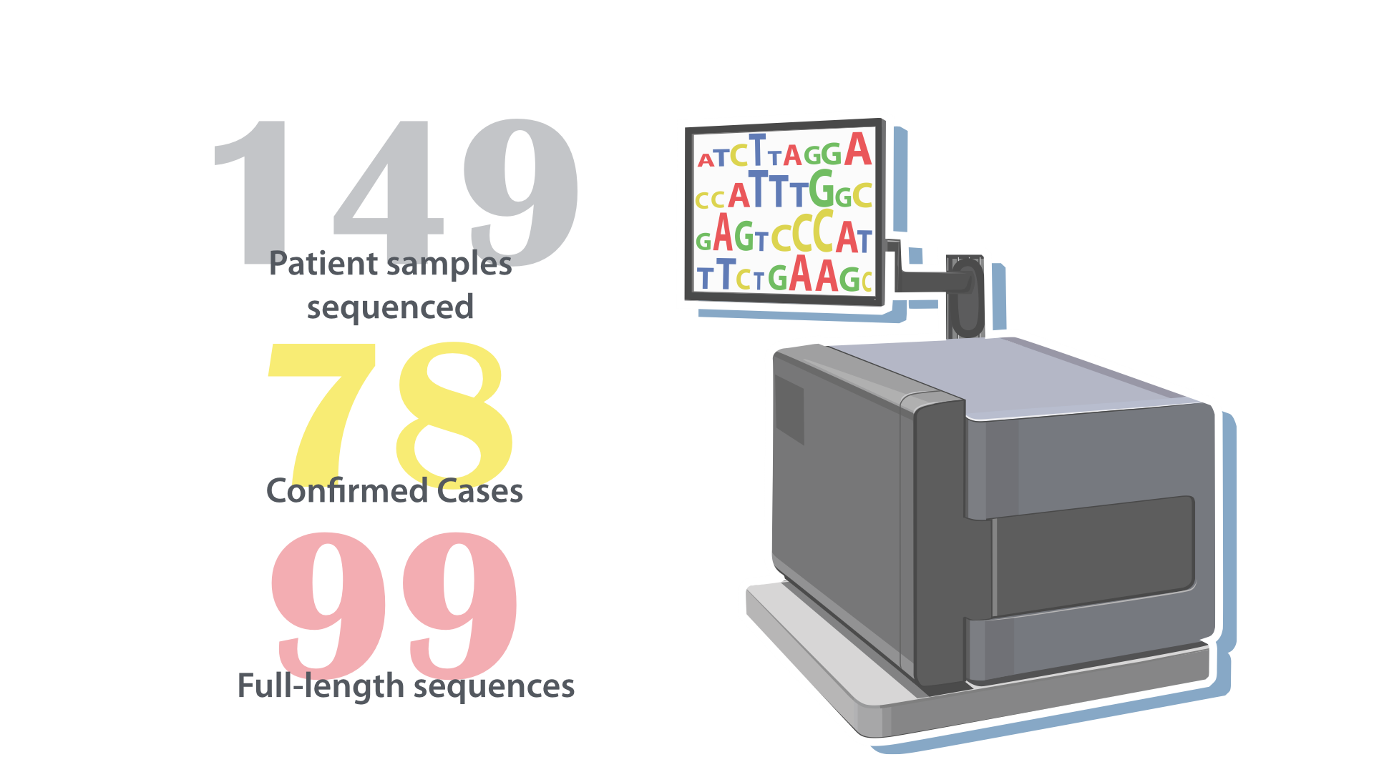
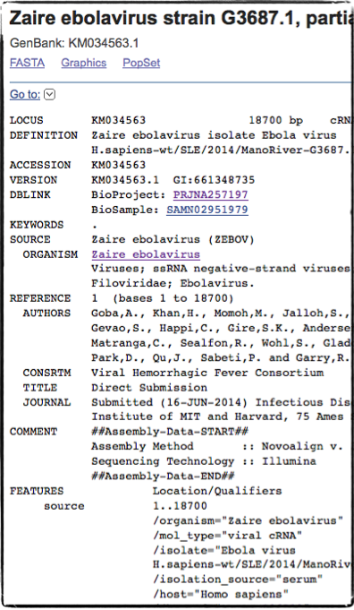
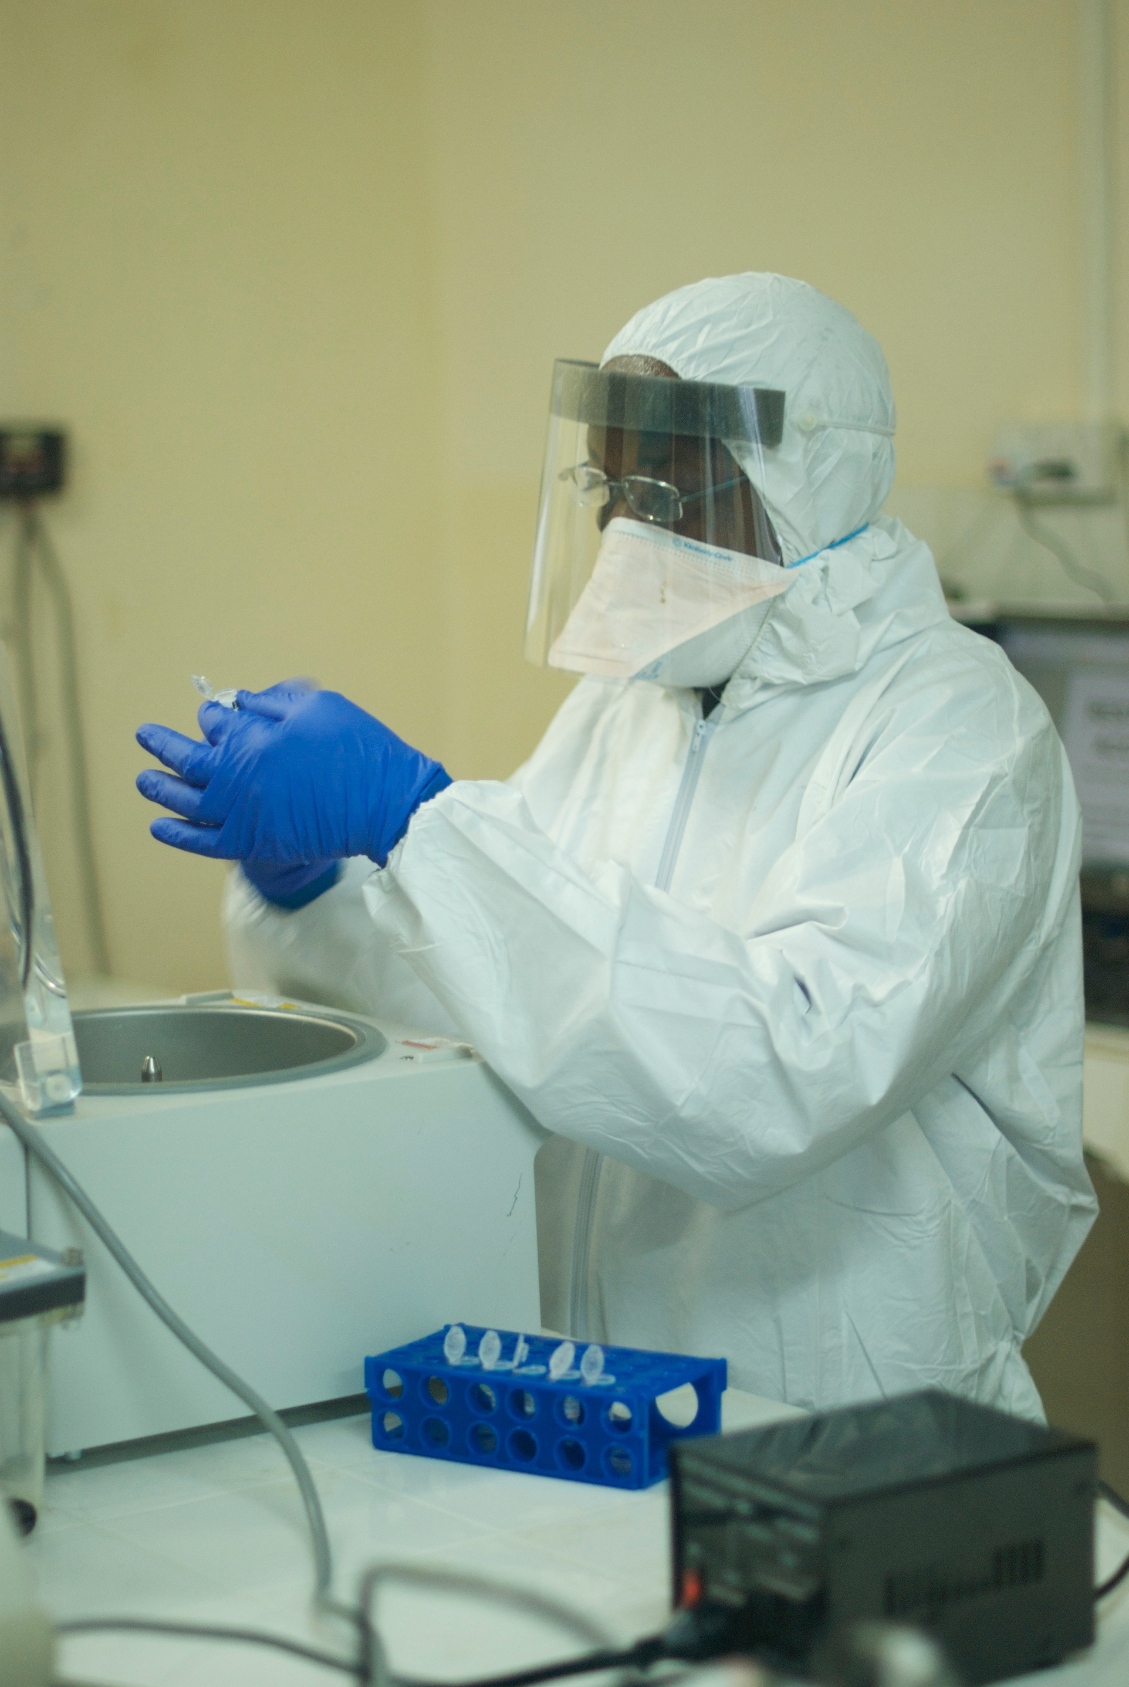
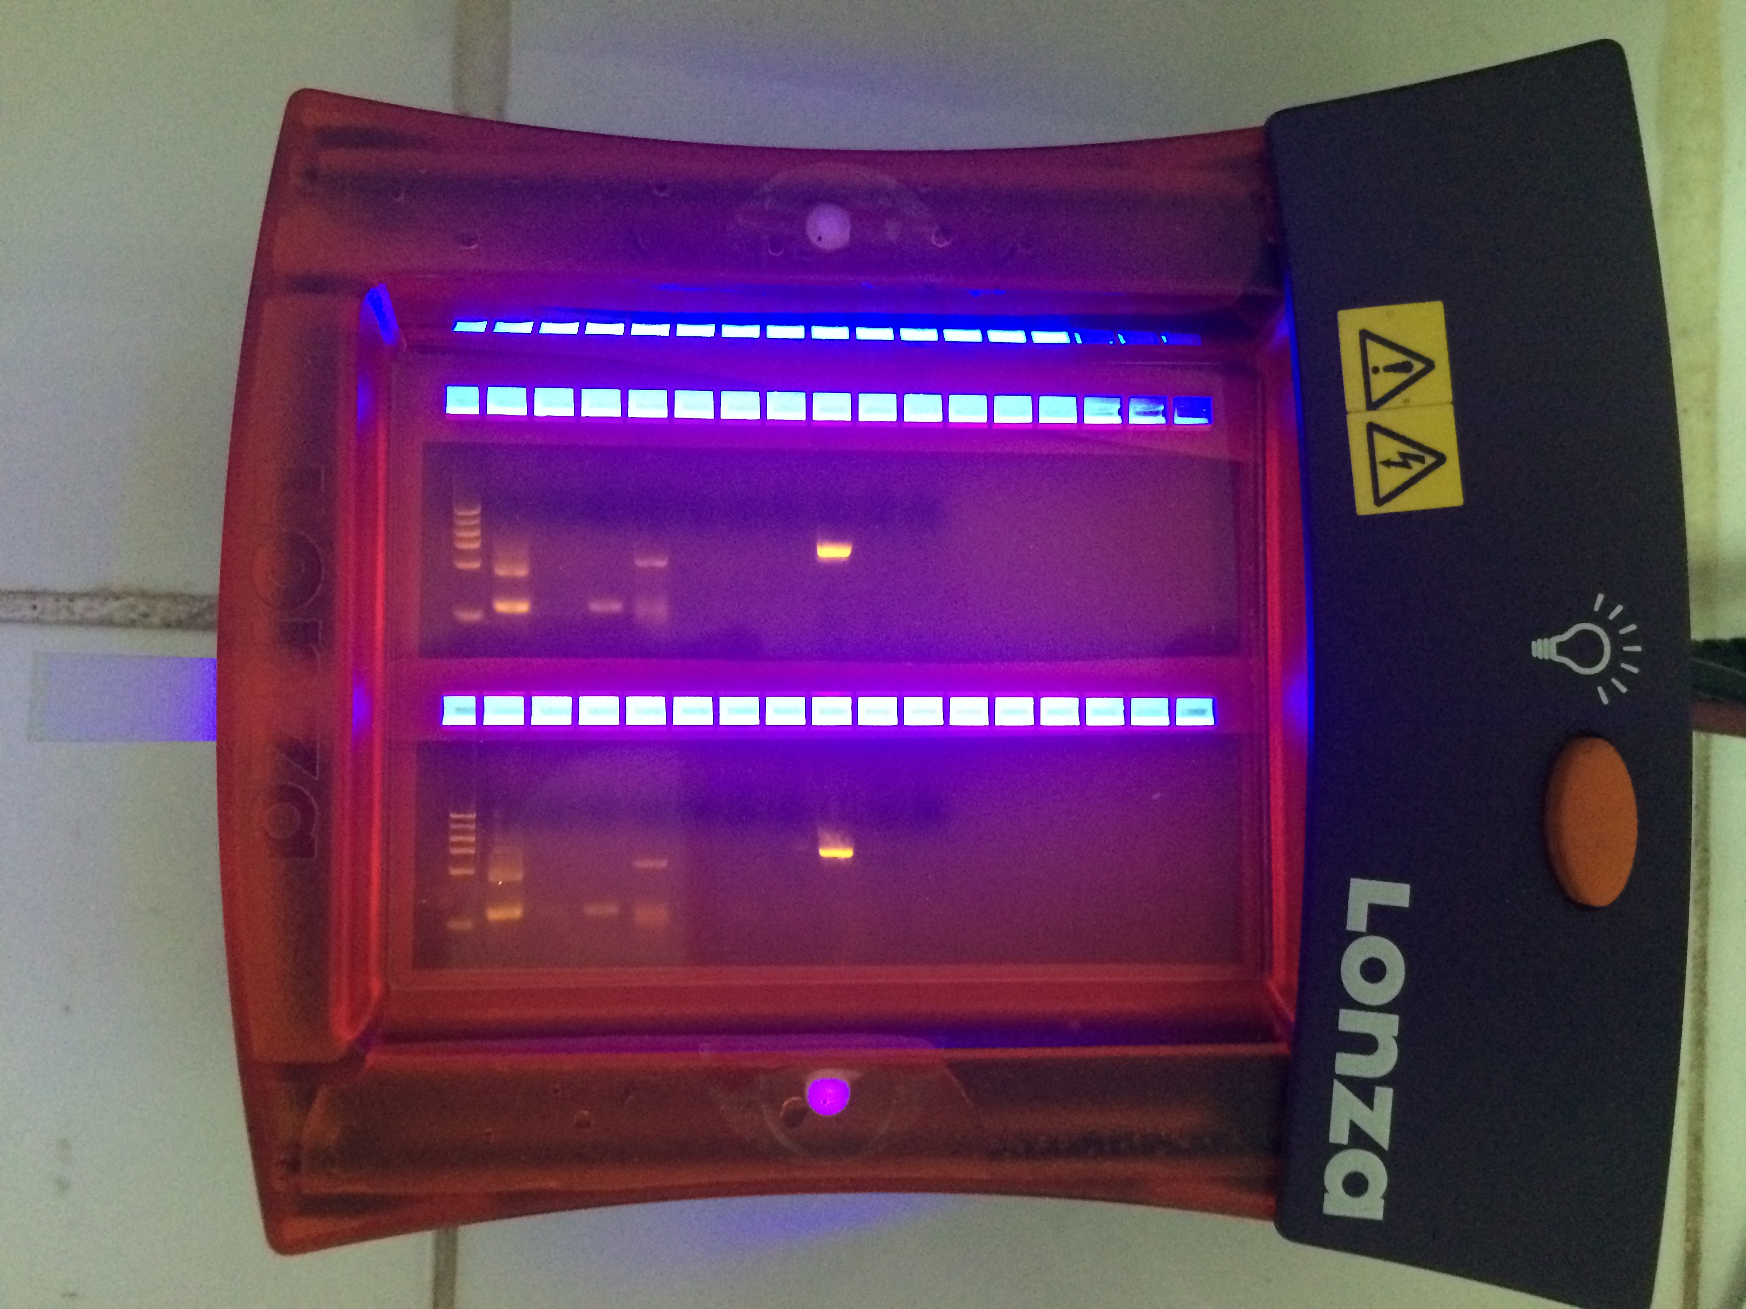
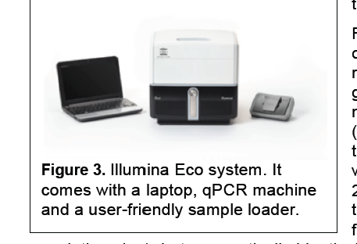
THE 2014 EBOLA VIRUS DISEASE OUTBREAK
99 genomes publicly available
March 2014
April
May
June
Surveillance SL and Nig
First Diagnosis in Nigeria
Provided tools and training for diagnosis and sequencing
Released another 150 genomes
First Diagnosis in Sierra Leone
Notes:
Given the great capacity work we had done over the years, we were not only positioned but the best individuals locally in Nigeria and Sierra Leone to handle a possible incursion. Within 4 days our team was in West Africa and in weeks had established surveillance in Sierra Leone and Nigeria supporting the teams there in diagnosis.
In May our team member Augustine Goba diagnosed first case of Ebola in Sierra Leone. With a strong feeling that we must share data and work collaboratively, within weeks we publicly made available 99 genomes of the Ebola virus.
Soon after our collaborator Christian Happi diagnosed first case in Nigeria. We have provided tools and training for sequencing to many organizations and released another hundred and released another 150 genomes.

Slide 9
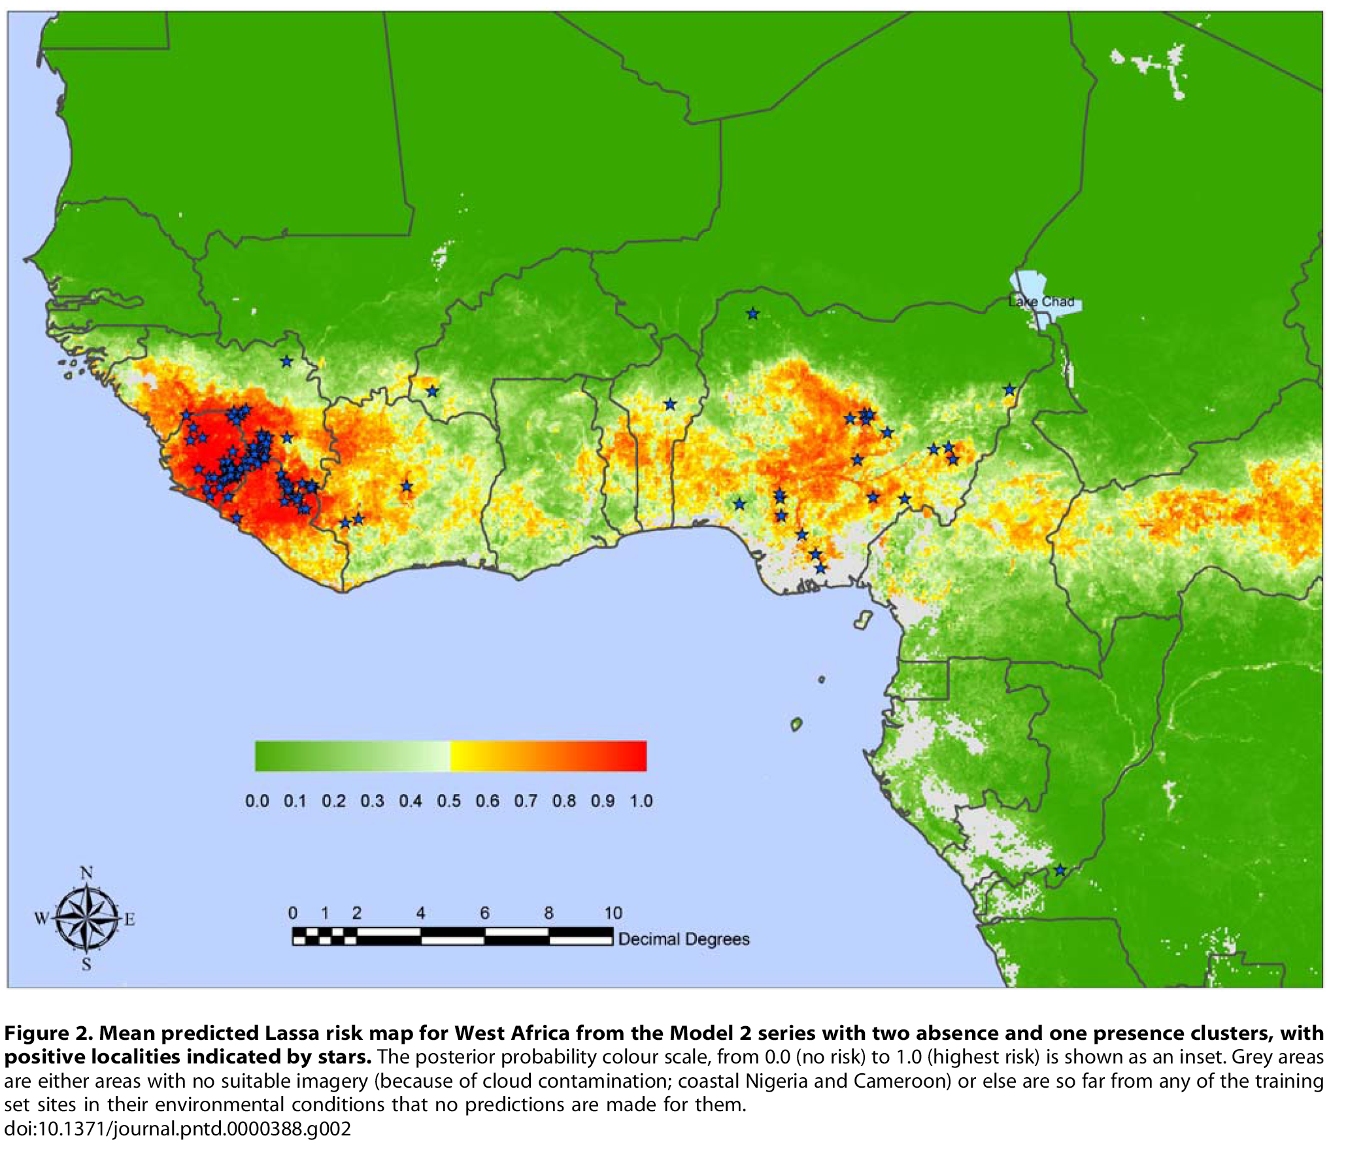
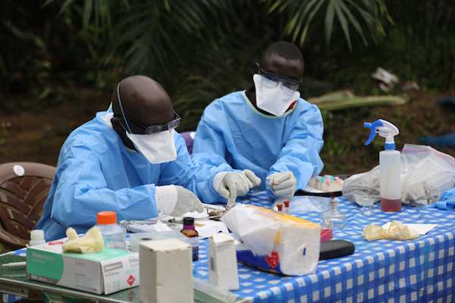
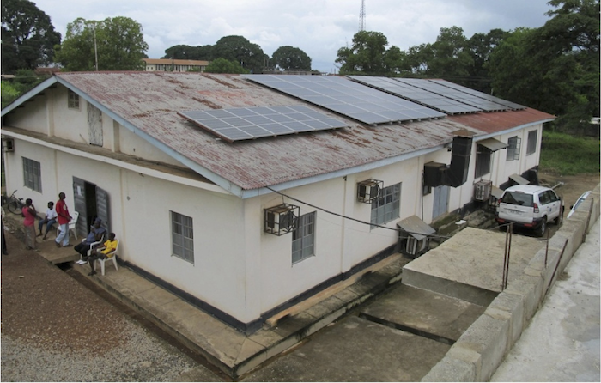
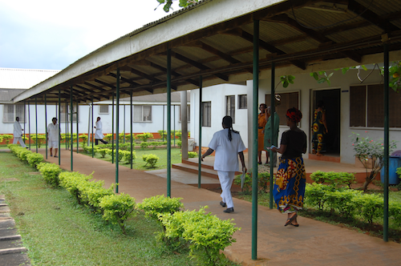
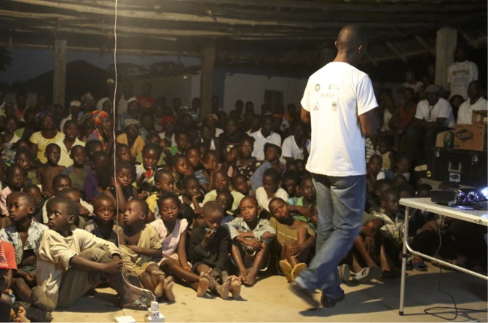
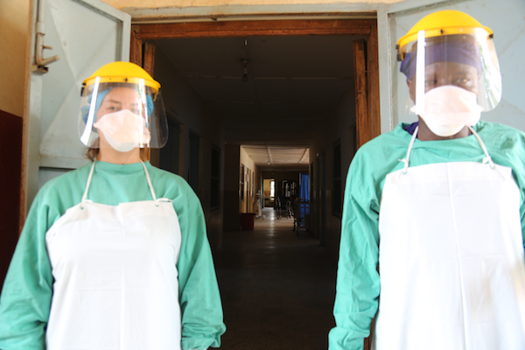
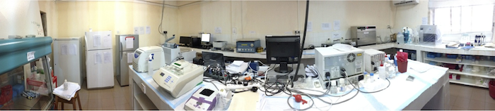
We had developed the capacity to study a BL4 pathogen
in rural field settings (Nigeria & Sierra Leone)

Slide 10
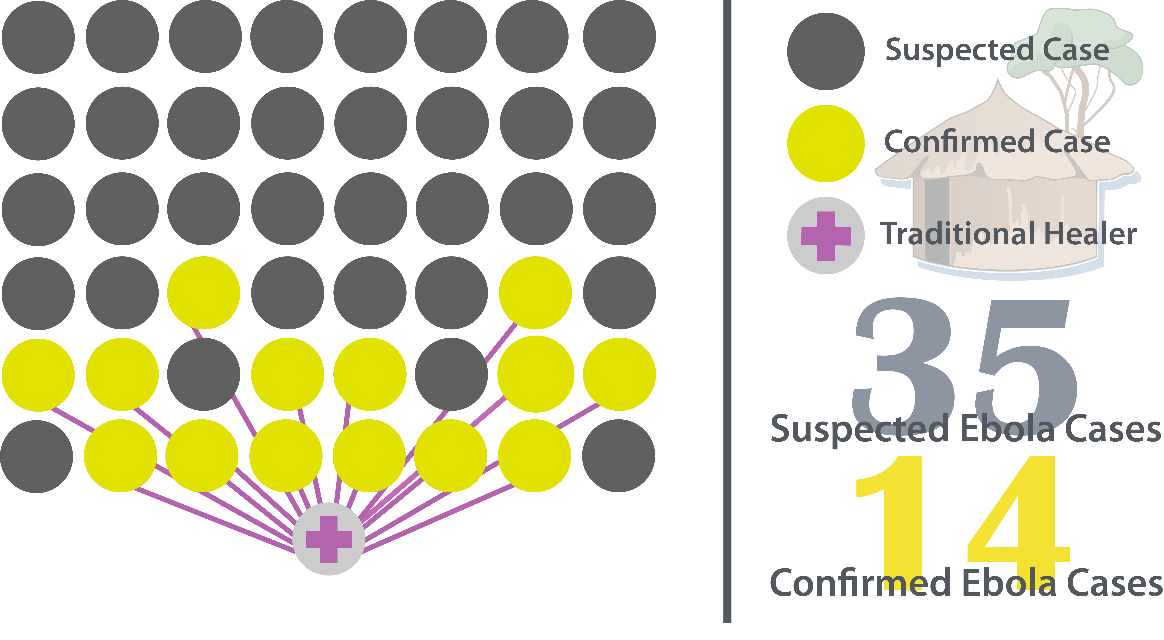
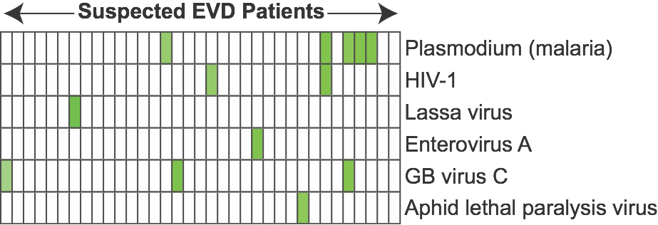
Ebola samples were rapidly sequenced in summer 2014
First large-scale genome sequence-based analysis of the circulating Ebola viral population
Gire et al., Science 345 (2014)
Notes:
Early insights – July 2014
Sustained human-to-human transmission
Initial entry of two viral lineages into Sierra Leone
Impact of diagnostics
Communicated preliminary findings with SL health leaders

Slide 11
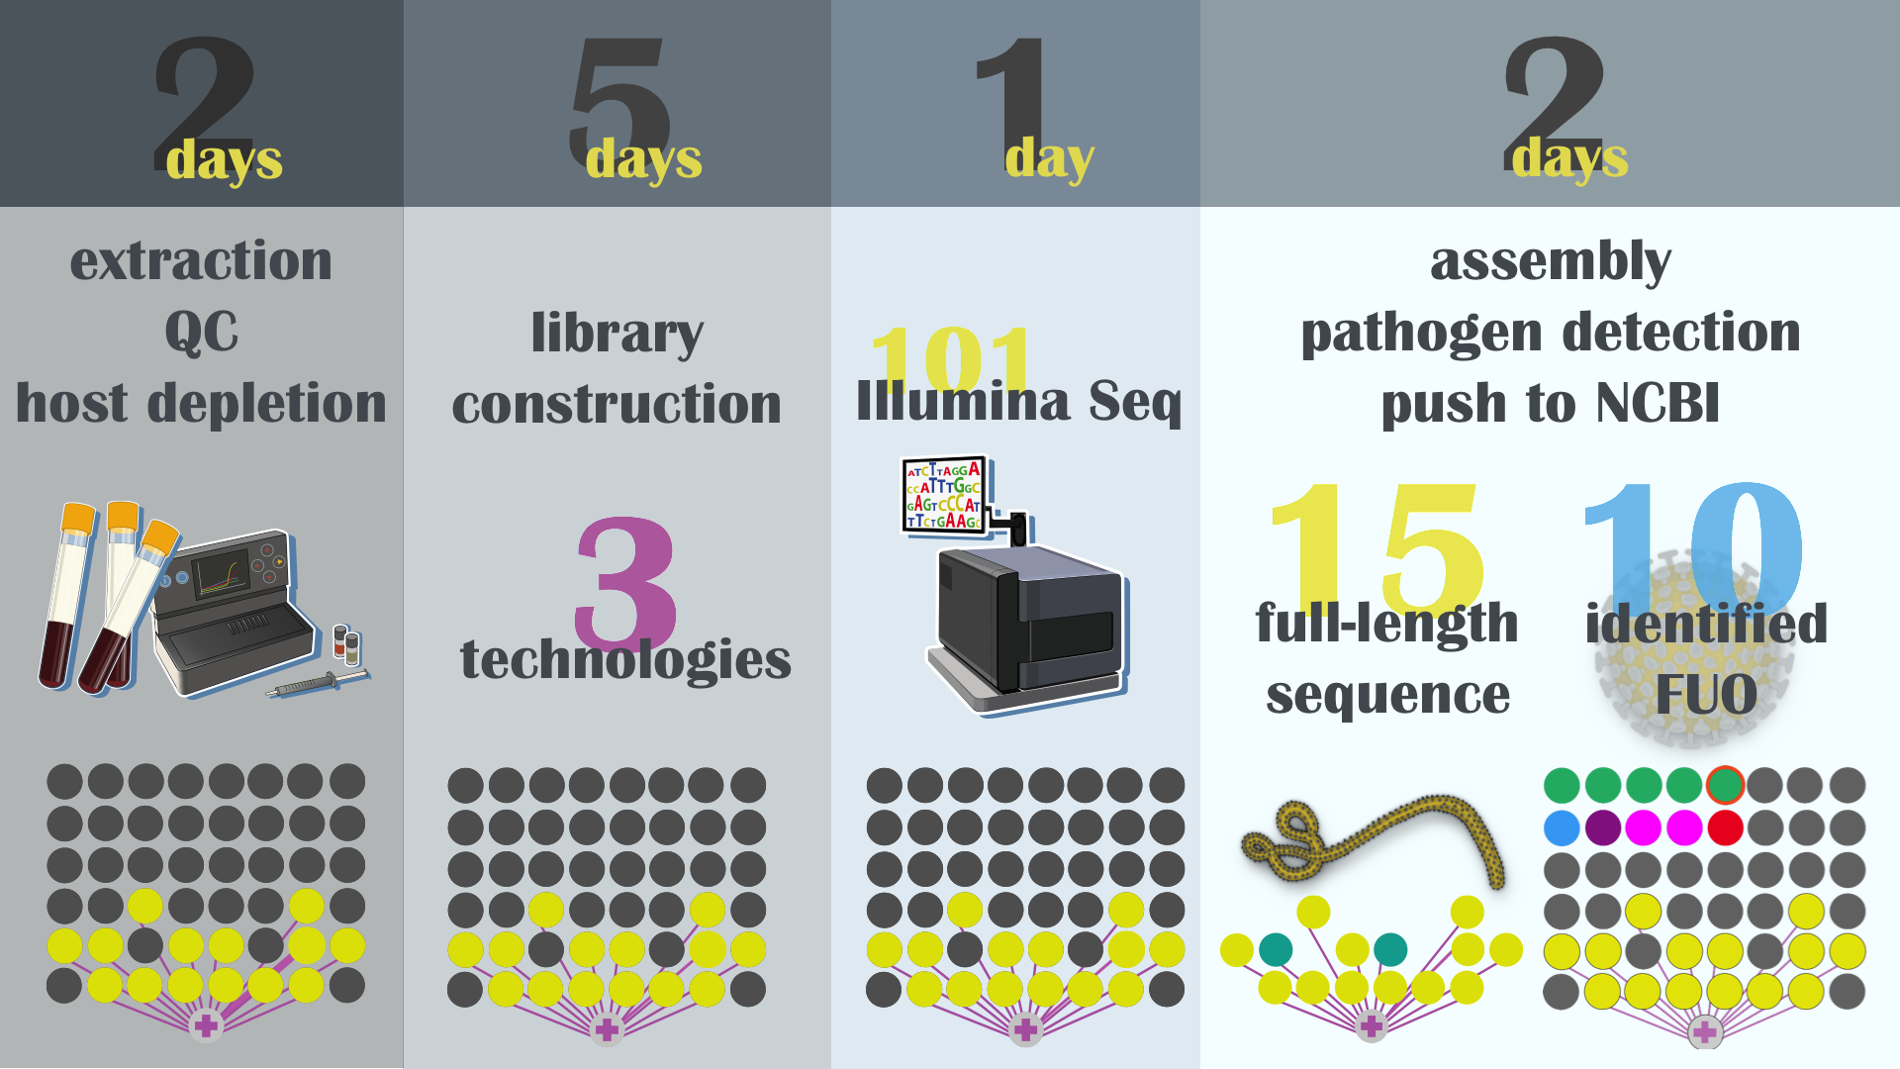

The data were generated super quickly!
10 days from sample to Genbank

Slide 12
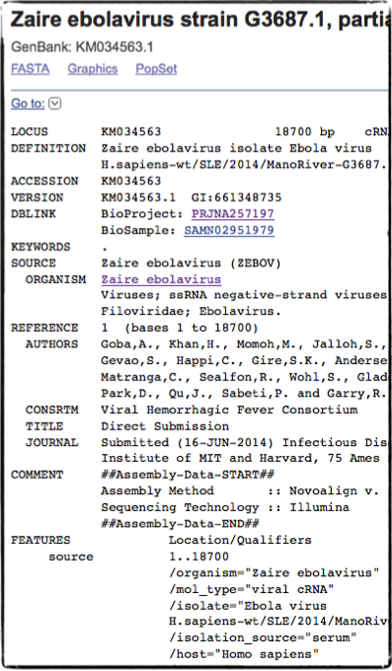
We made this data public immediately.
Another 150 samples sequenced: August 2014 -March 2015
New deep Ebola and Lassa fevers Sequencing Methods were developed and published immediately for the benefit of the community ( Matranga CB et al. Genome Biol. 15 (2014)

Slide 13
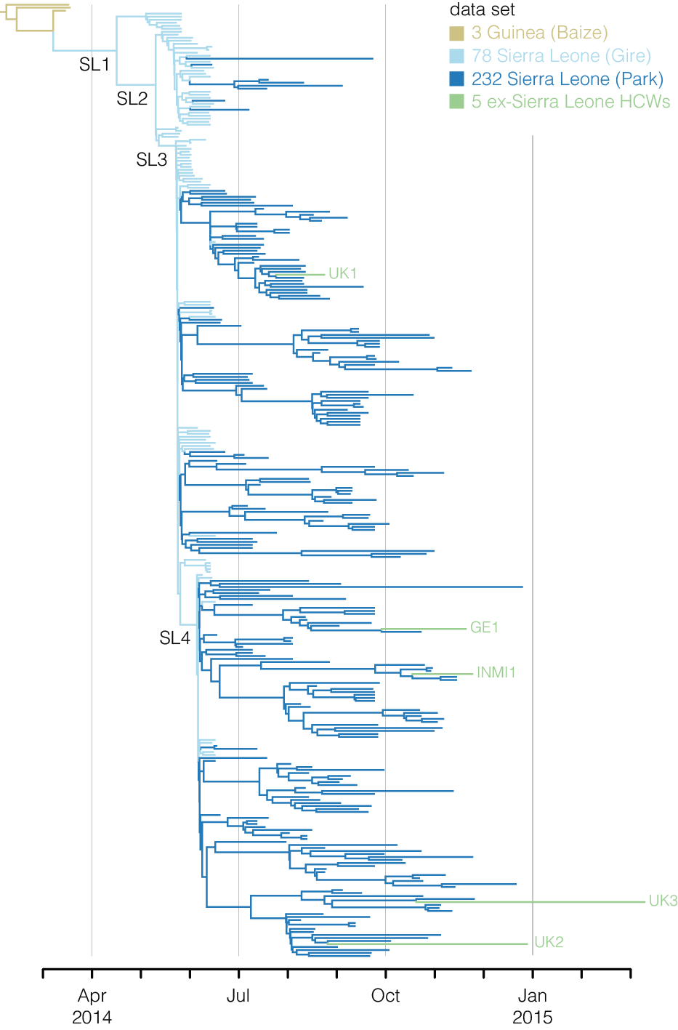
New samples from Sierra Leone are all SL2 or SL3
Sustained human-to-human transmission
No additional zoonotic introductions from the reservoir
No newly imported viral diversity from other countries
Mutations fall in spatial and temporal patterns
(Gire et al., Science, 345, 2014)
Park, DJ et al., Cell 161 (2015).
Notes:
4 types of virus found in samples in SL
232 EBOV complete genomes (150 KGH, 82 CDC Bo) + 86 (Gire) = 318 genomes
464 SNPs (125 nonsyn, 176 syn, 163 non-coding)

Slide 14
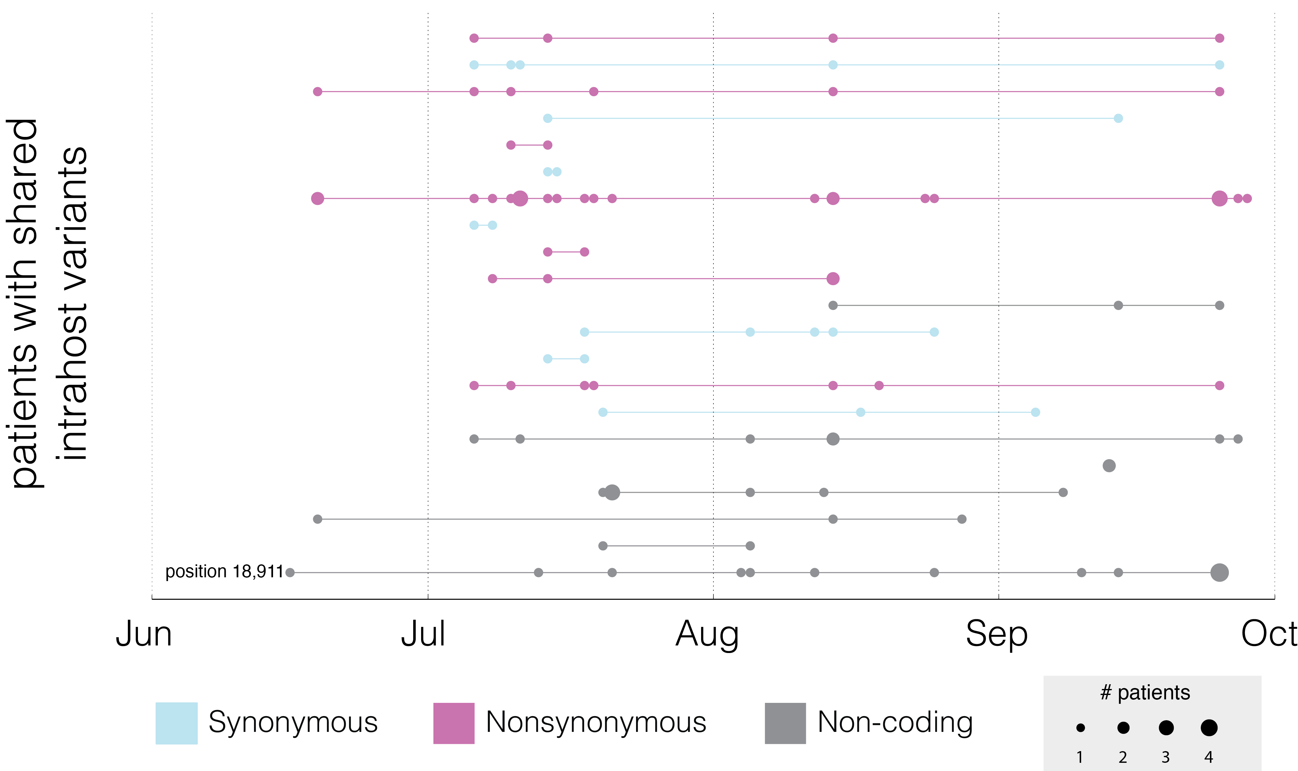
Evidence for host-to-host transmission of multiple
Ebola virus genomes
Park, DJ et al., Cell 161 (2015).
Notes:
- 247 iSNVs, including 21 shared by multiple patients

Slide 15
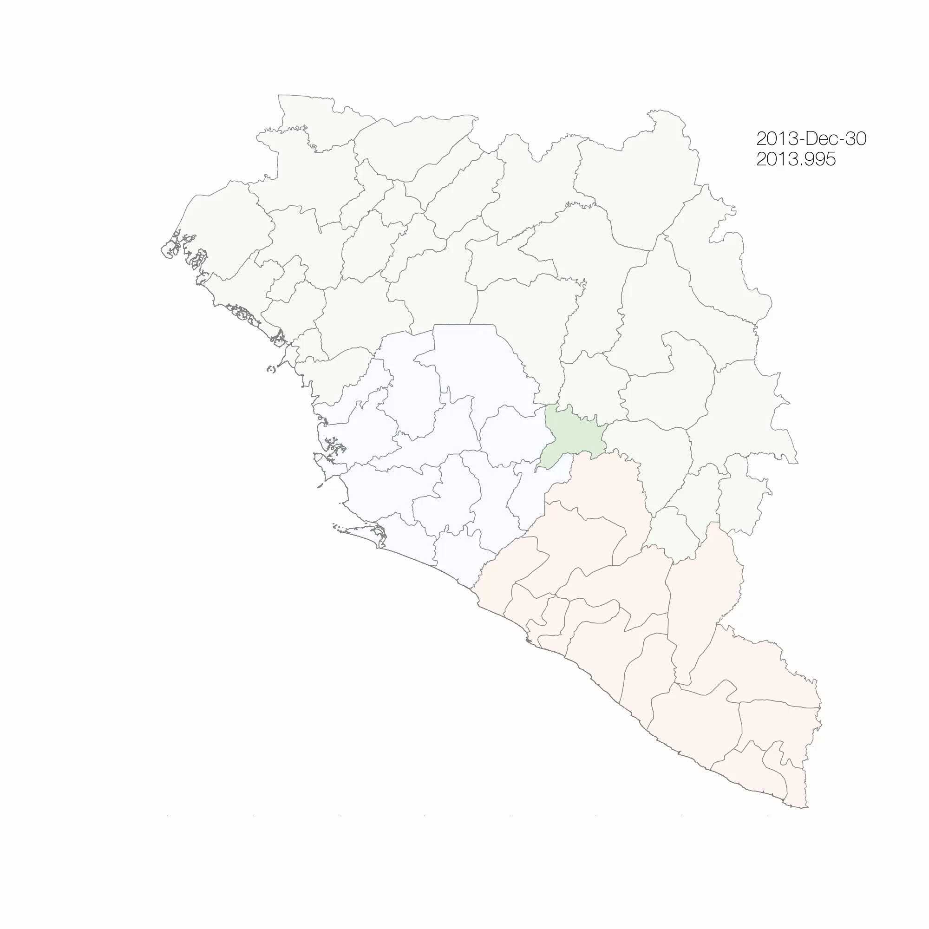
Genomics Surveillance, Transmission and Spread EVD in Sierra Leone

Slide 16
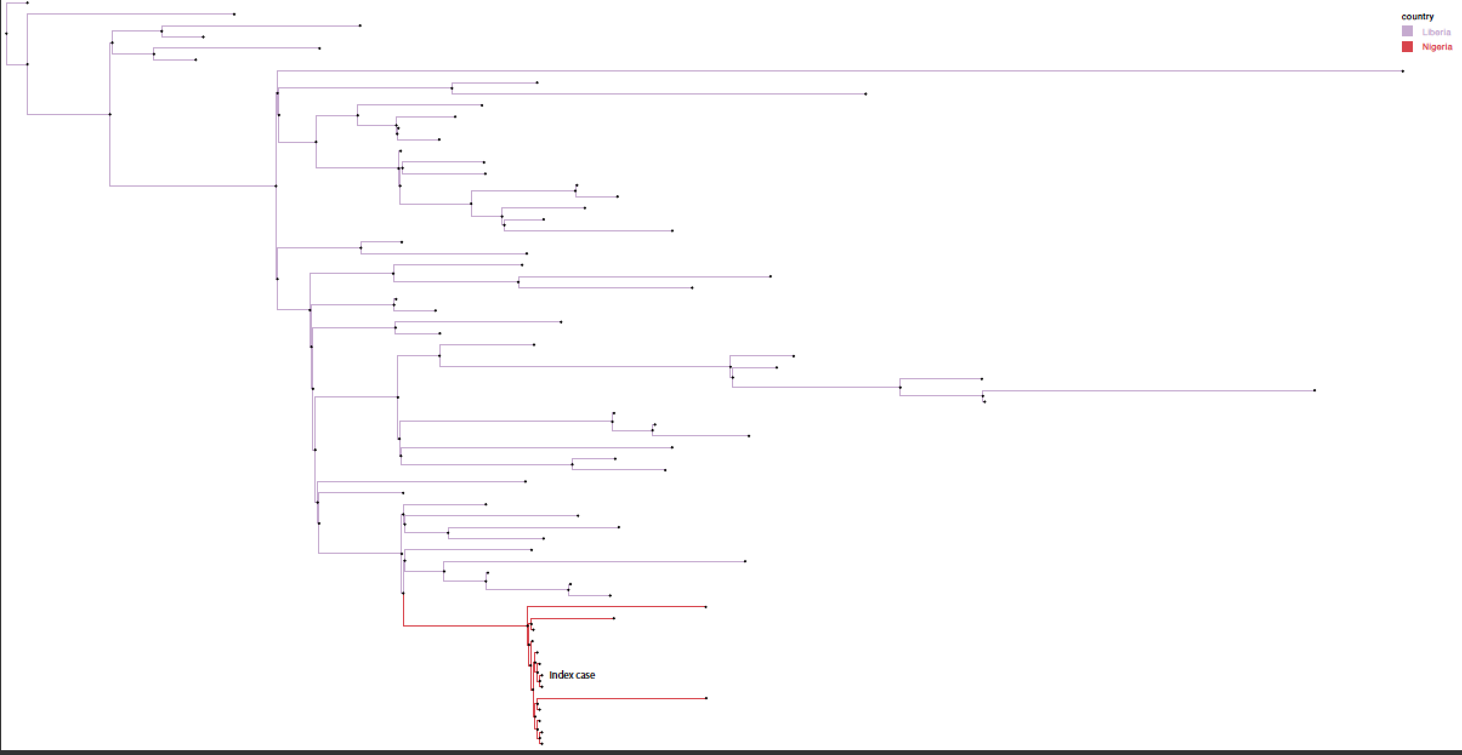
Complete Sequence and data Release of Ebola virus from Nigeria (October 2015)

Slide 17
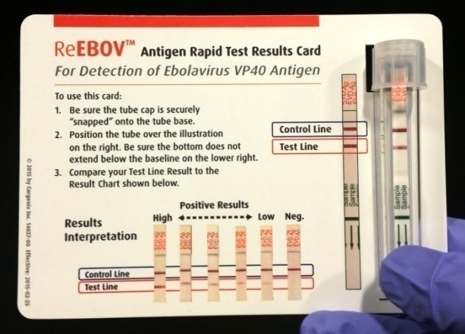
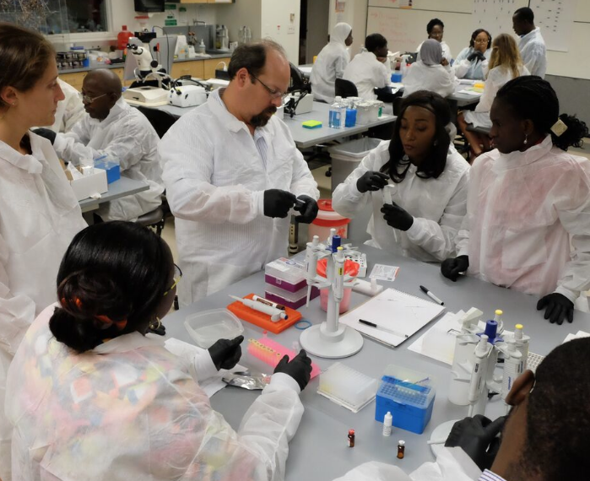
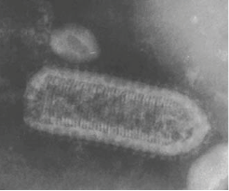
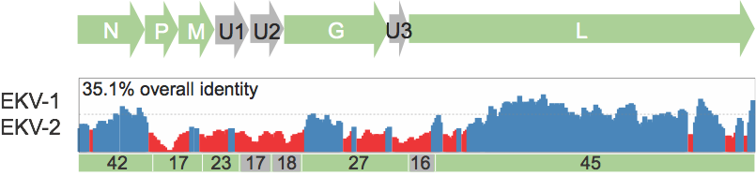
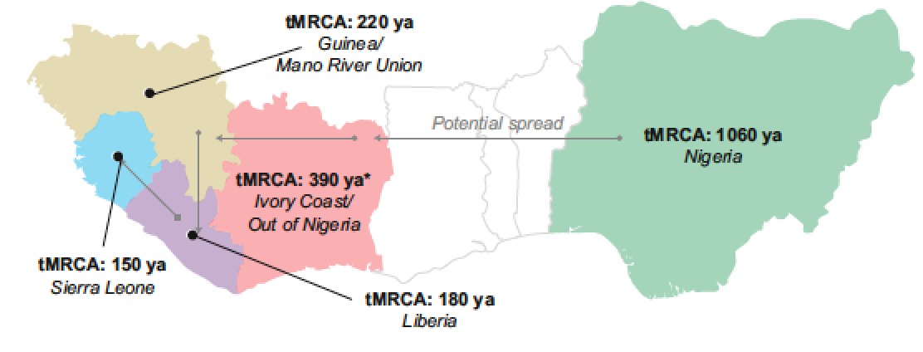
New Discoveries and New Diagnostic Tool Developed
Partnership with Corgenix: ReBOVTM developed
Discovery of two highly divergent Rhabdoviruses (Stremlau, et al., PLoS Negl Trop Dis 2015)
Clinical Sequencing uncovers the Origins and Evolution of Lassa Virus (Andersen et al., Cell, 162, 2015)
-Lassa virus is mainly transmitted from Mastomys to Human
-Virus has evolved ways of evading human immunity and

Slide 18
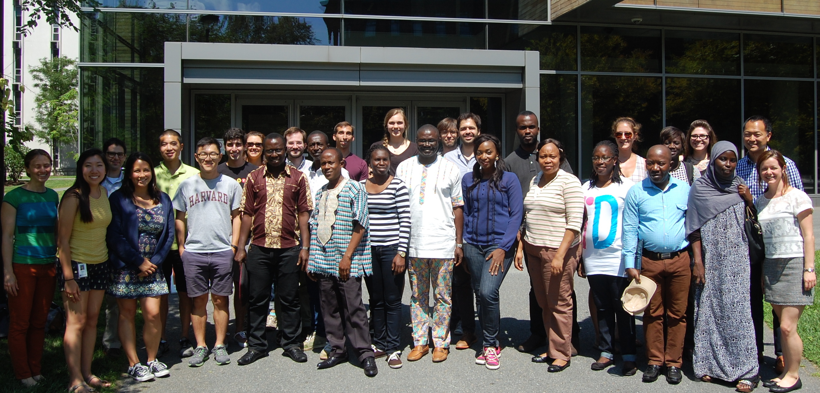
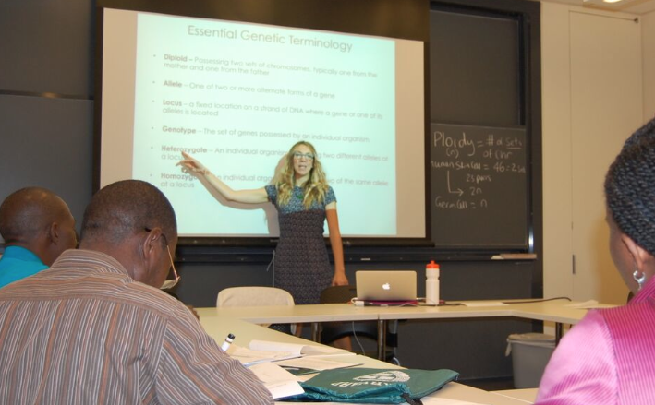
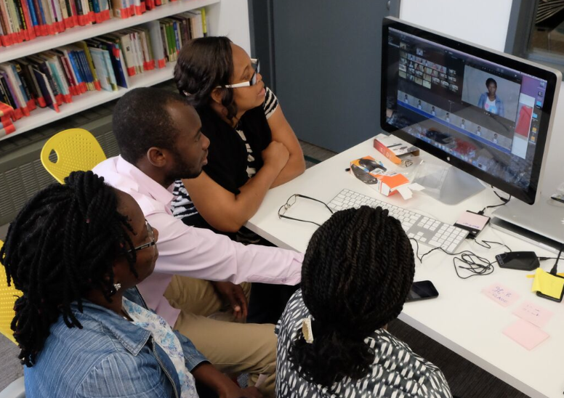
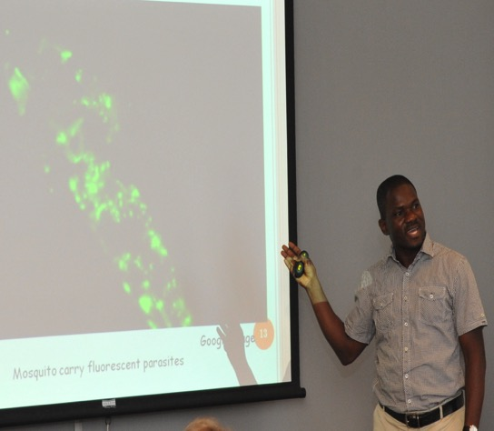
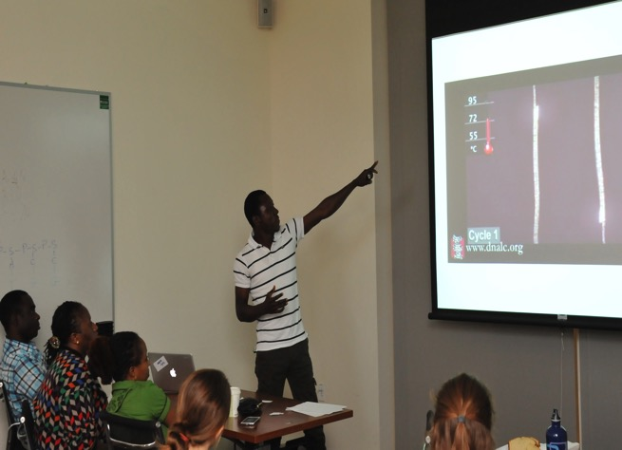
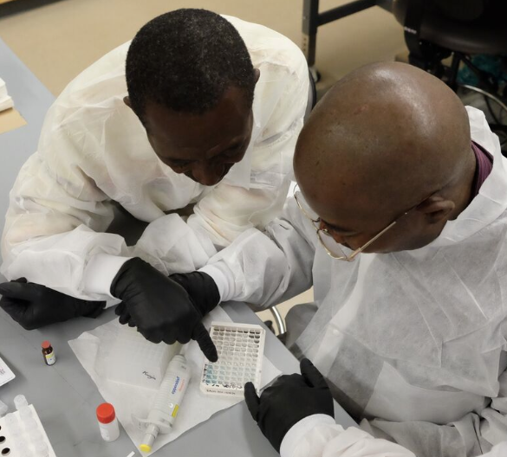
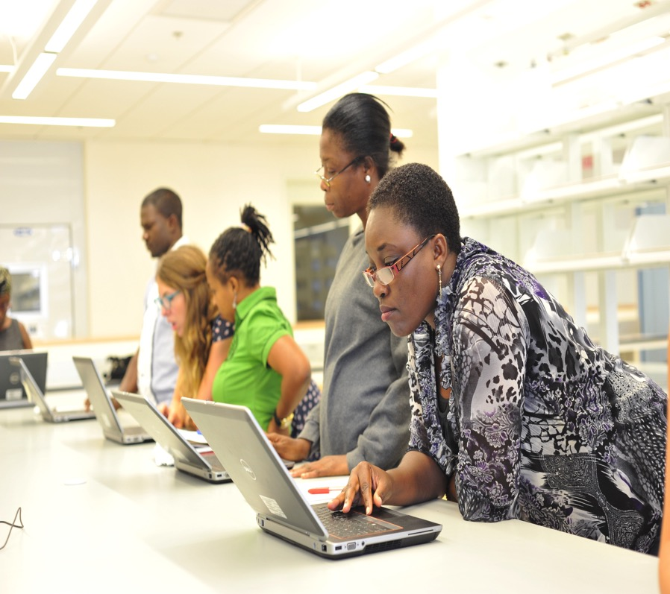
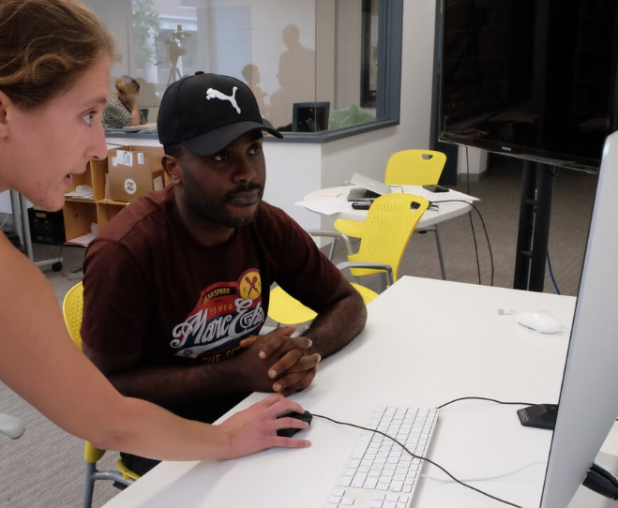
Foundational Genomics Training (30 trainees)– Summers 2014-15
Genetics and Genomics Theories
Diagnostic techniques
DNA and Next Gen Sequencing
Science Communication
Teaching Padagogy
Bioinformatics
Biosafety
Notes:
Genetics Theory: Mendelian genetics, Personalized genetics lab, Genetics of complex traits, Sources of variation
Dx techniques: Primer design, DNA and next gen sequencing, RDT/ELISAs (Corgenix)
Science Communication: Giving effective presentations, Video production, How people learn

Slide 19
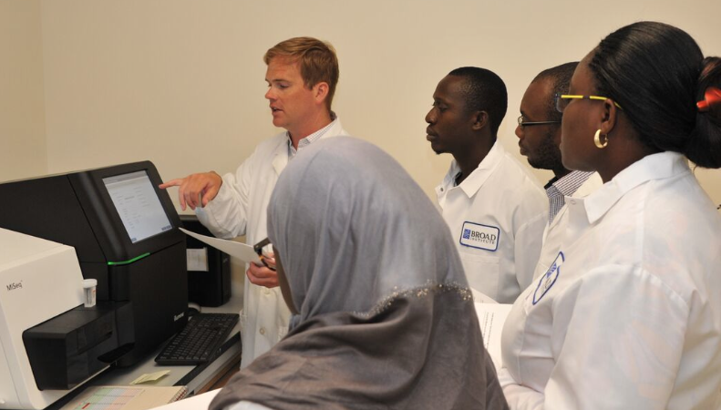
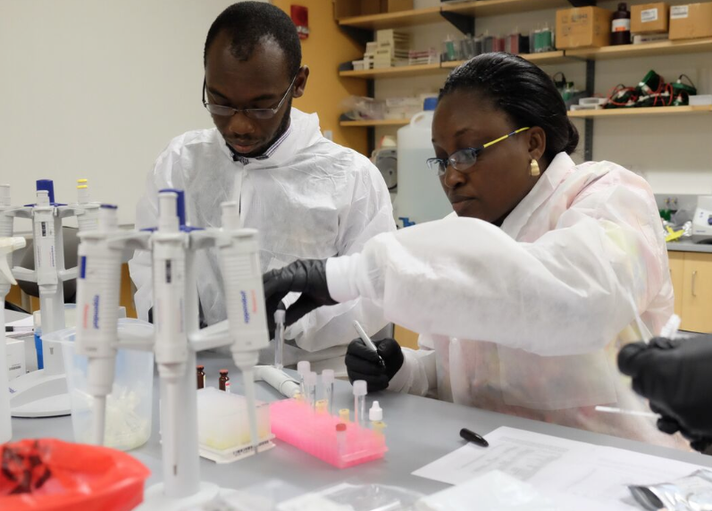
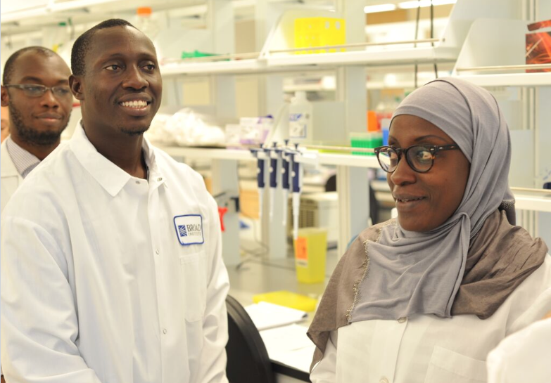


Advanced Genomics Training – Summer 2015
MiSeq installation and operation
Sample preparation and sequencing
Sequencing analysis
Independent research

Slide 20
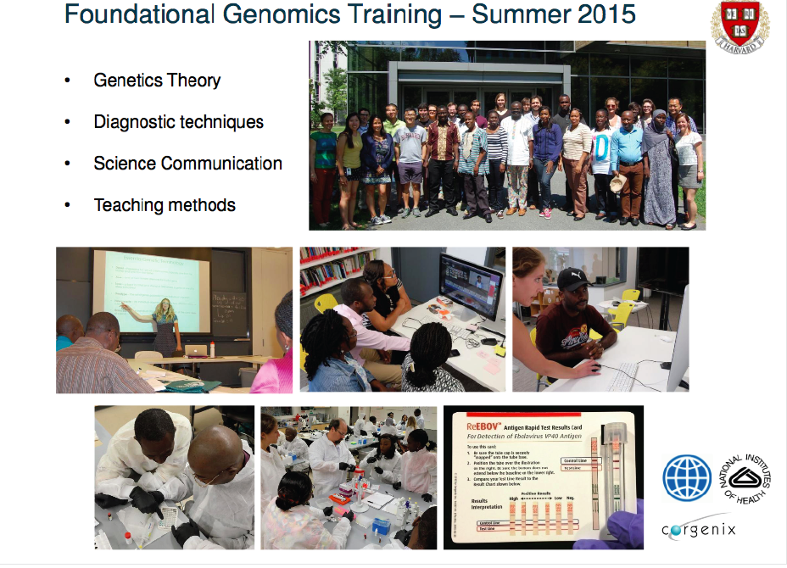

Slide 21
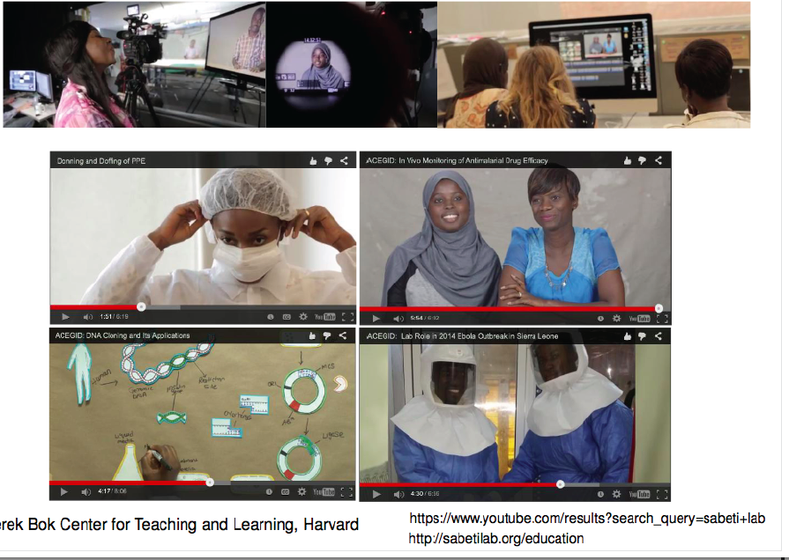
Foundational Genomics Training – Summer 2015
Educational Videos
Donning and Duffing in the Laboratory
Applications of molecular technology in Malaria Research
Cloning Technology
Molecular diagnosis of Ebola

Slide 22
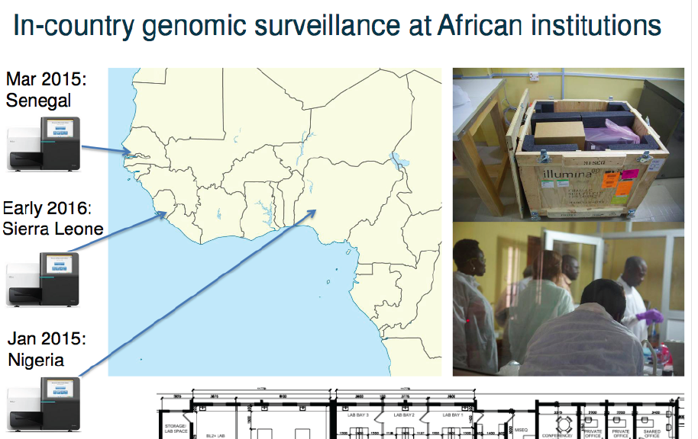
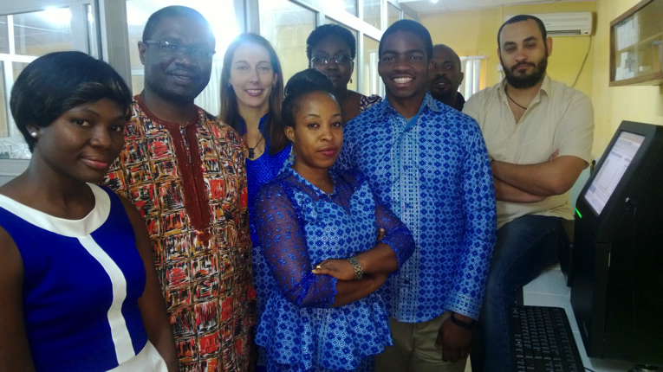
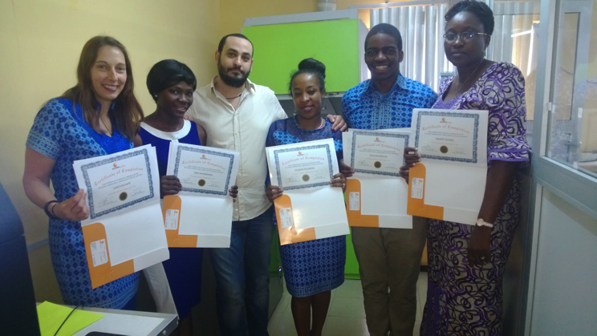
Notes:
Illumina Sequencing machine, EcoMachine; Roche Real time PCR Machine; Gel Documentation device; Nano drop; MilliQ

Slide 23
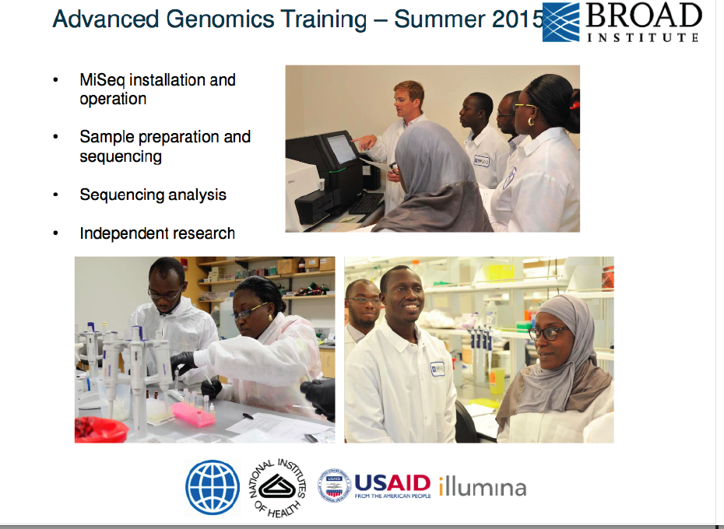

Slide 24

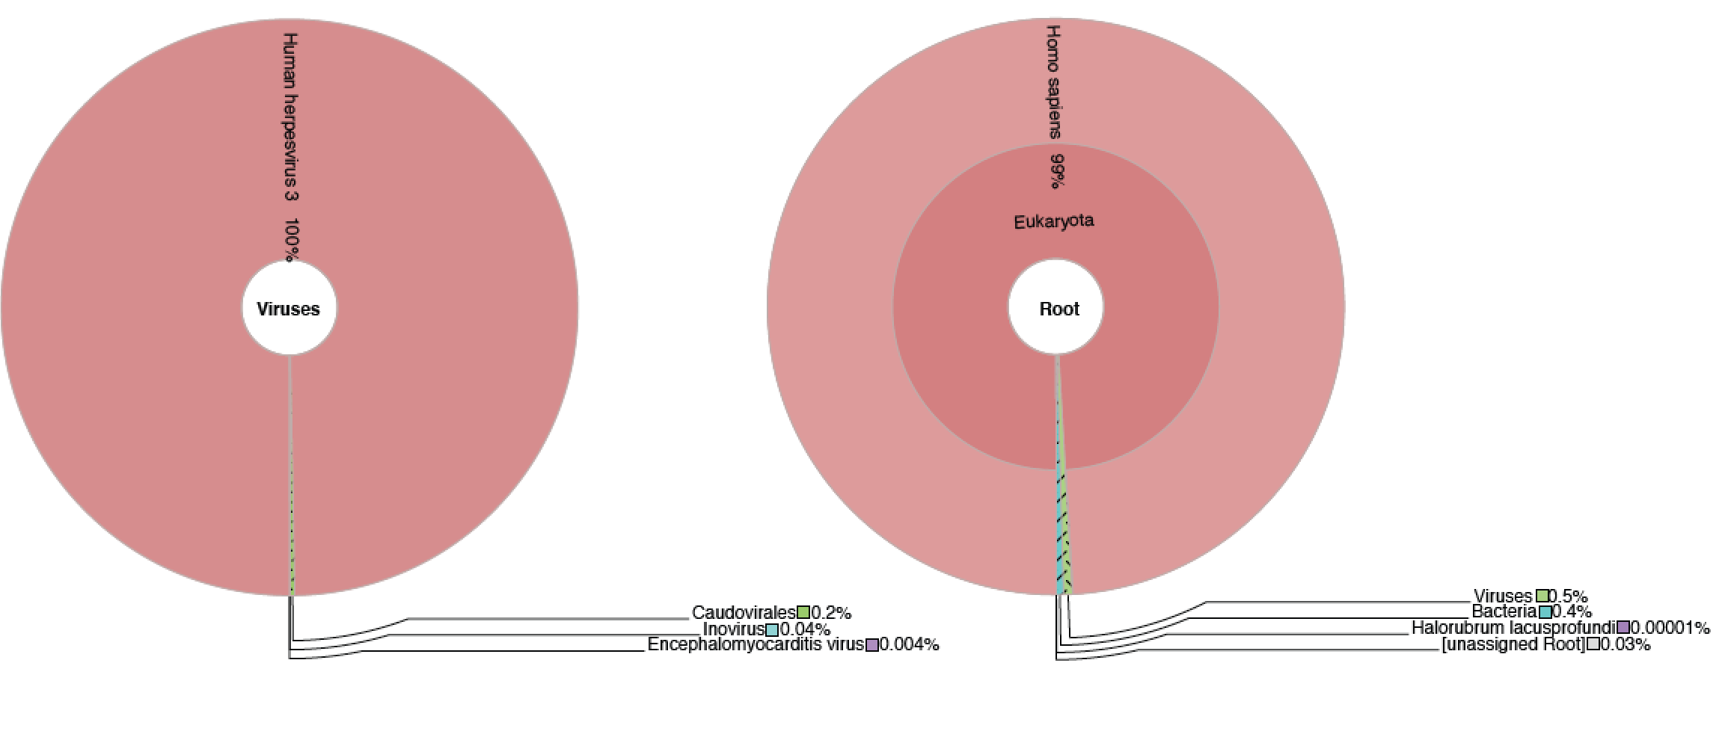
New Ebola Outbreak Scare in Nigeria!!
The World Almost Came to a New Stop.
About three weeks ago, government had also stated that additional tests, using next generation sequencing methods, were going to be carried out at the Redeemers University African Centre of Excellence for Genomics of Infectious Diseases at Ede, Osun State, to confirm which virus must have caused the infection and the subsequent death of the UNICAL student.
October 2015

Slide 25
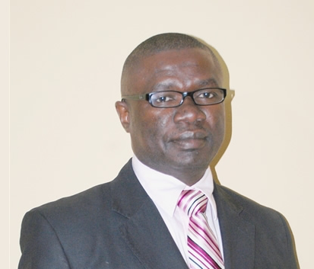
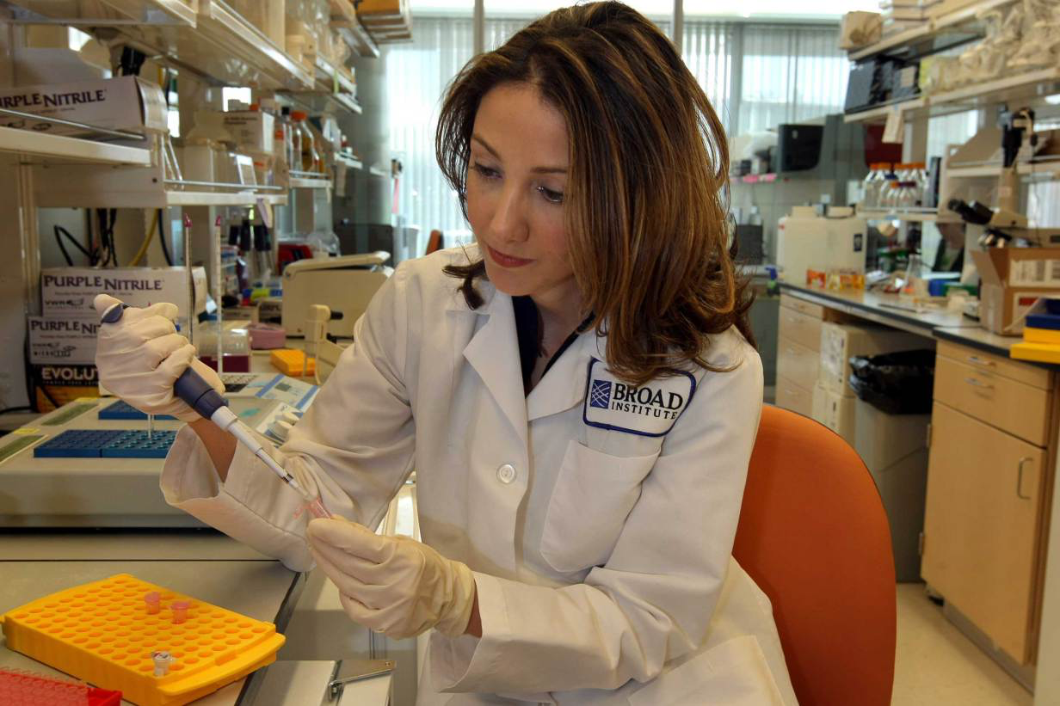
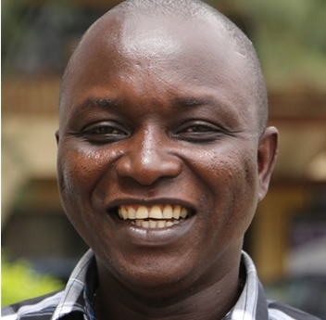
Awards
RUN, Vice Chancellor’s Award
Researcher of the year award -RUN
100 Most Influential People - Time
Dr. Humar Khan honored as amongst Nature's 10 most influential scientists of 2014

Slide 26
Program Activities and their
Disbursement Linked Results

Slide 27
Short Courses Launched – DLR 2.1
TRAININGS | LOCATION | DATE | NUMBER OF PARTICIPANTS
Summer Genomics Foundation Training | Harvard/Broad Institute, USA | July – August 2014 | 11
Summer Genomics Foundation Training | Harvard/Broad Institute, USA | July – August 2015 | 11
Summer Advanced Genomics Training | Harvard/Broad Institute, USA | July – August 2015 | 4
Molecular Biology training | ACEGID Laboratory, Nigeria | July – September 2015 | 2
MiSeq Training | ACEGID Laboratory, Nigeria | January – February, 2015 | 7
MiSeq Training | UCAD, Senegal | April 2015 | 5
DNA fingerprinting and molecular identity testing of humans, animals, plants and infectious diseases | Lahor, Edo State, Nigeria | September 2015 | 39
qPCR and its Applications in Infectious diseases | UCAD, Senegal | May 2015 | 7
TOTAL |  |  | 86

Slide 28
Short Courses for the next year
TOPICS | TIMELINE
Good Laboratory Practices | 1st Quarter
Manuscript writing & Grantmanship | 1st Quarter
Thesis Supervision and Mentorship | Second Quarter
Application of molecular Biology and genomics in infectious diseases | Second Quarter
Next Generation sequencing | Third Quarter
Bioinformatics and its Application to Infectious diseases | Third Quarter

Slide 29
Masters & Ph.D. Programs in Progress – DLR 2.2 & 2.3
YEAR | DEGREE | No. OF STUDENTS |  |  | FEMALE
 |  | NATIONAL | REGIONAL | TOTAL | NATIONAL | REGIONAL
Masters Programs
2014 | Microbiology | 6 | 2 | 8 | 3 | 1
 | Chemical Sciences | 7 | - | 7 | 3 | -
2015 | Microbiology | 5 | 2 | 7 | 3 | 2
TOTAL |  | 18 | 4 | 22 | 9 | 3
Ph. D Programs
2014 | Microbiology | 4 | 4 | 8 | 1 | 2
2015 | Microbiology | 3 | 4 | 7 | 2 | 2
TOTAL |  | 7 | 8 | 15 | 3 | 4

Slide 30
Future Masters & Ph.D. Programs
Master’s in Molecular Biology and Genomics
Master’s in Bioinformatics

Slide 31
Outreach Periods/Internships – DLR 2.4
Training at Broad Institute, USA
Internship for WAHO fellows
Molecular Biology foundation training
Genomics summer boot camp for high school students:

Slide 32
Accreditation – 2.5
ACCREDITATING BODIES | COUNTRY | STATUS
NUC | Nigeria | In Progress
Center for Appraisal of Tertiary Education Studies (CAPES) | Brazil | In Progress

Slide 33
Published Articles – DLR 2.6
TOPIC AREAS | NAME OF JOURNAL | NO. OF PUBLICATION | REGIONAL | IMPACT FACTOR
Viral Hemorrhagic Fever | New England Journal of Medicine | 1 | Yes | 55.87
Viral Hemorrhagic Fever | Nature | 2 | Yes | 41.45
Viral Hemorrhagic Fever / Genomics | Science | 2 | Yes | 35.61
Viral Hemorrhagic Fever / Genomics | Cell | 2 | Yes | 32.24
Viral Hemorrhagic Fever / Genomics | Genome Biology | 2 | Yes/No | 10.85
Viral Hemorrhagic Fever / Genomics | PLoS Neglected Tropical Diseases | 2 | Yes | 4.47
Viral Hemorrhagic Fever / Genomics | Viruses | 2 | Yes | 3.35
Malaria Research | Malaria Journal | 1 | No | 3.109
Malaria Research | Parasitology | 1 | No | 2.56
Malaria Research | Journal of Parasitology Research | 1 | No | 2.09
Viral Hemorrhagic Fever / Genomics | International Journal of Infectious Diseases | 2 | Yes | 1.86
Diagnostics | Future Virology | 1 | Yes | 1.01
Mosquito Borne Diseases | Journal of Infectious Public Health | 1 | No
 | TOTAL | 20

Slide 34
Revenue Generated – DLR 2.7
REVENUE | SOURCES
Grant | NIH - H3Africa Genomics project NIH – new Telephone base device for diagnosis of malaria
Tuition Fees
Program Fees | Short term progress

Slide 35
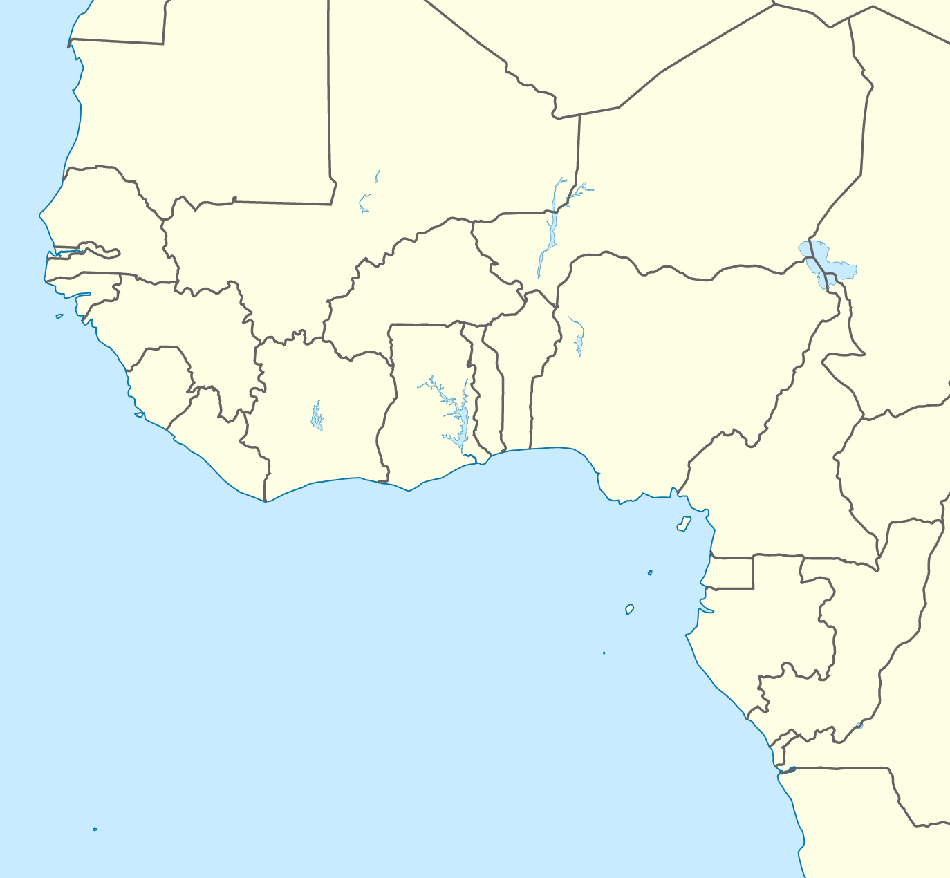
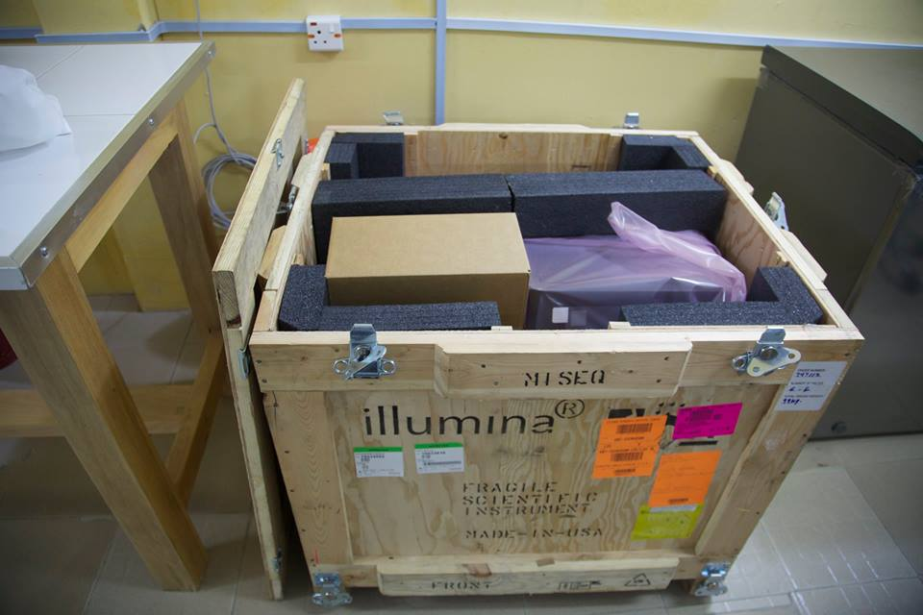




Infrastructure Development for Genomics Surveillance of infectious Diseases
Mar 2015:
Senegal
Early 2016:
Sierra Leone
Jan 2015:
Nigeria

Slide 36
New Discoveries and New Diagnostic Tool Developed
Partnership with Corgenix: ReBOVTM developed
Discovery of two highly divergent Rhabdoviruses (Stremlau, et al., PLoS Negl Trop Dis 2015)
Clinical Sequencing uncovers the Origins and Evolution of Lassa Virus (Andersen et al., Cell, 162, 2015)
-Lassa virus is mainly transmitted from Mastomys to Human
-Virus has evolved ways of evading human immunity and

Slide 37
We made this data public immediately.
New deep Ebola and Lassa fevers Sequencing Methods were developed and published immediately for the benefit of the community ( Matranga CB et al. Genome Biol. 15 (2014)

Slide 38

Challenges and Mitigations
Logistics
Infrastructure
Manpower
Politics
Create a foundation for African scientists to carry out tractable and important genetic research projects entirely in country.

Slide 39


August 2014: Resupplying before departure

Slide 40


Expanded scientific capabilities to enable sustainable, collaborative and independent health research

Slide 41
Top Goal/Hope for the next year
Increase number of Students and Faculties intake (regional and Female)
Identify local and international industries for internship
Increase IGR
Obtain International Accreditation
Active deep sequencing to identify and characterize pathogens causing fever

Slide 42
More Information
www.acegid.org

