Slide 1
ACE IMPACT RESULTS VERIFICATION
Process, Overview & Guidelines
Mrs Adeline Addy
M&E Specialist, ACE Impact,
Association of African Universities
26th May 2021
Ms Maud-Andree Kouadio
Education Consultant,
World Bank
Mr Emmanuel Ansong
Procurement Specialist, ACE Impact,
Association of African Universities

Slide 2
Results Submission
Download and use current template
Review, Feedback & Revisions
Adhere strictly to revision guidelines and timelines
Ensure revised versions are uploaded
Verification & Draft Reports
Sensitize students/ finalise reports
Follow up on “no response” students
Reports Finalisation
Review draft reports
Verification Letters
Process disbursement request immediately for timely disbursements
Submit results under appropriate period
Upload necessary documents and click on submit
Further revisions not possible after submission deadline
Facilitate process
Quality check data
Communicate any challenges to RFU
Notify RFU on discrepancies
Verification of Student & Internship Results: Process
Timeliness
Participatory
Transparency

Slide 3
Overview of Verification: Enrolments & Internships (DLRs 3.1, 3.2, 3.4 & 5.2)
Eligible: 98%
Response Rate: 91%
Verification Rate: 83%
High Quality Data
Competence in use of online platform
Stellar Performance: 100% Eligibility, Response, Verification & Disbursement Rates …IT IS POSSIBLE!!!
CApIC (Nigeria);
CEA-VALOPRO (Côte d’Ivoire);
WACCBIP-NCDS & WACCI (Ghana)
LESSONS:
Data collection and tracking are essential
Data Quality Checks are critical – involve the students
Timely and correct submission is key

Slide 4
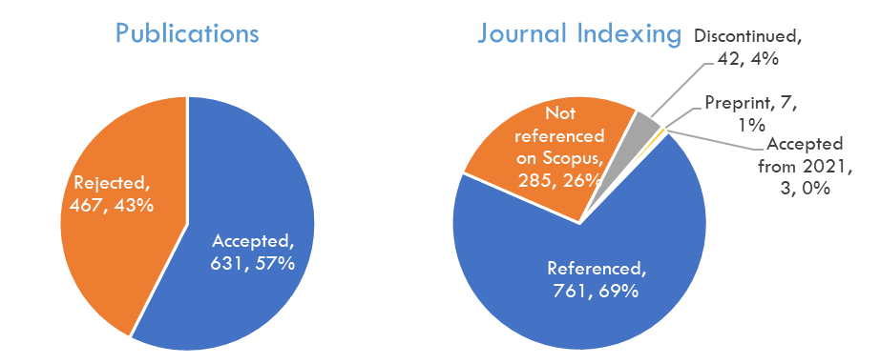
Verification: Research Publications (DLR 4.2)
Quality Assessment
Relevance Assessment
Experts’ concerns:
Authors’ affiliation to centre not clear
Context of research
Unclear or no alignment with centres’ objectives
No reference to the ACE Impact Project
Low impact journals

Slide 5
Verification: Programme Accreditation (DLR 4.1)
2 Existing & 3 New Centres in Burkina Faso and Ghana achieve results
14 Programmes accredited
5 PhD STEM Programmes
8 MSc STEM Programmes
1 BSc STEM Programme
2 International (valid for 5 years)
12 National (valid for 3 years)
ACE | Programme | Accreditation
CEA-2iE, Burkina Faso | MSc Water, Sanitation and Hydro-agricultural Development | International (CTI)
CoE_2iE, Burkina Faso | BSc Civil Engineering, Building and Public Works
 | MSc Electrical and Energy Engineering
RWESCK, Ghana | MSc Water Resources Engineering | National (GTEC)
 | MSc Water Supply & Environ. Sanitation
 | PhD Water Resources Management
 | PhD Water Supply & Treatment Technology
WACWISA, Ghana | MSc Irrigation and Drainage Engineering | National (GTEC)
 | PhD Irrigation and Drainage Engineering
CoE_KEEP, Ghana | MSc Computer Engineering
 | MSc Materials Engineering
 | MSc Telecommunications Engineering
 | PhD Computer Engineering
 | PhD Telecommunications Engineering

Slide 6
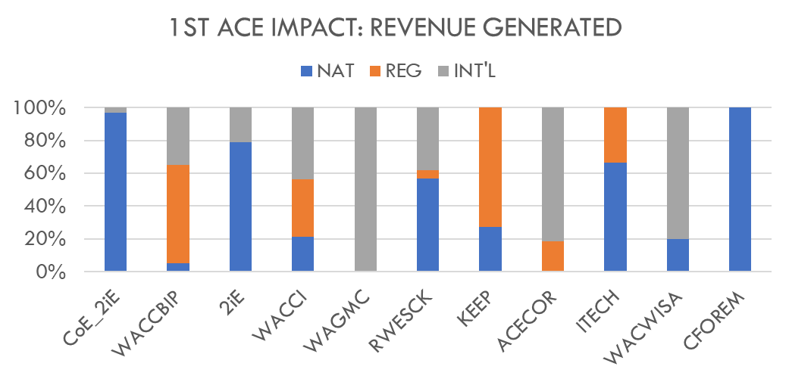
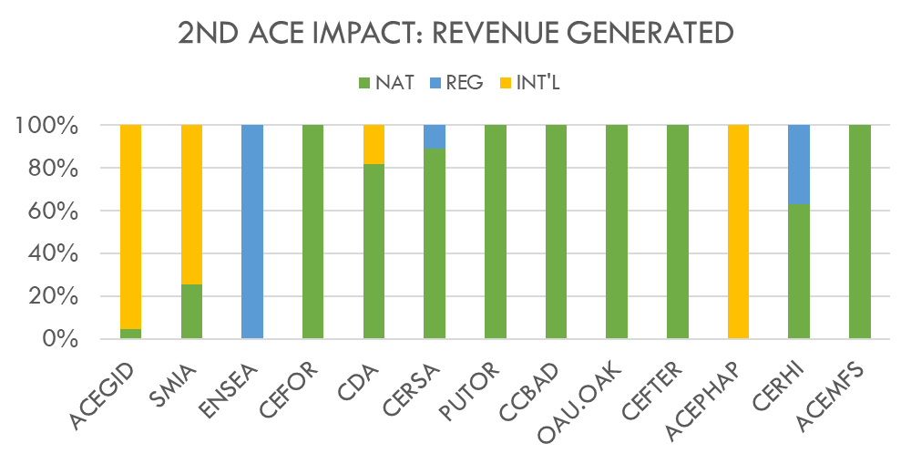
Verification: External Revenue (DLR5.1)
US$ 28,031,891.04
Benin, Burkina Faso, Côte d'Ivoire, Ghana, Nigeria & Togo
(Fees, Grants, Consultancy Fees)

Slide 7
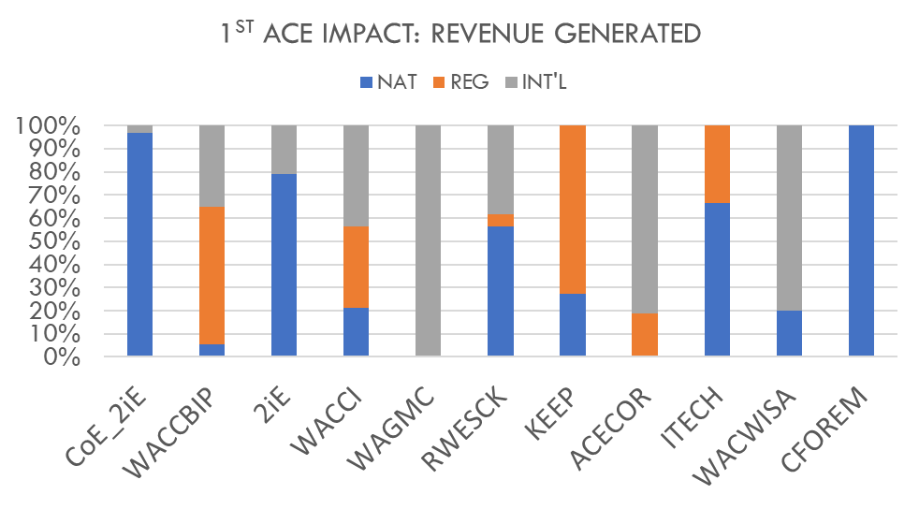
Verification: External Revenue (DLR5.1)
US$ 28,031,891.04
Benin, Burkina Faso, Côte d'Ivoire, Ghana, Nigeria & Togo
(Fees, Grants, Consultancy Fees)

Slide 8
Verification: Teaching and Research Environment (DLR 4.3)
COUNTRY | CENTER |  |  |  | STATUS
TOGO | CERVIDA |  |  |  | Partially approved – Center to: 1. Submit formulation of approved milestones 2. Finalize pending milestones for final review
GAMBIA | STEE
DJIBOUTI | CoE_DJ |  | CEALT
GUINEA | CEMS |  | CEA-PCMT |  | Fully approved – Final approved submitted
SENEGAL | AGRISAN |  | CEA-AGIR
NIGER | EMIG |  | IEA/MS4SSA
BURKINA (5 centers) | CEFORGRIS |  | ITECH_MTV
 | CFOREM | 2iE |  | CoE_2iE
BENIN | CoE_EIE | C2EA |  | CEA-SMIA
NIGERIA (12 centers) | ACEPHAP | SPED |  | FUELS
 | CEFOR | CApIC |  | ACEDHARS
 | ACETEL | CDA |  | OAU-OAK
 | ACEITSE | ACEMFS |  | ACENPEE
TOGO | CERME
GHANA (9 centers) | ACECoR | RWESCK |  | WACWISA | Fully approved – Final approved submitted
 | WACCI | TReCK |  | CoE-KEEP
 | RCEES | WAGMC |  | WACCBIP
NIGERIA (5centers) | ACEGID | CERHI |  | ACENTDFB
 | PUTOR | CEFTER
NIGER | CERPP
TOGO | CERSA
All milestones' formulations reviewed and approved
3 conditionally
Verification for achieved milestones opened
Upon centers’ request for online verification
Quarterly for onsite verification – Next round planned for July 2020

Slide 9
Verification: Teaching and Research Environment (DLR 4.3)
Reminder on Key Verification criteria
Self-certification on national procurement rules
Environmental and Social Management Plan (ESMP)
National procurements rules
Compliance with the national/university policies
Letter from center’s management to WB
Manage environmental and social impacts from civil work
Prepared in conjunction with WB
Disclosed in-country and at the World Bank website
Before commencement of any eligible activities
Session on Wednesday and Thursday

Slide 10
Verification: Fiduciary Management (DLRs 6.1 – 6.4)
DLR 6.1 – Timely fiduciary reporting
DLR 6.2 – Functional internal audit committee
90% of centers submitted results
97 % earned 50% of yearly earnings
For submission of IFRs
Due on Feb 25
Financial and Procurement audits due in
June 2021 and 2022
Recommendations
Submit all documents as indicated BY DUE DATE to earn disbursements
All documents to be sent to country FMS (with copy to reg. team) and submit on M&E portal
Centers to recruitment of FMS/accountants ASAP to complete DLR activities
Few centers submitted results
Internal Audit Committee creation docs
7 Centers – Benin, Guinea & Togo
Internal Audit reports
4 Centers – All Benin centers & CERSA-Togo
Minutes of Committee
Only CERSA submitted (achieved 100%)
Recommendations
First submission for Internal Audit Committee requires decree of creation, chart and first minutes of committee
Centers to recruitment of internal audits ASAP to complete DLR activities
10
Next round of verification planned after Financial audits due date (July – September 2021)

Slide 11
Verification: Fiduciary Management (DLRs 6.1 – 6.4)
DLR 6.3 – FM online transparency of ACE
Progress
Centers have earned an average of 47% of DLR 6.3 as of May 3
Only 3 centers with 100% (RWESCK, WACCI, & CERSA)
Most missing documents: Procurement Audit and Annual Work Plan
Recommendations
Display all documents on center website in addition to submission on the M&E Portal.
Ensure that documents are easily accessible from center’s homepage
Check that links are working; some documents did not load and were not counted
Next round of verification planned after Financial audits due date (July – September 2021)
11

Slide 12
Verification: Fiduciary Management (DLRs 6.1 – 6.4)
DLR 6.4 – Quality of Procurement planning
All submissions should be submitted to AAU/WB procurement specialists with copy to reg. team and on M&E portal
Approved procurement plans
Procurement audits
Verification criteria
Deep dive session on verification process during breakout sessions this afternoon & on Thursday
Procurement Performance Reporting
Status of Procurement Activities (numbers/amounts)
Summary of Procurement Report
Procurement implementation performance reporting
Next round of verification planned after Financial audits due date (July – September 2021)
12

Slide 13
Next Steps
DLRs 6.1 – 6.4 (Fiduciary Management)
IFRs, Audit Reports, etc. submission: 15 Jul – 13 Aug 2021
DLRs 3.1 – 3.4, 4.2 & 5.2 (Students, Publications & Internships)
Other DLRs
DLRs 3.3, 4.1 & 5.1 (PSTC, Prog. Accreditation & Revenue)
Report Submissions: 1 – 11 June 2021
Verification: 14 – 25 June 2021
Verification: 16 Aug – 1 Sept 2021
Revisions: 15 – 25 Sept 2021
Verification letter: 30 Sept 2021
Report Submissions: 1 – 8 Dec 2021
Feedback & Revisions: 15 Dec 2021 – 4 Jan 2022
On demand – Every trimester
Details to be provided on DLRs 2.1, 2.2, 5.3 & 7.5 in upcoming workshop
DLR 4.3 (Improved Teaching and Research Environment)
Call for verification: 15-30 July 2021
Onsite visits (if feasible): 15-30 Aug 2021
Feedback & revisions: 1-15 Sep 2021

