Slide 1
CENTER OF EXCELLENCE IN INFORMATION AND COMMUNICATION TECHNOLOGIES
AWONO ONANA
Coordinator
UNIVERSITY OF YAOUNDE I

Slide 2
CETIC TEAM IN ACCRA
LOGMO AARON, NATIONAL FOCAL POINT/MINESUP
TONYE Emmanuel, Vice-Rector Research and Cooperation, representing the Rector
AWONO ONANA, Coordinator
BILONG Paul, Deputy Coordinator
KOFANE Timoléon Crépin, Principal Researcher
OBEN Julius, Internal Auditor
ANABA Marie Noelle, Project Assistant

Slide 3
OBJECTIVES
STRENGTHEN THE CAPACITY OF THE CONTINENT IN THE FIELD OF MATHEMATICAL MODELING AND SCIENTIFIC COMPUTING & RELATED ENGINEERING APPLICATIONS
CONTRIBUTE TO OVERCOMING CHALLENGES OF AFRICAN DEVELOPMENT BY APPLICATIONS OF MATHEMATICS AND INFORMATICS IN THE FOLLOWING AREAS: AGRICULTURE, ENERGY, HEALTH, ENVIRONMENT, INFRASTRUCTURE, MINE, UAE ECONOMY
CONTRIBUTE TO THE CREATION OF KNOWLEDGE IN THE FIELDS OF MATHEMATICAL MODELING AND SCIENTIFIC COMPUTING

Slide 4
PROGRAM ACTIVITIES AND THEIR DISBURSEMENT LINKED RESULTS FOR THE DLI 2.6 AND RESULTS ON PRIVATE SECTOR .

Slide 5
RESEARCH FINANCEMENT
INTERNATIONAL PROJECTS (Ex : ERMIT PROJECT Financed by the EU (2510 000 euros)
MINISTRIES (Ex : Ministry of Public Works (Structural design), Ministry of Post & Telecom (ART. INTELLIGENCE & Cybersecurity) – 205 mFCFA
Les entreprises PUBLIQUES (Ex : CNPS (social security)
Les entreprises PRIVEES

Slide 6
RESEARCH- PUBLISHED ARTICLES – DLR 2.6
See Annex for the list Publications_list_CETIC.docx

Slide 7
PRIVATE SECTOR
PRIVATE SECTOR PARTNERS WE COLLABORATED WITH DURING THIS PERIOD.
ENEO, ORANGE, MTN, CRTV, SGBC, AXA, CNPS, SOPECAM, SABC, ALUCAM, INOV, ANTIC, ZEBREKA, ITG Store, MSEC NET, TOTAL, CAMTEL

Slide 8
PRIVATE SECTOR
RESEARCH CONDUCTED AND THE RESULTS OBTAINED.
THEMES.xlsx

Slide 9
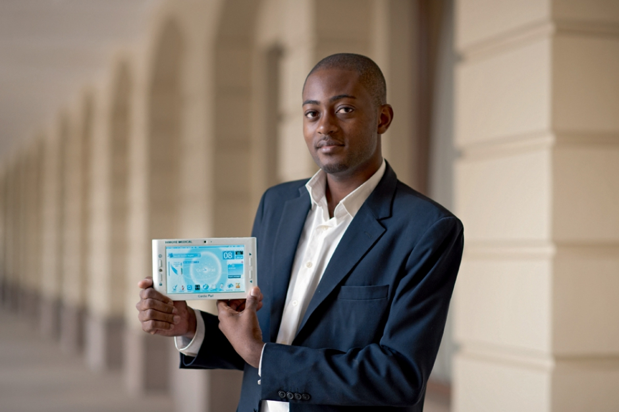
SUCCESS STORY : CARDIOPAD - ARTHUR ZANG

Slide 10
Main Programming Challenges
ACCREDITATION CHALLENGE CTI, HCERES, ABET
INCREASE THE QUALITY AND RELEVANCE OF TEACHING AND RESEARCH
DEEPER INVOLVEMENT OF PRIVATE SECTOR IN RESEARCH
REGIONALITY AND GENDER ISSUE CHALLENGES

Slide 11
MAIN PROGRAM MANAGEMENT CHALLENGES
OWNERSHIP OF PROJECT MANAGEMENT CONSTRAINTS
IMPACT OF PROJECT MANAGEMENT METHODS (FINANCIAL MANAGEMENT, PROCUREMENT) ON THE TRANSFORMATION OF TRADITIONAL GOVERNANCE PRACTICES AT THE UNIVERSITY
IMPLEMENTATION OF QUALITY MANAGEMENT IN THE UNIVERSITY AS A WHOLE

Slide 12
Main Goal/Hope for the next meeting
SHARING BEST PRACTICES IN ACE PROJECT MANAGEMENT AND MANAGEMENT OF RESEARCH AND INDUSTRIAL RELATIONS

