Slide 1
Procurement
5th ACE Project Workshop
17 – 19 May, 2016
Prepared & Presented by
Charles John Aryee Ashong
Ghana WB Procurement Team

Slide 2
Table of Contents
Project Procurement Arrangement & DLI
Bank procurement information, Requirements, procedures, etc.
Procurement Implementation Observations
Exercises
Things to AVOID

Slide 3
Bank procurement information, Requirements, procedures, etc.

Slide 4
General Conditions
Proof of Expenditure
Insurance
Use of Goods for Purposes Intended
Plans and Schedules
Records & Reports
Articles of Agreement
Equal Opportunity
Purpose Intended
Economic and Efficient
Expenditure for Project Only
Promote Competitive Intl Trade
Obligation to Supervise
Need for Policies & Rules
Procurement as
Instrument in
Public Sector
Management
Guidelines, Policies and
Country Procurement Work

Slide 5
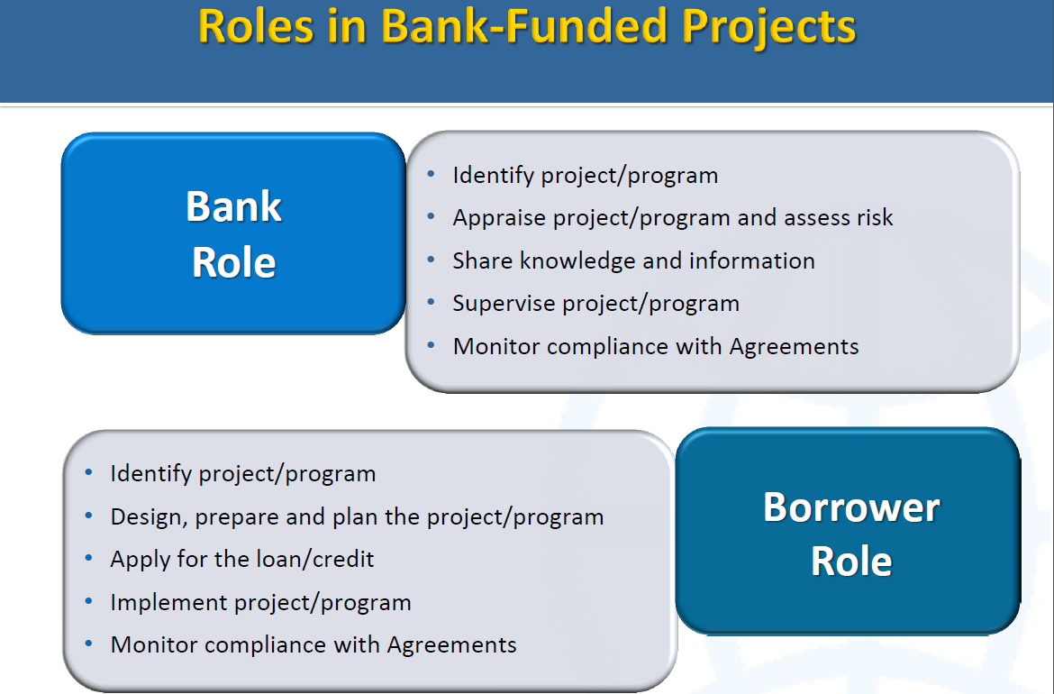

Slide 6
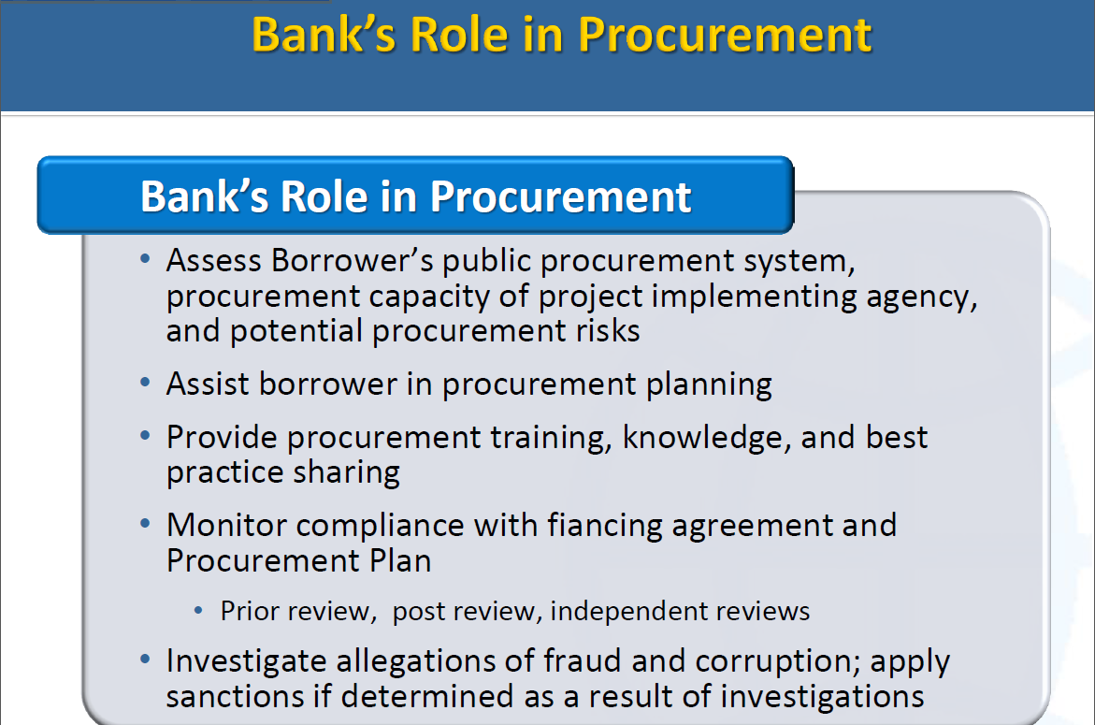

Slide 7
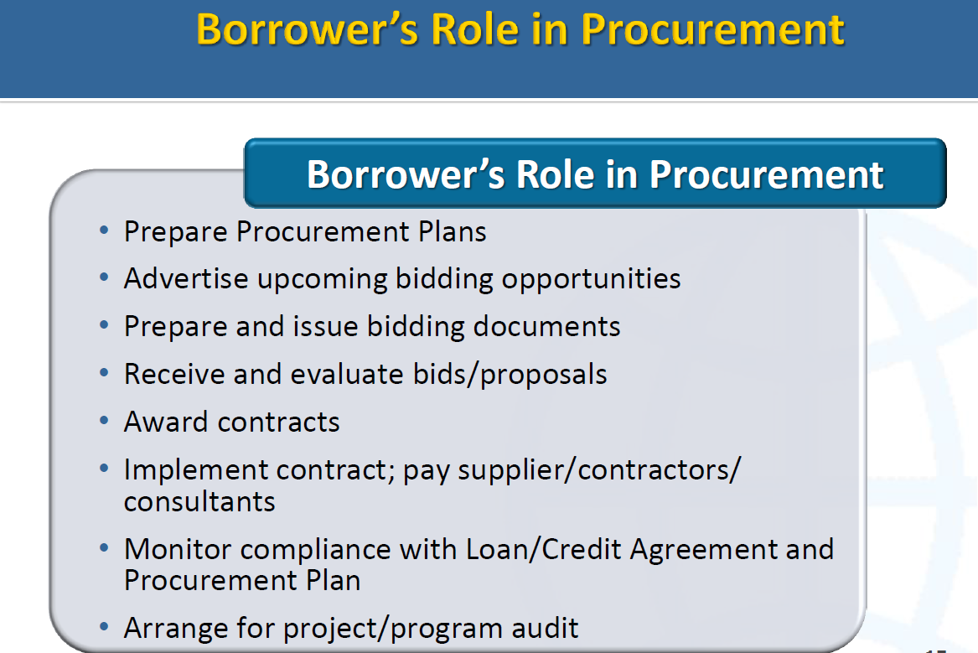

Slide 8
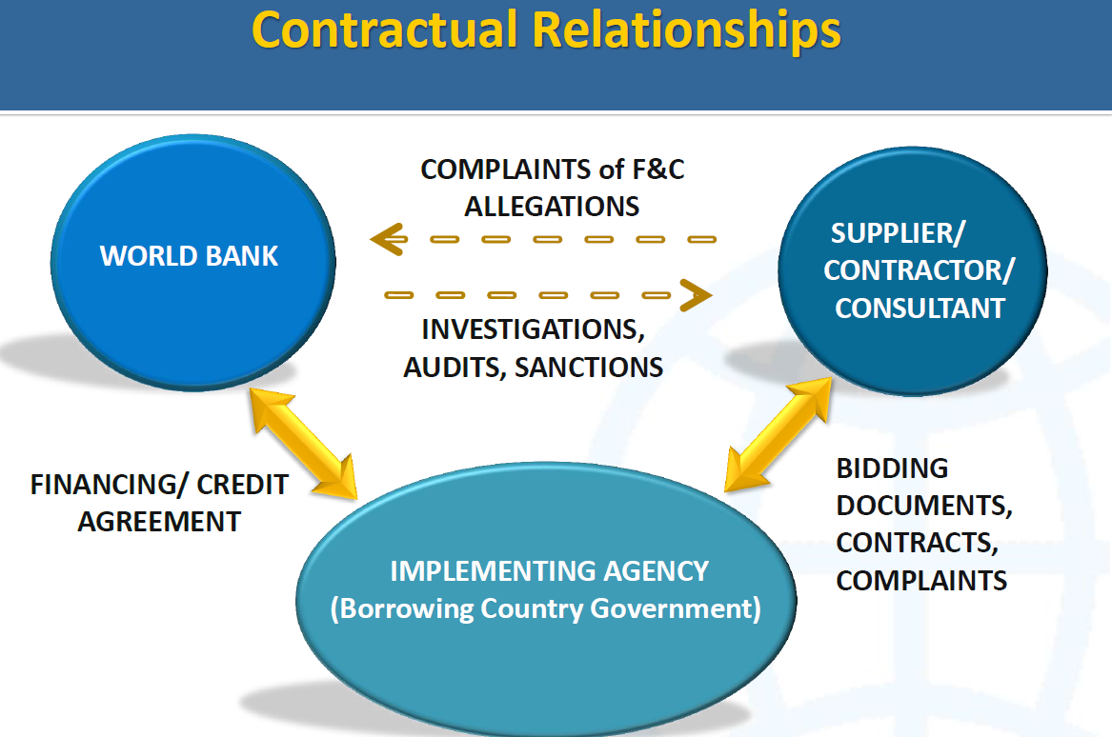

Slide 9
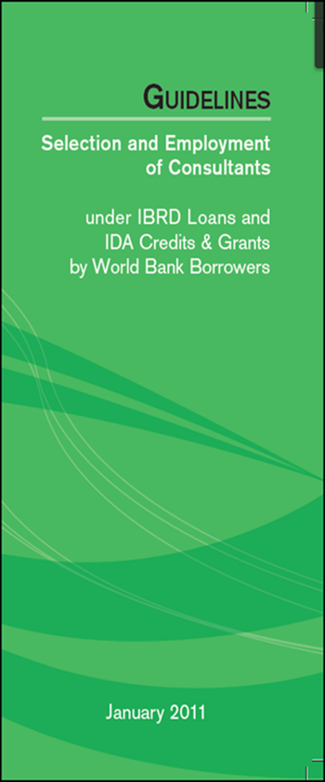
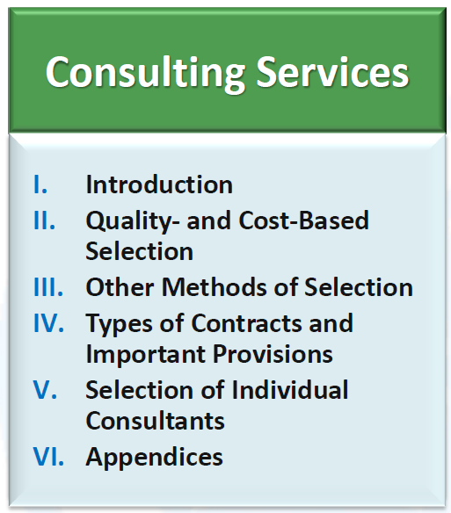
GUIDELINES
SELECTION AND EMPLOYMENT
OF CONSULTANTS
UNDER IBRD LOANS AND IDA CREDITS & GRANTS
BY WORLD BANK BORROWERS
Dated Jan 2011, revised July 2014

Slide 10
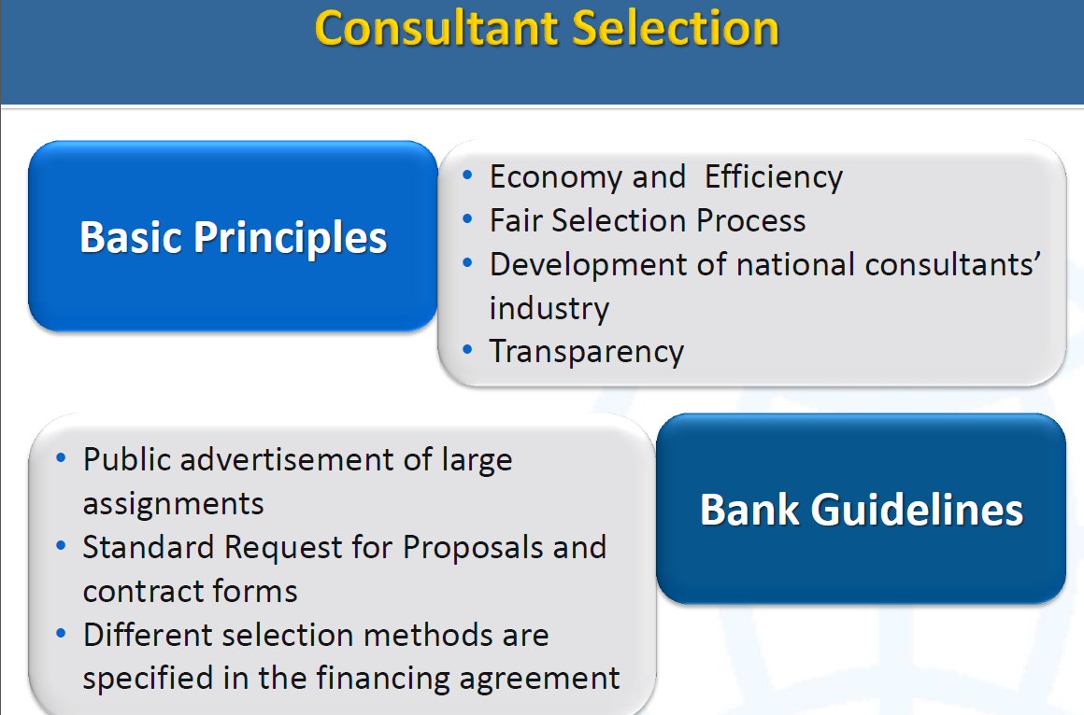

Slide 11
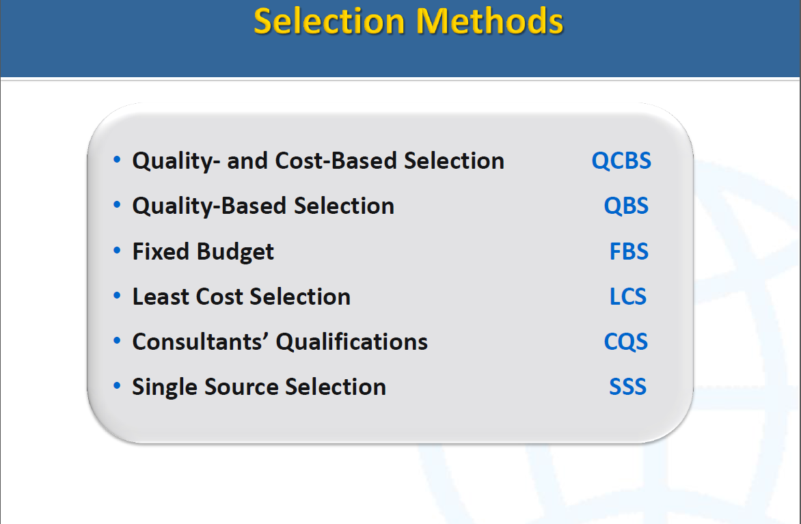
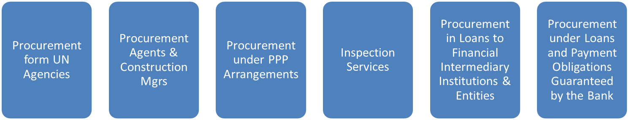
The above Selection Method can be used for selection of the following :

Slide 12
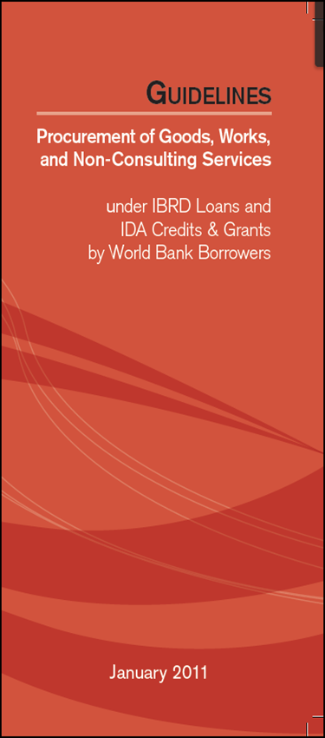
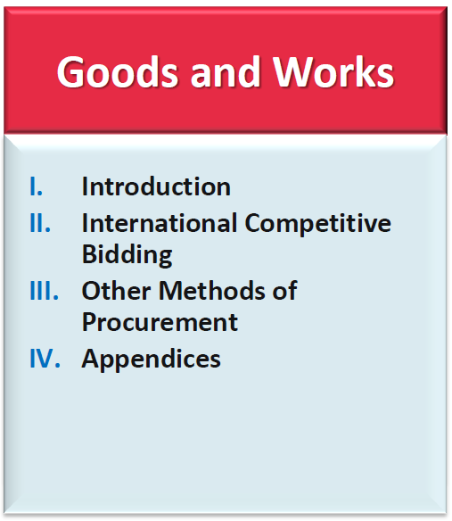
GUIDELINES
PROCUREMENT OF GOODS, WORKS, AND
NON-CONSULTING SERVICES
UNDER IBRD LOANS AND IDA CREDITS & GRANTS
BY WORLD BANK BORROWERS
Dated Jan 2011, revised July 2014

Slide 13
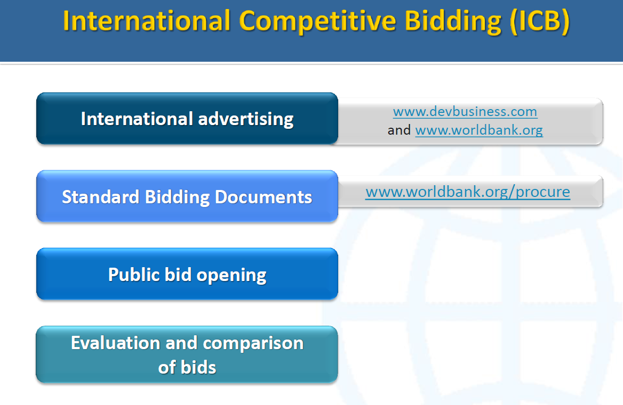

Slide 14
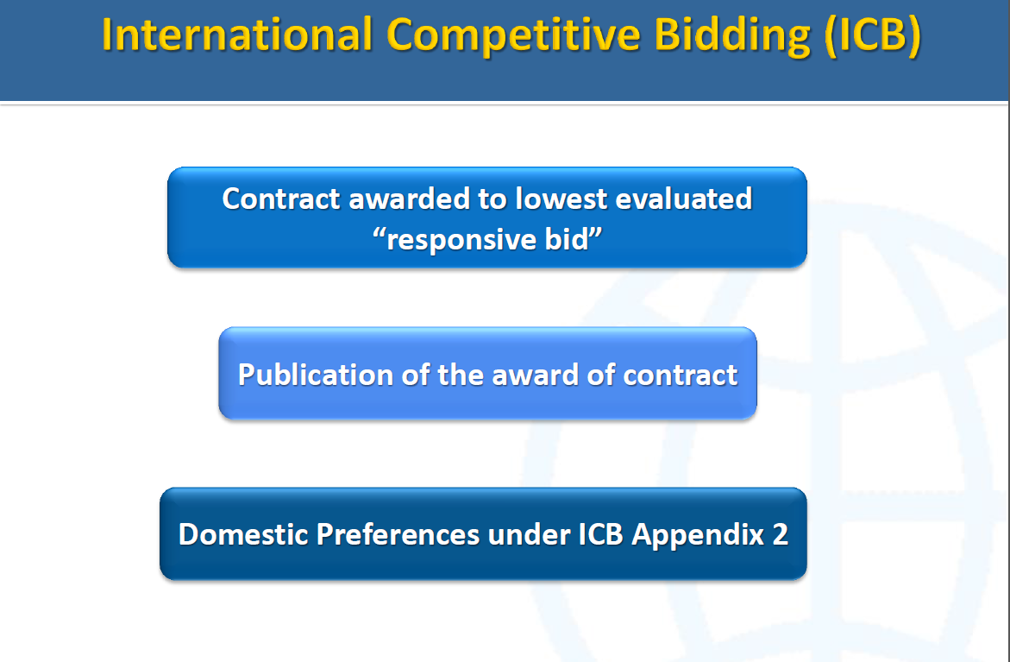

Slide 15
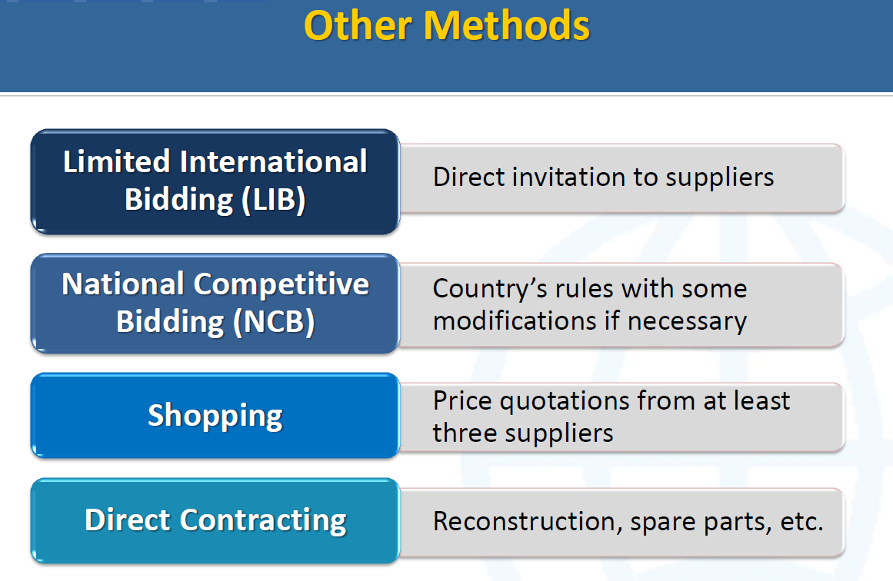

Slide 16
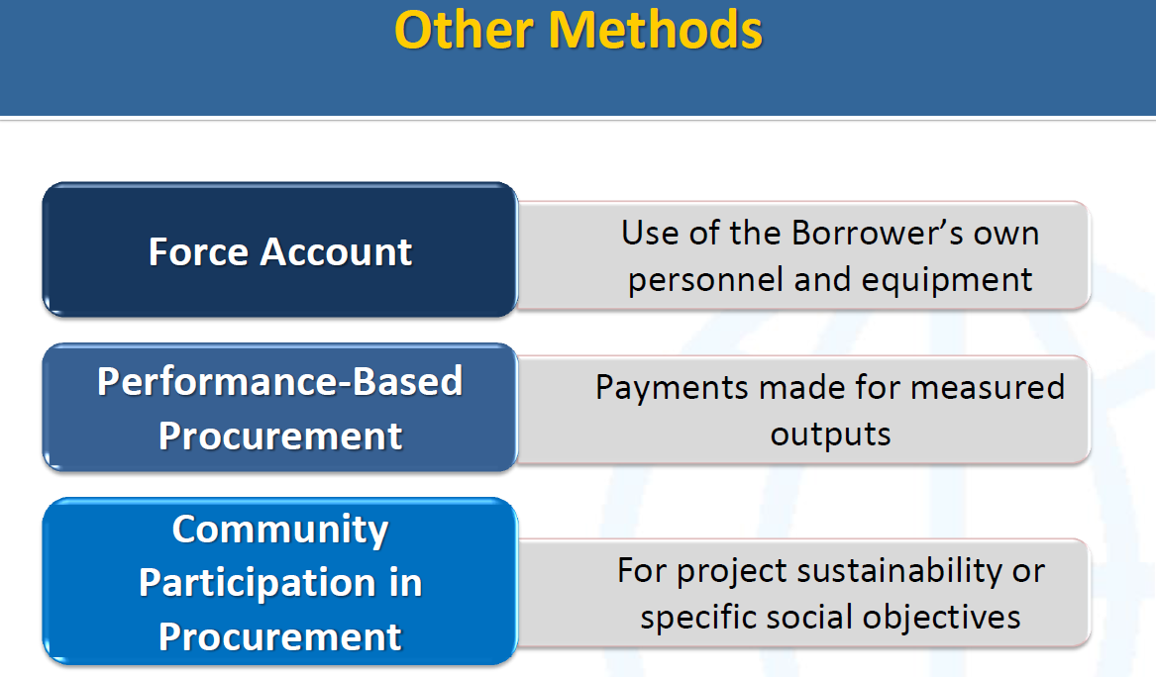

Slide 17
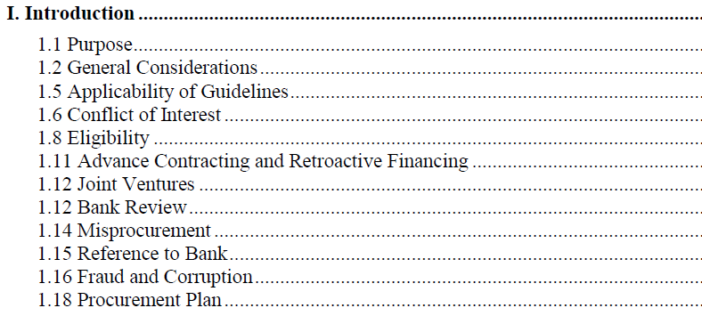
Note Bank Core Procurement Requirements per the Bank procurement Guidelines, dated Jan 2011, revised July 2014, indicated in the legal Agreement

Slide 18
Project Procurement Arrangement & DLI

Slide 19
Introductory Remarks
Once the Technical decisions are made and settled on “(Approved Work Plan and Budget-WP&B) for the project,
  Procurement is the vehicle used by the Borrower (whether by itself or use of private – external service providers) to implement the project to achieve the required results and the PDO of the Project.
That is why the procurement plan requires that the Borrower indicates under which component in the Project Paper the particular procurement falls and what results it will achieve.
Therefore a delay in drawing realistic WP&B and Procurement Plan (PP) and for it to be approved in time, as well as, the timely execution of the PP affect project implementation and the achievement of the PDO.
Furthermore the constant updating of the PP and its use as a Management and M&E tool allows the Borrower to be on top of procurement delivery and proactively identify bottlenecks, institute and implement mitigation measures in time.

Slide 20
Procurement Arrangements of the Project
The Project is both Results Based Financing linked with DLI for the Centers [Comp 1] and AAU (Regional Facilitation) is transaction based [Comp 2].
Comp 1:
  designed as a government program to which the World Bank contributes funding. The ACE project uses government and institutional budgets, agreed rules and emphasizes the strengthening of governmental and institutional oversight for its implementation.
  The World Bank finances an agreed amount of this program if the results are achieved and the agreed fiduciary and safeguards rules and standards are followed.
  The financing contribution of the governments and institutions will be the value of the estimated salaries and operational costs for the implementation of the ACEs.
  The amount of credit disbursements will be contingent on the satisfactory achievement of agreed, pre-specified program implementation progress and performance results.
Comp 2
  credit disbursement will be based upon statement of expenditures

Slide 21
Procurement Arrangements of the Project
Procurement activities under the ACE project will be implemented
  under Component 1 by each Center of Excellence and
  under Component 2 by the RFU hosted within the AAU (Component 2.1), National Universities Commission, and Nigeria (Component 2.2) and by a project unit in the Ministry of Basic and Secondary Education in the Government of The Gambia (Component 2.3).
All activities to be supported under the project will adhere to the World Bank “Guidelines on Preventing and Combating Fraud and Corruption in Projects Financed by IBRD Loans and IDA Credits and Grants, dated October 2006 and revised in January 2011”.

Slide 22
Procurement Arrangements of the Project
For Component 1, which has a DLI approach,
all expenditures to be reimbursed under the project will be part of the Eligible Expenditure Program.
Each ACE will prepare a procurement manual with the relevant World Bank and national procurement system procedures for goods, consisting mainly of laboratory and related equipment, as well as for works, consisting mainly of rehabilitation of classrooms and laboratories.
Consultant services will also be undertaken mainly for example technical assistance, preparation of manuals, specialized reports, financial and procurement audits, and other assignments.

Slide 23
Procurement Arrangements of the Project
For Component 2, the RFU at AAU, the National Universities Commission, Nigeria and the implementation team in The Gambia
will use the World Bank “Guidelines: Procurement of Goods, Works and Non-Consulting Services", dated January 2011 or the World Bank "Guidelines: Selection and Employment of Consultants", dated January 2011, with procurement plans acceptable to IDA.
The RFU at AAU and National Universities Commission, Nigeria will procure both goods and consultant services, such as computer equipment and simple consultant contracts (works contracts are excluded),
while the Gambia will procure consultant services only from the other participating ACEs, and also will procure goods when justified (works contracts are excluded).

Slide 24
Procurement Implementation Arrangements
Under Component 1,
  each ACE implementing agency has procurement administrative units as appropriate under national legal frameworks, with a head of unit and procurement officers.
  Generally these procurement implementation arrangements are appropriate to implement the relevant national procurement procedures for Component 1.
Under Component 2,
  the RFU at AAU, the National Universities Commission, Nigeria, and The Gambia project unit (PCU) have structures as appropriate for implementation of Bank procurement procedures.
  Although the structures are in place for both project components, there are still risks and mitigation measures to be implemented.

Slide 25
Procurement Assessment
Under Component 1,
During appraisal an individual procurement assessment was carried out for each of the 19 ACE entities, to identify the procurement risks for project implementation, and also the recommended mitigation and strengthening measures, (NB: 2nd Step)
  The project will provide implementation support to the selected ACE institutions to assist in addressing the mitigation measures identified.
Under Component 2,
the procurement risk assessments were also completed for the RFU hosted within AAU, for National Universities Commission, Nigeria and for the project management unit in The Gambia.
  The project will provide implementation support to assist in addressing the mitigation measures identified.

Slide 26
Procurement Assessment
Under Component 1,
Assessment. In line with Results Based (a) carry out an assessment of the proposed Program’s fiduciary systems, including consideration of how the Program handles the risks of fraud and corruption; and (b) develop a reference against which fiduciary performance during Program implementation will be monitored.
On the basis of the assessment findings, fiduciary specialists then work with the borrower to identify measures to strengthen the Program’s fiduciary systems and to address gaps. These measures are an input to the PAP to be agreed, as needed, between the borrower and the Bank, containing priority actions that the borrower agrees to carry out during
Program implementation. They may be considered for inclusion as disbursement linked indicators (DLIs) for the Program (Hence the DLI#4- 4.1 and 4.2).
The final fiduciary systems assessment is disclosed at the same time as the PAD.
  As part of overall implementation support, task teams and fiduciary specialists monitor Program performance on fiduciary aspects of the Program and support the borrower in implementing agreed measures.
  NB: High Value procurement deemed by the TTL as priority will be treated as IPF Prior Review Procurement receiving Bank procurement review,
Under Component 2,
the procurement risk assessments were also completed in line with IPF for the RFU hosted within AAU, for National Universities Commission, Nigeria and for the project management unit in The Gambia.
  The project will provide implementation support to assist in addressing the mitigation measures identified.

Slide 27
Procurement DLIs associated with the Project
These are key performance actions deemed necessary to strengthen the performance of
the government’s procurement processes, oversight and controls (including integrity systems), monitoring and evaluation for the program.
Disbursement Linked Indicators | Action to be Completed | Amount of the Financing | Disbursement Calculation Formula
DLI#4 – Timely and Audited Procurement | DLR# 4.1 Timely procurement audit | 400,000 | DLR#4.1: 50,000 per year
 | DLR#4.2: Timely and Satisfactory Procurement Progress |  | DLR#4.2: 50,000 per year
Methods of Measurement
DLR#4.1 - Third-party procurement process verification (audit); Each ACE to have a third party procurement verification report, usually on an annual basis. This could be combined with the annual financial audit reporting timeline. and
DLR#4.2 - Timeliness of procurement progress
  (25% of all procurement contracts signed by year 1; 55% by year 2, and 100% by year 3, and verification of installation by year 4)

Slide 28
Reporting of Procurement Progress
Summary Procurement Progress

Slide 29
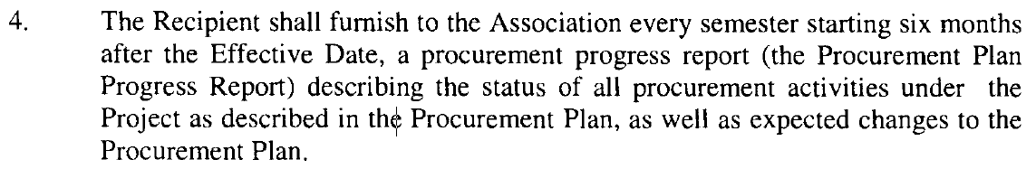
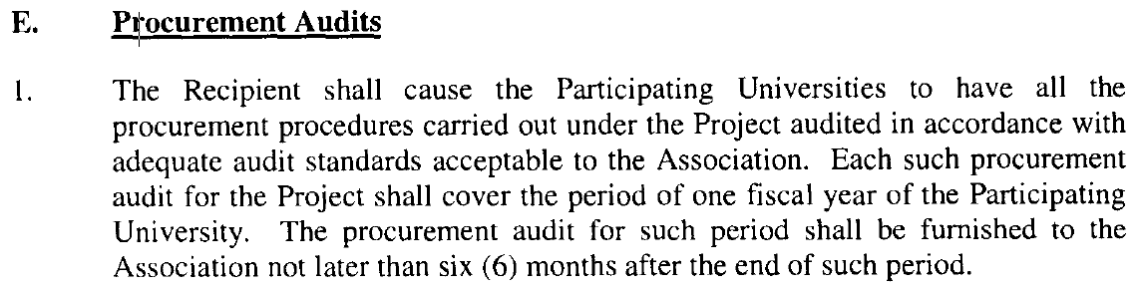
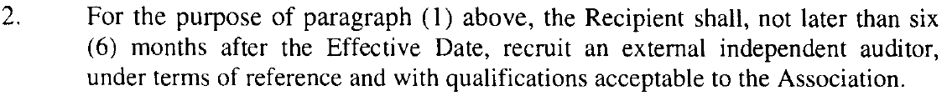
Reporting of Procurement Progress
From Financing Agreement – Schedule 2

Slide 30
Remedies of Non Compliance of Procurement Provisions
ONLY procurements emanating from the Approved Work Plan & Budget is eligible on the Procurement Plan.
ONLY procurable Items on the APPROVED Procurement Plan must be procured.
Given that the ACE’s implementation is Results Based Linked to DLI, the non compliance of Procurement provisions in the Legal Agreement leaves the TTL with declaring potential misprocurement or possible options including:
Withholding of the Amount for the procurement DLI and advising that all the procurements going forward shall be prior reviewed
That the Bank can, based on its Audit and inspection right, shall cause for a forensic procurement audit.
It may further Cancel the Project and Stop funding.

Slide 31
Things to AVOID

Slide 32
Conflict of Interest
Priority # 1 of consultants: client’s interest
No consideration for future work
Avoid conflicts with other assignments & corporate assignments
➔ Do not hire the firm in case:
  an assignment in conflict with prior / current obligations to the client
  Conflict between consulting activities & procurement of G, W or S
  Conflict among consulting assignments
  Business or family relationship between Consultants (incl. their personnel & sub-consultants) and a member of a Borrower’s staff directly involved in preparation of ToR, selection process, supervision of the contract unless resolved in a manner acceptable to the Bank
Notes:
GLs 1.9.

Slide 33
NB: Conflict of Interest
Any firm found to have a conflict of interest shall be ineligible for award of a contract.
A firm shall be considered to have a conflict of interest in a procurement process if:
(a) such firm is providing goods, works, or non-consulting services resulting from or directly related to consulting services for the preparation or implementation of a project that it provided or were provided by any affiliate that directly or indirectly controls, is controlled by, or is under common control with that firm. This provision does not apply to the various firms (consultants, contractors, or suppliers) which together are performing the Contractor’s obligations under a turnkey or design and built contract;11 or
(b) such firm submits more than one bid, either individually or as a joint venture partner in another bid, except for permitted alternative bids.
  This will result in the disqualification of all bids in which the Bidder is involved. However, this does not limit the inclusion of a firm as a sub-contractor in more than one bid. Only for certain types of procurement, the participation of a Bidder as a sub-contractor in another bid may be permitted subject to the Banks’ no objection and as allowed by the Bank’s Standard Bidding Documents applicable to such types of procurement; or
(c) such firm (including its personnel) has a close business or family relationship with a professional staff of the Borrower (or of the project implementing agency, or of a recipient of a part of the loan) who:
  (i) are directly or indirectly involved in the preparation of the bidding documents or specifications of the contract, and/or the bid evaluation process of such contract; or
  (ii) would be involved in the implementation or supervision of such contract unless the conflict stemming from such relationship has been resolved in a manner acceptable to the Bank throughout the procurement process and execution of the contract; or
(d) such firm does not comply with any other conflict of interest situation as specified in the Bank’s Standard Bidding Documents relevant to the specific procurement process.

Slide 34
NB: Eligibility
Firms & individuals from all countries having the essential capabilities required to fulfill contract are eligible.
Exceptions:
  Prohibition of commercial relations between the borrowing country and the firm’s country, as a matter of law or official regulation, if exclusion does not preclude effective competition
  Compliance with a decision of the UN’s Security Council under Chapter VII of Charter of the UN to prohibit import from or payment to a particular country, person or entity
  Conflict of interest
  Government owned enterprises of the Borrowing country unless: (i) legally & financially autonomous, (ii) operate under commercial law, (iii) independent of borrower
  Firms engaged in corrupt, fraudulent, collusive, coercive or obstructive practices

Slide 35
Unfair Competitive Advantage
Consultants shall not drive a competitive advantage from having provided consulting services related to the assignment
➔ Make available to all short-listed consultants with the RFP all information that would give a consultant a competitive advantage.
Notes:
Vocabulary: RFP
GLs: 1.10.

Slide 36
Misprocurement
If Goods, works or services not procured in accordance with LoA and Procurement Plan
  The Bank will declare “misprocurement”
  The Bank does not finance the expenditure for such G/W/S
  Policy: cancel that portion of the loan allocated to misprocured G/W/S
  The Bank may exercise other remedies in LoA
If No objection provided based on incomplete, inaccurate or misleading information, or
If contract modified without Bank’s approval
  The Bank may still declare “misprocurement”
Notes:
GLs: 1.12.

Slide 37
Misprocurement
WHEN
PROCEDURES LAID DOWN HAVE NOT BEEN FOLLOWED
RESULT
1. DIFFICULTIES IN PROCESSING CONTRACTOR’S OR SUPPLIER’S
PAYMENTS
2. MISPROCURING OFFICER MAY BE SURCHARGED OR
DISMISSED
3. IF MISPROCUREMENT BOARDERS FRAUD AND CORRUPTION,
CRMINAL CHARGES MAY BE PREFERRED
4. THE PUBLIC ACCOUNTS COMMITTEE MAY RECOMMEND
DISCIPLINARY ACTION ON THE MISPROCURING OFFICIALS
CAN THE CONTRACT CONTINUE?
Notes:
GLs: 1.12.

Slide 38
Fraud & Corruption Provisions
“It is the Bank’s policy to require that Borrowers (including beneficiaries of Bank loans), as well as bidders, suppliers, and contractors and their subcontractors under Bank-financed contracts, observe the highest standard of ethics during the procurement and execution of such contracts. [1] In pursuance of this policy, the Bank:
[1] In this context, any action taken by a bidder, supplier, contractor, or a sub-contractor to influence the procurement process or contract execution for undue advantage is improper.”
Notes:
GLs: 1.14 – 1.15.

Slide 39
Fraud & Corruption Provisions & Definitions
Corrupt Practice
Offering, giving, receiving or soliciting, directly or indirectly, of anything of value to influence improperly the actions of another party.
Fraudulent Practice
Any act or omission, including a misrepresentation, that knowingly or recklessly misleads, or attempts to mislead, a party to obtain a financial or other benefit or to avoid an obligation.
Collusive Practice
An arrangement between two or more parties designed to achieve an improper purpose, including to influence improperly the actions of another party
Coercive Practice
Impairing or harming, or threatening to impair or harm, directly or indirectly, any party or the property of the party to influence improperly the actions of a party
Obstructive practice
(aa) deliberately destroying, falsifying, altering or concealing of evidence material to the investigation or making false statements to investigators in order to materially impede a Bank investigation into allegations of a corrupt, fraudulent, coercive or collusive practice; and/or threatening, harassing or intimidating any party to prevent it from disclosing its knowledge of matters relevant to the investigation or from pursuing the investigation; or
(bb) acts intended to materially impede the exercise of the Bank’s inspection and audit rights provided for under par. 1.16 (e) in the Guidelines.
Notes:
GLs: 1.14 – 1.15.

Slide 40
Actions by the Bank in case of Fraud & Corruption
Will reject a proposal to award if the bidder directly or through an agent engaged in F&C
Will cancel the portion of the loan allocated to the contract if Borrower’s representative or beneficiary engaged in F&C without Borrower taking appropriate & timely action
Will sanction the firm or individual:
  Indefinite or temporary Debarrement
  See: http://www.worldbank.org/debarr
Will have the right to require a provision in BDs & contracts requiring bidders & contractors to permit the Bank to inspect their related accounts & records.
Notes:
GLs: 1.14 – 1.15.

Slide 41
Anti-Corruption Hotline
  Department of Institutional Integrity (INT)
  Toll-free: 1-800-831-0463 (24 hours/day)
  Collect call: 704-556-7046
  By mail: PMB 3767
  13950 Ballantyne Corporate Place
  Charlotte, NC 28277, USA
  Phone: 202-458-7677 Fax: 202-522-7140
  E-mail: investigations_hotline@worldbank.org
  Website: www.worldbank.org/integrity
  Click on "Online Complaint Form"
  Anonymous calls are accepted.
  Please be as specific as possible.
Notes:
GLs: 1.14 – 1.15.

Slide 42
Some Observations

Slide 43
Typical Observations on Pre-Contract Activities
Delays between planned and actual procurement activities on procurement plan.
Delays in evaluation, awards and signing of contract agreements.
Inappropriate documentation to cover the entire procurement cycle with Untimely recording of information and data collection
Handling of Prior Review and Post Review Requirements, especially, the inappropriate use of PROCYS and approving authorities
Unrealistic/Over estimated information on procurement plans as well as non adherence to WB Proc Guidelines per the FA, in drawing and executing the Plan
Not using the full potential of a Approved Procurement Plan with Disbursement projections to manage, monitor and evaluate procurement implementation.

Slide 44
Typical Observations on Post-Contract Activities
Insufficient readiness for Start of Contract & Delay in contract effectiveness (securities, Advance Mob, LCs, etc)
Contracts not executed as provided for in the contract (time and cost overruns, poor quality, etc)
Payment delays (too many signatories) and Abandoned contracts
Frequent change of Ideas mid-stream of a contract execution and the associated HUGE Variation/Change Orders with no adequate Budget in the Contract/Project.
Poor Performance of Service Providers (Contractors, Consultants, Suppliers)
Ineffective and inefficient contracts monitoring and evaluation (cost, quality and time controls, etc)
Incomplete Contract Closures/Close out

Slide 45
Exercises

Slide 46
Exercise 1
Based on the below Table, please report on what stage the Center is at in fulfilling DLR#4.1 Procurement Audit
Name of Center | Contract executed and completed (& when) | Contract on-going- Procurement Auditor (at Work & when to complete) | Pre-contract stage to recruit Procurement Auditor (& when will contract be signed | Yet to put the procurement in the plan/ or Yet to initiate the Procurement Process (& when)

Slide 47
Exercise 2
Based on the below Table and using your Procurement Plan, populate the Summary Procurement Progress Table below for your Respective Centers. In Respect of DLR#4.2

Slide 48


